Slide 1
June 17th, 2014
Preliminary
structural and thermal design of a cryostat
for the 11 T dipole magnets

Slide 2
Table of contents
Objectives
Cryo-assembly overview
Vacuum vessel preliminary structural design
Thermal shield preliminary thermo-mechanical design

Slide 3
Objectives
Integration of the collimators in LHC Dispersion Suppressors
Proposal of a layout for the best exploitation of the available space
Conceptual design of a bypass cryostat, carrying cryogenic lines (E, N, etc.) and busbars (M1, M2, M3)
Preliminary structural and thermal design of the cryostat
Structural analysis of the vacuum vessel
Thermal and structural analysis of the thermal shield

Slide 4
Cryo-assembly overview
Line X straight
Cryogenic lines and busbars bent below the collimator
Collimator
Cold mass A
Cold mass B
Bypass cryostat

Slide 5
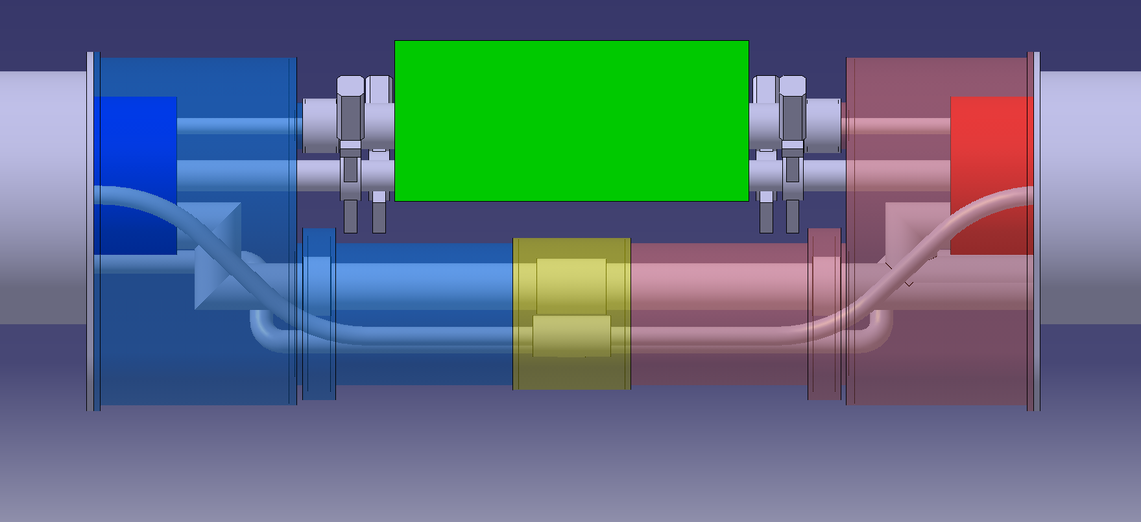
Bellows
Cryo-assembly overview
Collimator
Vacuum vessel cylinder
Interconnection
sleeve
Vacuum vessel drift tube
Vacuum vessel cover

Slide 6
Vacuum vessel cover structural design
Geometry meshed with SHELL elements
Shell thickness as parameter
Flat end & lateral surface
Constraint: fixed support (flange)
Material AISI 304L
Young’s modulus 200 GPa
Density 7930 kg/m³
R_{p1,0} 240 MPa min
Lateral surface
Flat end

Slide 7
Vacuum vessel cover structural design
Stress analysis according to EN 13458-2 Annex A
general/local primary membrane stress (f_{m}, f_{L})
bending stress (f_{b})
secondary stress (f_{g})
Leak test load case
Pressures outside (1 bar)
inside (0 bar)
Gravity acceleration (9.8 m/s²)
Forces line X (~2 kN)
lines V1, V2 (~1 kN)
busbar (~20 kN)
$f_{m}≤0,9 R_{p1,0}$ = 216 MPa
$f_{L}≤R_{p1,0}$ = 240 MPa
$f_{m}+f_{b}$ or $f_{L}+f_{b}≤R_{p1,0}$ = 240 MPa
$f_{m}+f_{b}+ f_{g}$ or $f_{L}+f_{b}+f_{g}≤{2 R}_{p1,0}$ = 480 MPa
3
1
4
2
5

Slide 8
Vacuum vessel cover structural design
Stress analysis according to EN 13458-2 Annex A
Highest stresses @ points 3 & 4
Lower stresses (higher margin) @ other points
Always below limits for many
combinations of thicknesses
Stress analysis is not the
driving parameter for design!
Evaluation of deformations needed!

Slide 9
Vacuum vessel cover structural design
Evaluation of deformations
Deflection of V1 & V2 pipes @ ~0.3 m from flat end
Normal operation load case
Pressures outside (1 bar)
inside (0 bar)
Gravity acceleration (9.8 m/s²)
V2
V1

Slide 10
Vacuum vessel cover structural design
V1 & V2 pipes deflection for different combinations of thicknesses

Slide 11
Vacuum vessel cover structural design
Weight for different combinations of thicknesses

Slide 12
Vacuum vessel cover structural design
Proposed thicknesses
Lateral surface 12 mm
Flat end 30 mm
Performances
Max. deflection V1 & V2 pipes < 0.3 mm
Weight ~ 400 kg
Max. stresses (@ point 4) f_{L} ~ 7 ≤ 240 MPa
f_{L}+f_{b}+f_{g} ~ 130 ≤ 480 MPa

Slide 13
Vacuum vessel drift tube structural design
Design based on buckling analysis
Analytical ^{design} Eigenvalue Nonlinear ^{verification}
Geometry meshed with SHELL elements
Shell thickness as parameter
Material AISI 304L
Young’s modulus 200 GPa
Density 7930 kg/m³
R_{p0,2} 200 MPa min

Slide 14
design
Vacuum vessel drift tube structural design
Analytical calculation according to EN 13445-3
Safety factor = 1.5
Minimum thickness 4.5 mm
Theoretical elastic instability pressure for collapse ~0.3 MPa

Slide 15
verification
Vacuum vessel drift tube structural design
Eigenvalue buckling analysis in ANSYS®
Load atmospheric pressure (1 bar)
Constraints no rigid-body motions
no stiffening effects at both ends
Bellows/interconnection sleeve: negligible effect for safer design
(higher support stiffness =
higher load causing buckling)

Slide 16
verification
Vacuum vessel drift tube structural design
Min. eigenvalue (1st mode shape) for different thicknesses
λ_{min} > 1 thickness 3.25 mm
Not safe!
Ideal material without imperfections
Thickness 4.5 mm
λ_{min} ~3
In agreement with theoretical pressure ~0.3 MPa (applied 0.1 MPa)

Slide 17
verification
Vacuum vessel drift tube structural design
Nonlinear analysis according to EN 13445-3 (“Direct Route”)
Large displacements enabled
Linear elastic – perfectly plastic material
Safety factor = 1.5
Circularity tolerance = 1.5 % (~3.8 mm) EN 13445-4
Procedure
Preliminary linear static structural analysis
Eigenvalue buckling analysis
Superimposition of the first 10 buckling mode shapes
Nonlinear static structural analysis on the deformed shape

Slide 18
verification
Vacuum vessel drift tube structural design
Design check
Max. value of the principal strains < 5 %
Max. principal ~0.1 %
Abs. min. principal ~0.1 %
Thickness 4.5 mm
Buckling pressure ~0.28 MPa

Slide 19
Vacuum vessel structural design
Conclusions - cover
Design carried out by evaluating deformations
Proposed thicknesses lateral surface 12 mm
flat end 30 mm
Conclusions – drift tube
Design carried out analytically (EN 13445-3)
Minimum thickness 4.5 mm
Proposed thickness 5 mm (if 4.5 mm not industrially available)
References EDMS nr. 1381046 → cover
EDMS nr. 1383501 → drift tube

Slide 20
Thermal shield thermal analysis
Geometry meshed with SHELL elements
Fixed thicknesses
Line X
(4 mm)
Line E
(cooling 50÷75 K)
Flat end
(5 mm)
Bottom tray
(~3 mm)
Drift tube
(2 mm)
Lateral surface
(2 mm)
Support post
(3 mm)

Slide 21
Thermal shield thermal analysis
Materials
Bottom tray Al series 6000 (6061 T6)
Other surfaces Al series 1000 (1100)
Nonlinear material properties
Thermal conductivity
k₁₁₀₀(T) > k₆₀₆₁(T)
Thermal expansion coefficient
~ the same for both alloys

Slide 22
Thermal shield thermal analysis
Steady-state thermal analysis
Radiative heat flux ~1.5 W/m² (presence of MLI)
Fixed temperature 50 K
Cooling using only line E
integrated in the bottom tray
Additional cooling of the drift
tube (contact using line E)

Slide 23
Thermal shield thermal analysis
Temperature distributions
without additional cooling with additional cooling

Slide 24
Thermal shield structural analysis
Deformations from temperature distributions
~ the same for both analyses
Y axis
Z axis
X & Z constrained
X, Y & Z constrained

Slide 25
Thermal shield structural analysis
Conclusions
Additional cooling does not reduce deformations (very high k₁₁₀₀ produces a uniform temperature distribution)
Additional cooling useful to compensate non-perfect conduction (intermittent welding and not continuous contact) [not modelled in this work]
Contact surface for additional cooling as best realizable (depending on space availability and line E path)
Support required for line X (Z displacement due to gravity)
References EDMS nr. 1391148

Slide 26
Thank you!
Acknowledgments
Délio
Arnaud → nonlinear buckling
Yann → material properties
Rossana & Luca → ANSYS thermal
Vittorio → cryostat design

Slide 27
EN 13445-3 (“Shells under external pressure”)
Procedure
Selection of a thickness e_{a}
Calculation of pressure for which mean circumferential stress reaches yield point $P_{y}=\frac{σ_{e} e_{a}}{R}$
Determination of circumferential strain at collapse ε (using formula or graph)
Calculation of theoretical elastic instability pressure $P_{m}=\frac{E{ e}_{a} ε}{R}$
Determination of ratio ${P_{r}}/{P_{y}}$ from ${P_{m}}/{P_{y}}$ (using graph)
Check of condition $P<\frac{P_{r}}{S}$

Slide 28
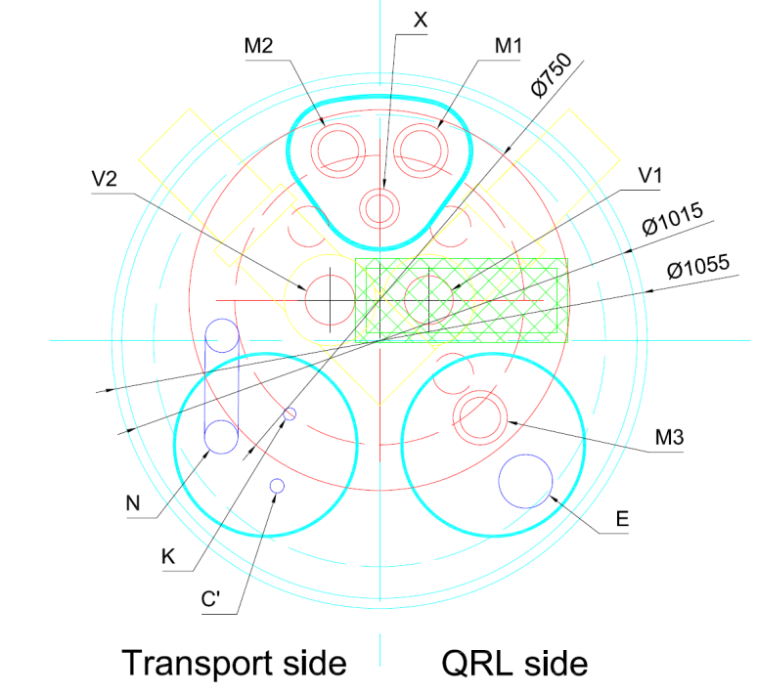
Future work
New proposed layout
Simpler design & fabrication
Standard interconnects
Easier interventions
Cold mass A
Collimator
Cold mass B

