Slide 1
TE-MSC-CI Section
Activities present and future

Slide 2
Summary of main activities
LHC Operation
Cryo-magnet coordination
The new storage building
Components procurement
Section support to LHC: MP3 and patroller
X-ray tomography and its mock-up
Participation to LHC Splices Task Force
Interventions for future shutdown
LHC Upgrade
DS Collimators (HL-LHC)
New inner triplet
Other projects and activities
HIE-ISOLDE
SPL
ITER (Plugs, Support posts)
CERN/France collaboration

Slide 3
LHC Operation

Slide 4
Cryomagnet coordination
Dipoles
23 cold tested and ok
7 without vacuum vessel
9 ready for cold test
1 being cryostated
11 being repaired
In total 44 dipoles available
Quadrupoles
3 cold tested and ok
4 to be tested
8 to be repaired
Special magnets
Q8-Q10
1 available
Q7
1 available
Q7-Q10
1 to be repaired (QH’s)
Inner triplets (Q1-Q3)
One each available (3)
To be tested (tested in US)
D1-D4
One each available (4)
To be tested (tested in US)
December 2010

Slide 5
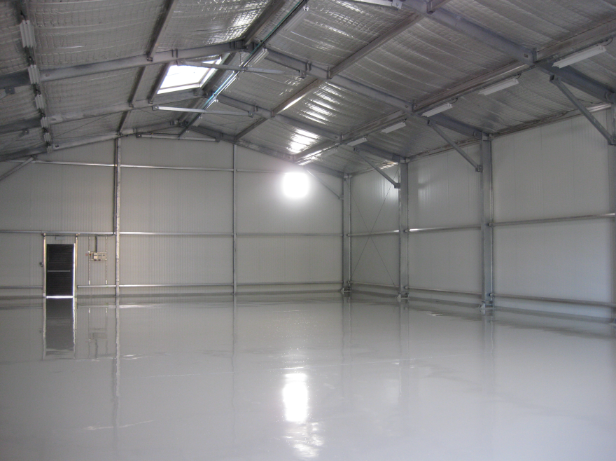
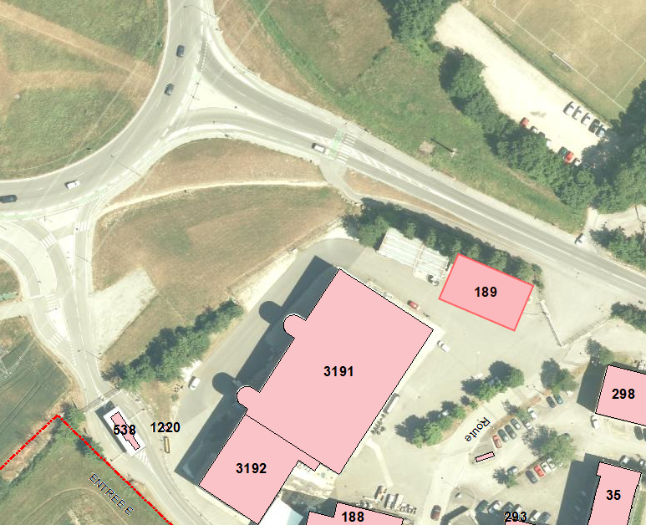
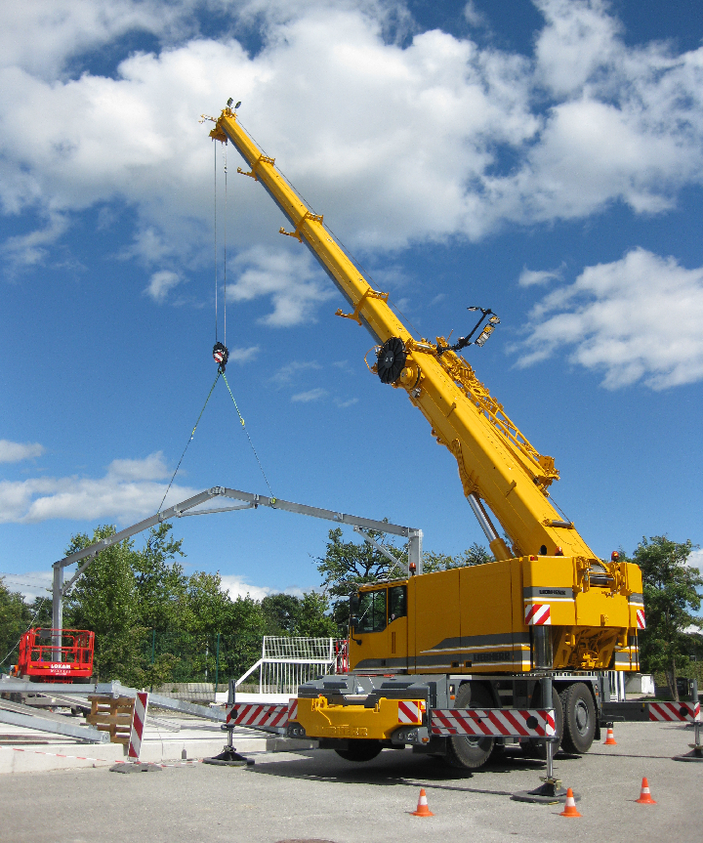
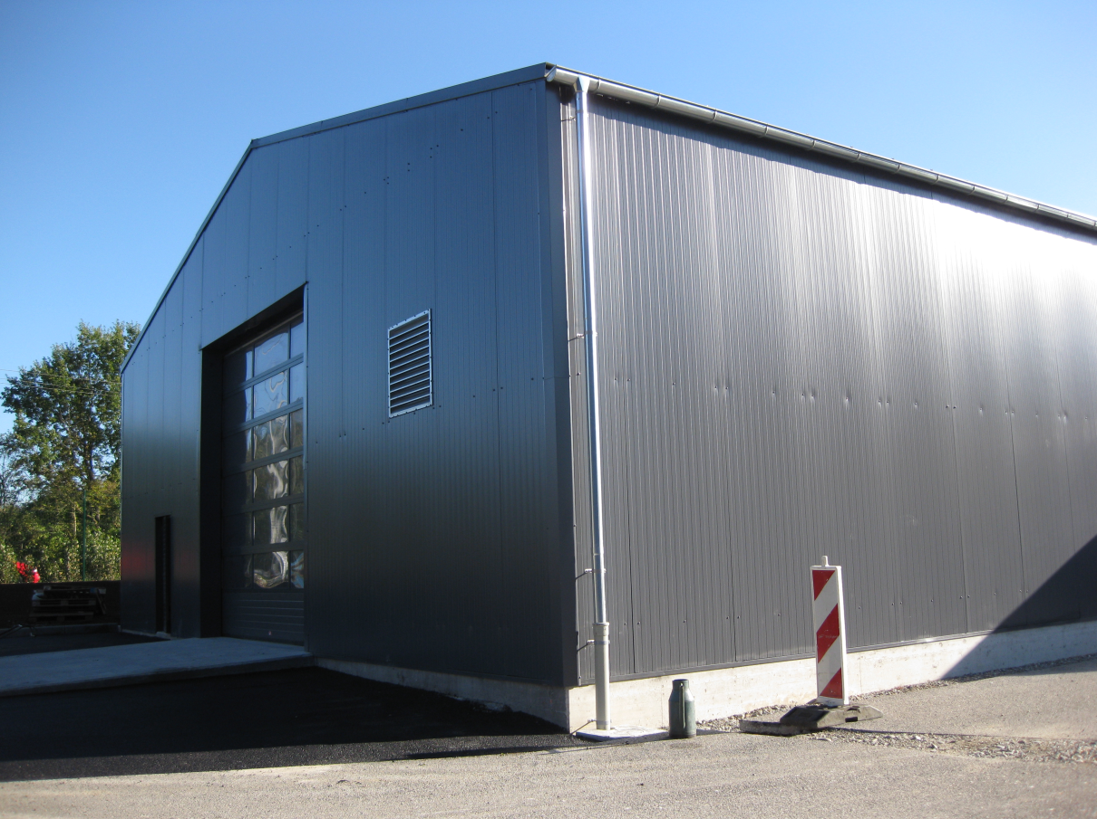
Building 189
New storage building
189
SMI2
375 m²
Budget <400 kCHF
For storage of
cryostats and
interconnections
components

Slide 6
Components procurement
Cold Support Posts
LHC spare
Short connection cryostats
DS collimators
ITER and INFN
W bellows
Firms selected
Tender document under preparation
Vacuum vessels
Some units procured by French Collaboration (CNRS)
Call for tender to launch for the other ones

Slide 7
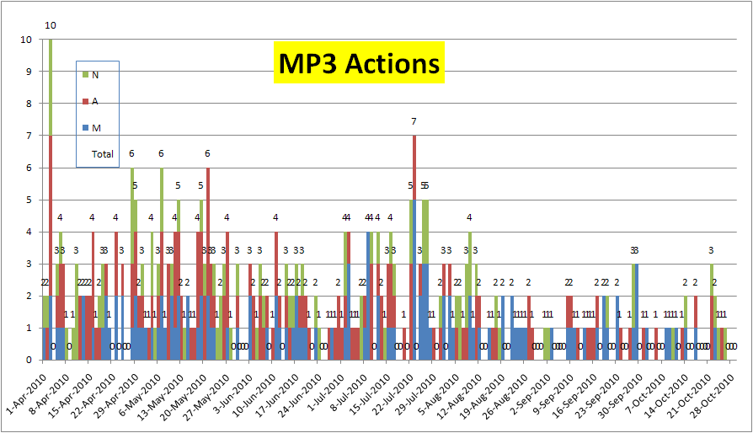
Section support to LHC operation
MP3 shifts and stand-by
Help for patrols

Slide 8
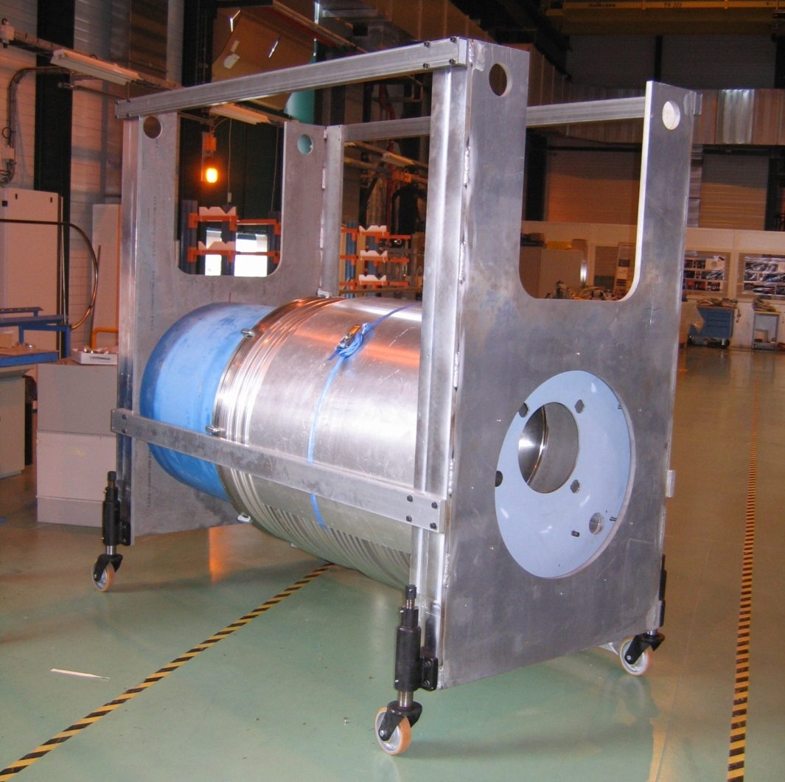
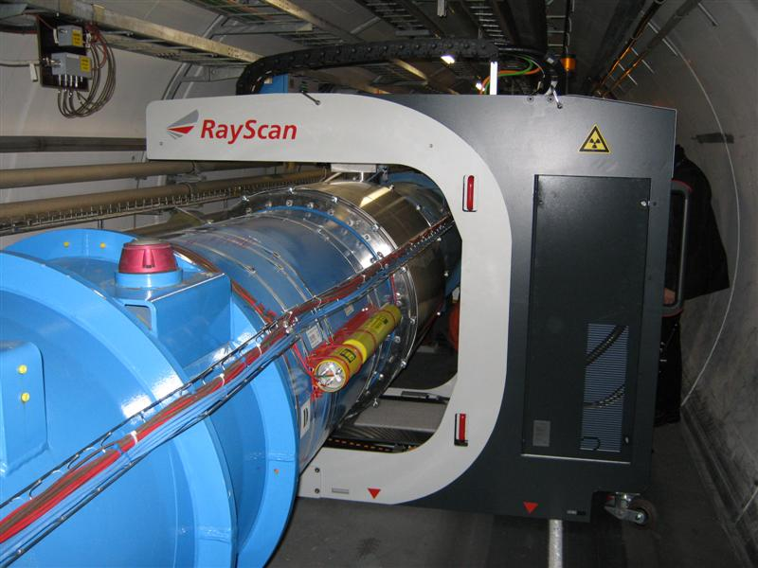
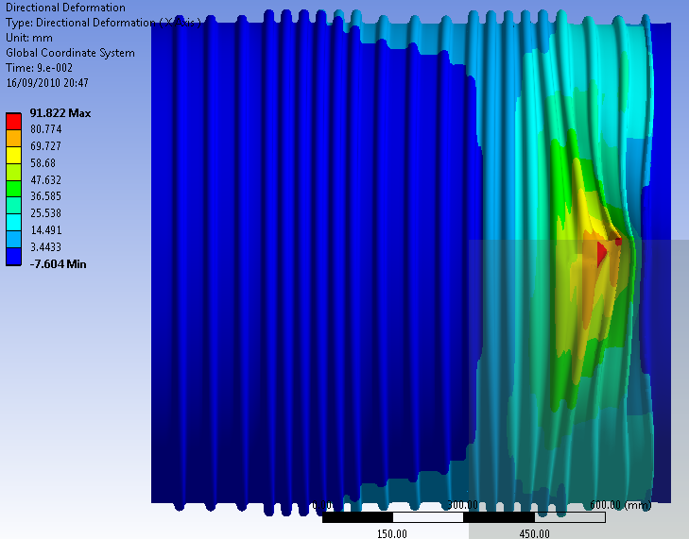
X-Ray tomograph
Mock-up manufacturing and maintenance
Simulation to assess safety of transport with LHe in cold masses
→ Authorization given
Optimization of image quality

Slide 9
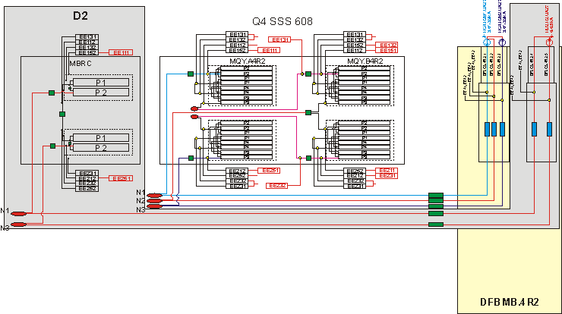
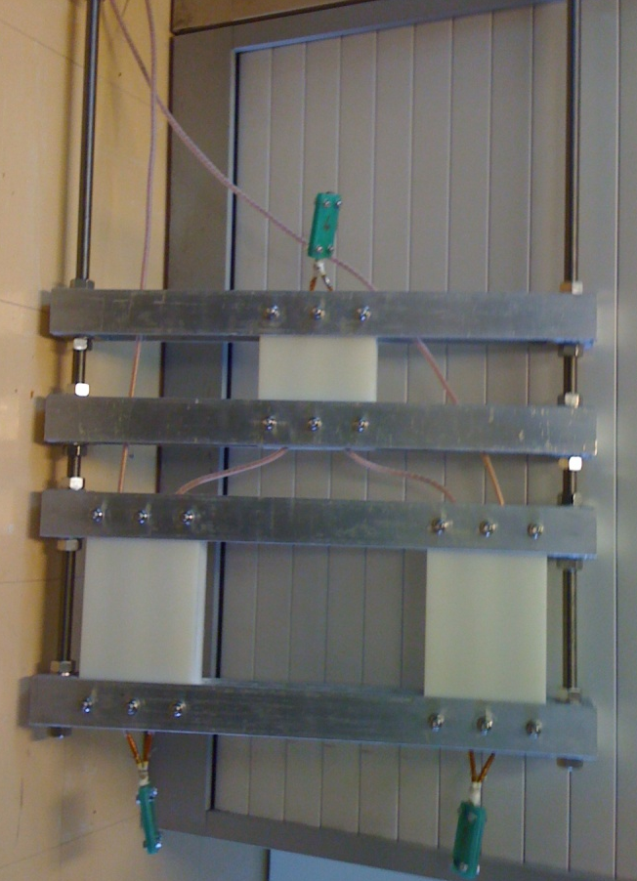
Splice task force
Inventory and synthesis schemes of the 94 6kA circuits
Setup for a performance and validation test
Voltage taps on in and out cables
3 connections in series
Design validated

Slide 10
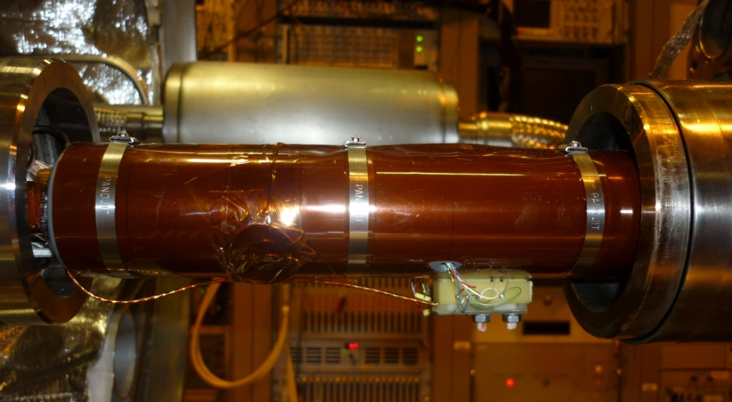
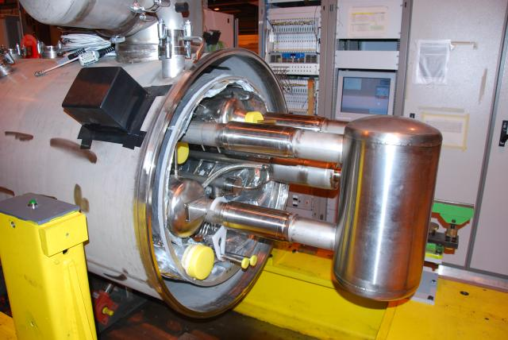
Splice task force
Participation to the cold testing of 13kA shunts
Preparation of the SSSs for test
Instrumentation
Quench stopper
Helium tank

Slide 11
Interventions during long shutdown
Management of the “special activities”
Interconnections thermal shield modification
No more grinding of machine welds
Better reliability
# | Description | Quantity | Location | Remark
1 | DS Collimators at P3 | 34 cryo-assemblies | IR3 (L&R) | End of shutdown
2 | Cryomagnets replacement | ≈ 10 ? | Everywhere | For NC or high int. splice resistance
3 | Splices investigation | ≈ 10 ? | Everywhere | 13kA, 6kA (see tomorrow), 600A (N)
4 | Circuits issues | 3 so far | Located | Open, high R
5 | DFBA splices | 16 units | Arc extremities | To be decided
6 | Consolidation of CC | 2 | L8,L1 (L3) | But all to be inspected
7 | Plug-in Modules | ? | Everywhere | Endoscopy ? Cleaning ?
8 | Y_lines | 3 | 3 arcs
9 | DN200 | ≈ 600 | 3 arcs
10 | SAM | 2 | R2, L8 | DN160 & He gauges
11 | RP samples | ? | Arc 45 | To install in other arcs?
12 | Interventions on new NCs | 15 % | Everywhere | Quick reaction
13 | Vacuum leaks | 11-20 | Everywhere
14 | Q5L8 replacement | 1 | MSL8
15 | Triplet braid | 2 | P2 & 8 | To be confirmed

Slide 12
LHC Upgrade

Slide 13
DS Collimators
Supervises the design changes
Follows-up the integration study for IR3 (both cold and warm)
Coordinates the execution of the Work Packages
Coordinates the installation of the equipment

Slide 14
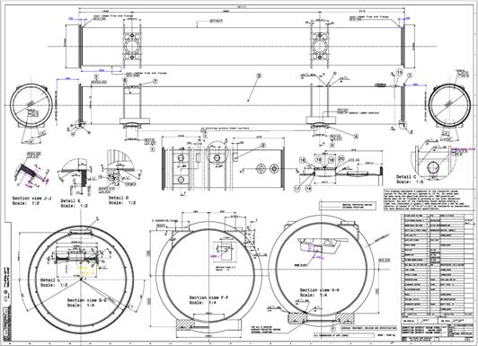
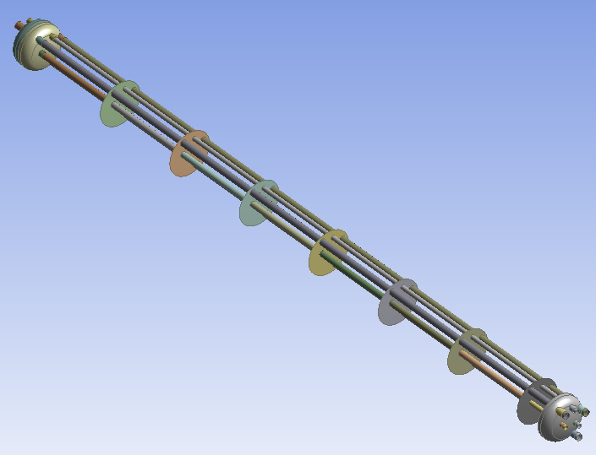
DS Collimators Integration
Design of shortened connexion cryostats
4,5 m shorter
2 support posts
Remove lead shielding
Displacement of shuffling module
Include all ECR
Sliding supports
Lira insulation
Stainless Steel shield

Slide 15
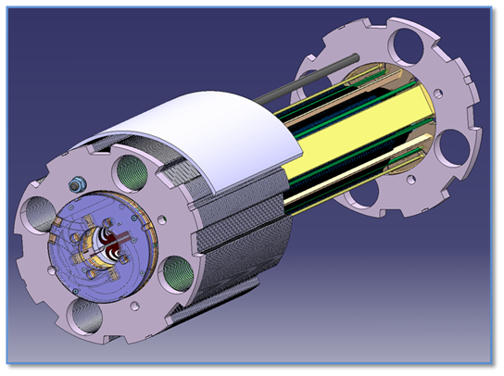
New inner triplets
Cryostat for short test magnet

Slide 16
Other projects

Slide 17
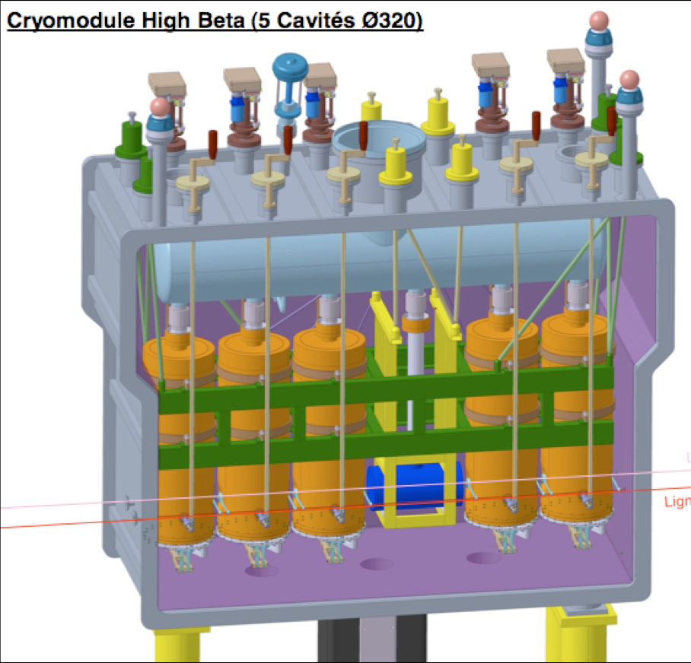
HIE Isolde
Design of vacuum vessel
Shape and thickness
Opening
Selection of seals
Integration of components
Cavities
Solenoid
Warm steerer
Thermal shield
Cryogenic components

Slide 18
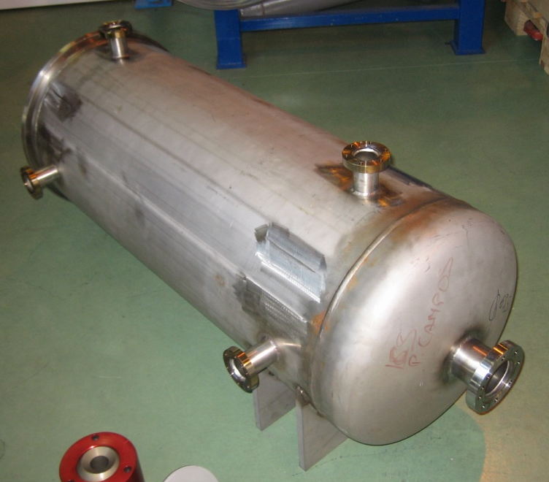
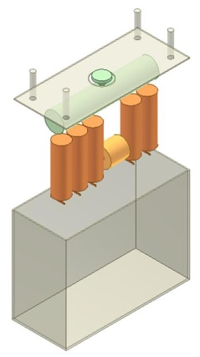
HIE Isolde
Assembly procedure
Opening of vacuum vessel
Insertion in vacuum vessel
Functional specification written for high energy cryomodule
Vacuum vessel for testing of B-Cam alignment instrumentation

Slide 19
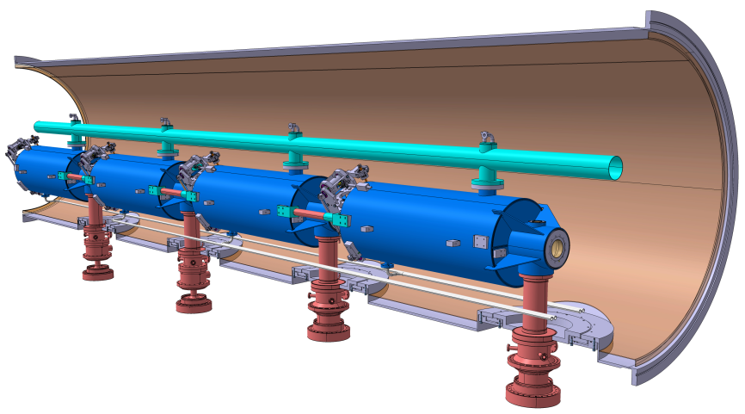
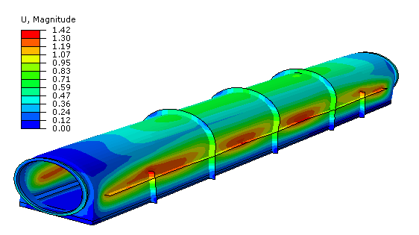
SPL
Responsible of WG3 : Cryomodule design
Part of the “SPL Study”
Collaboration with CNRS/CEA
Design of a 4 cavities cryo-module
Learning of the critical assembly phases
Proof of concept of innovative coupler based supporting system
Explore cryogenic operation issues

Slide 20
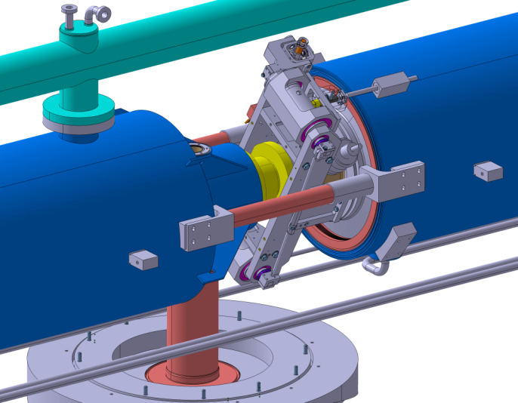
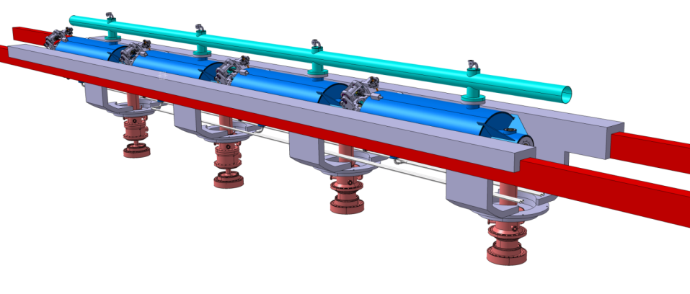
SPL
Integration of components
Equipped cavities
Couplers
Thermal and magnetic shield
Cryogenic components
Design of tooling for cryostating
Engineering specification (for end of 2010)

Slide 21
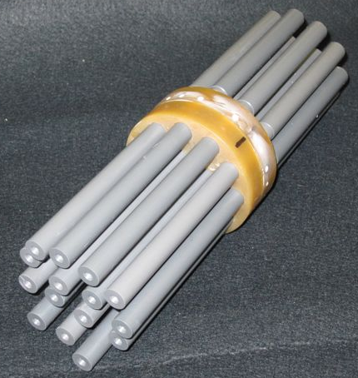
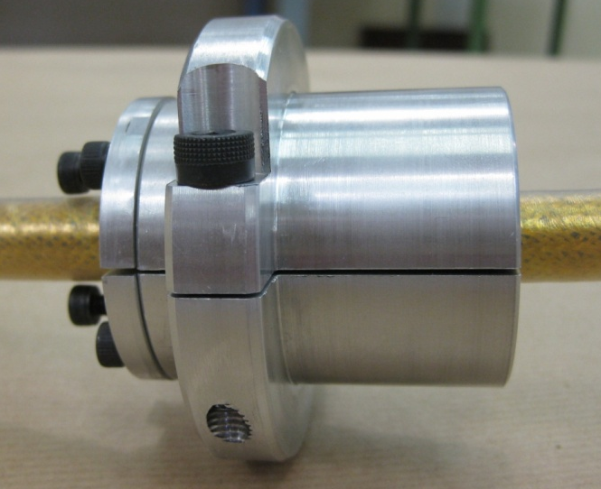
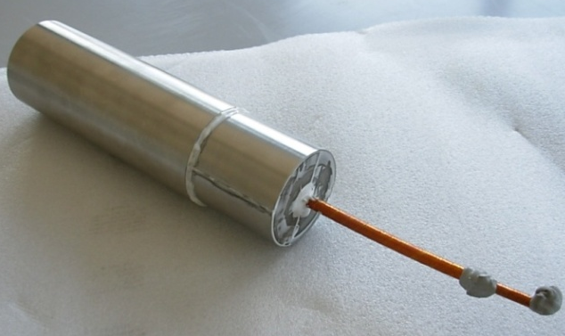
ITER
Design, manufacture and test a prototype plug
Tightness requirement less strict than LHC ones
All the electrical insulation layers have to be kept
First prototype well within specification
But only one cable
The extremities tightness will be important
Next prototype (in collaboration with MSC-ML)
Based on the acquired technology
15 crossing cables
Objective : same results in terms of pressure resistance,
leak tightness and electrical insulation
To be available beginning of 2011

Slide 22
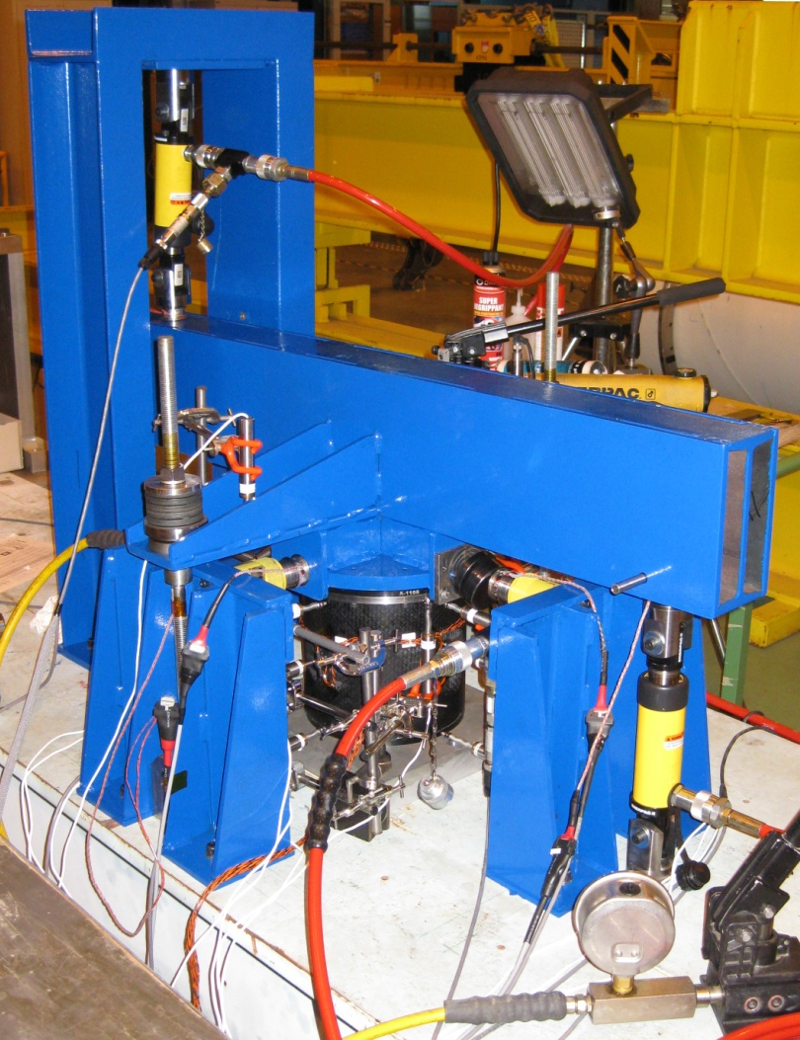
ITER
Cold supports post testing
Study and build of a dedicated tests set-up
Modify the existing test bench
Execute the tests on 5 columns
Give view on mechanical properties
Follows-up of conclusions

Slide 23
Protocole de Collaboration K1597/DG
Collaboration CERN-CEA-CNRS/IN2P3
Signed in December 2008
Value of contribution : 11.258.900 Euros
7.056.000 Euros in components
4.202.900 Euros in manpower
5 technical accord ongoing
Linac 4
SPL
New superconducting magnets
CLIC
Study on accelerators and components supply

Slide 24
Future

Slide 25
Work plan for 2011
LHC Operation
Cryo-magnet coordination
Spares cryostating
Support during operation : MP3 and Patrols
Procurement and storage of components
X-Ray tomography expertise

Slide 26
Work plan for 2011
LHC Consolidation, Upgrade and Maintenance
DS Collimators
Shortened connection cryostats
Technical coordination
Installation
Follow-up and support to LHC splices task force
6 kA splices
Shunt test in SM18
General
Preparation of next long shutdown special activities
Optimization of Interconnection thermal shield
Cryostating of MQXC

Slide 27
Work plan for 2011
Other projects
HIE-Isolde : Cryomodule design
SPL
ITER: Plugs and general consultancy
FRESCA 2 cryostat
CERN/France collaboration agreement management

