Slide 1
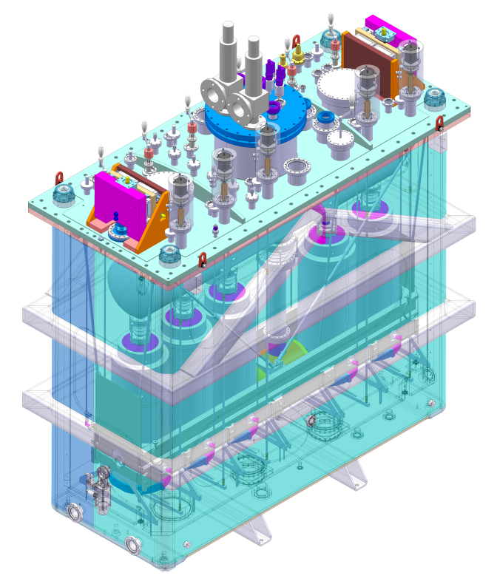
HIE-Isolde Cryo-module
CMI section meeting Feb. 2013

Slide 2
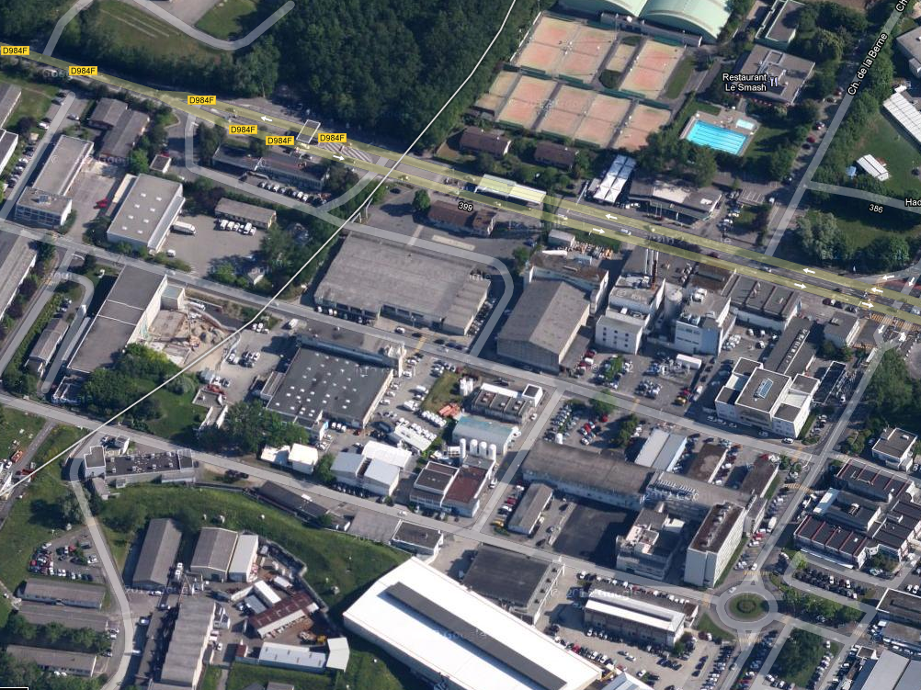
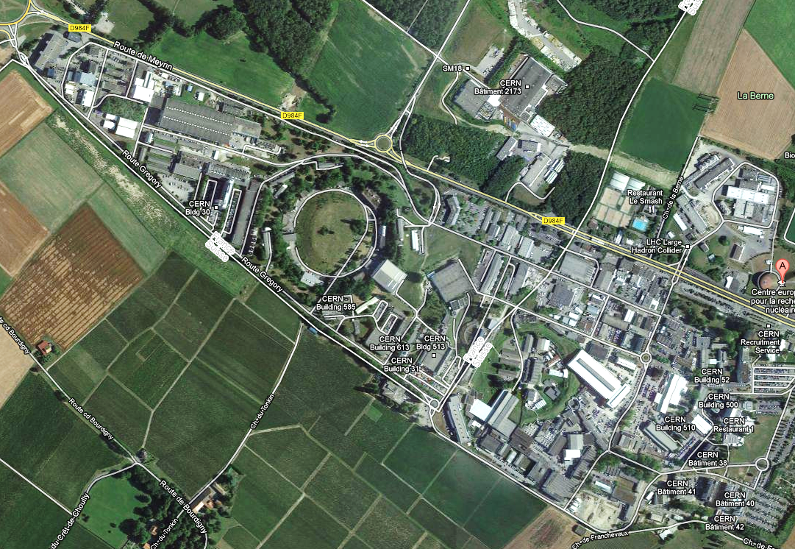
Isolde : B170

Slide 3
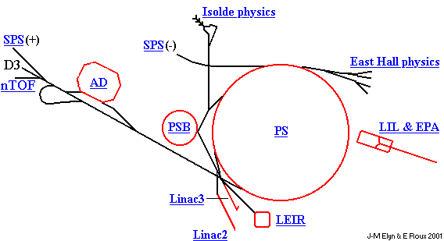
On-Line Isotope Mass Separator
Isolde intro
ISOLDE Physics
1.4GeV/c
Courtesy E. Siesling

Slide 4
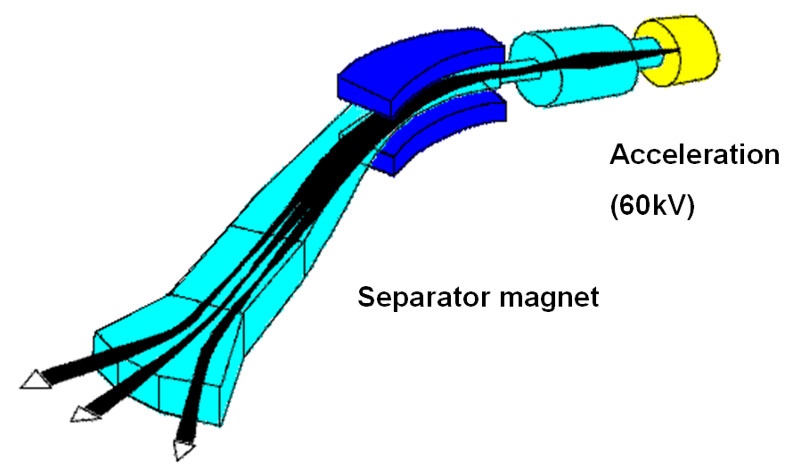
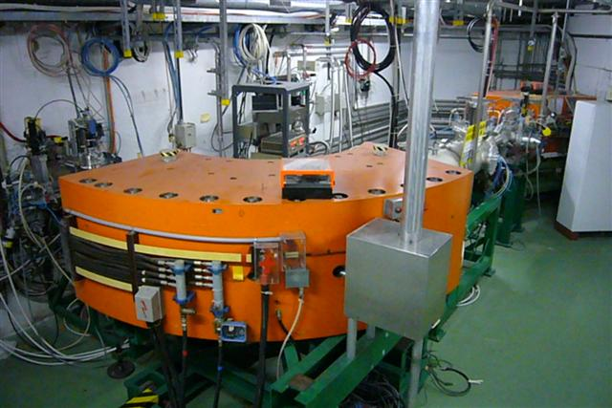
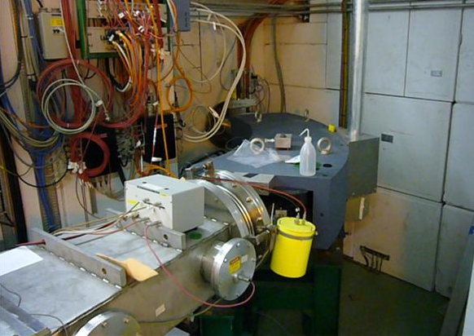
Separator magnet
HRS: M/ΔM=5000
GPS: M/ΔM=2400
HRS
GPS
Courtesy E. Siesling

Slide 5
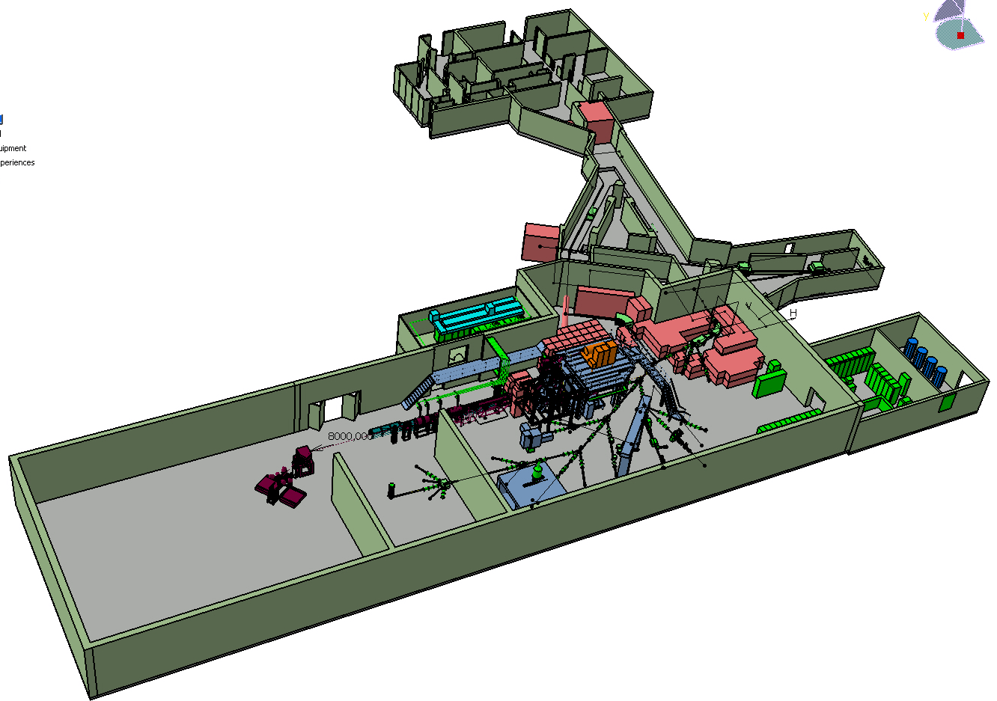
Separator magnet
Selectivity
Isolde layout
HRS
Protons 1.4GeV
GPS
Physics!
Courtesy E. Siesling

Slide 6
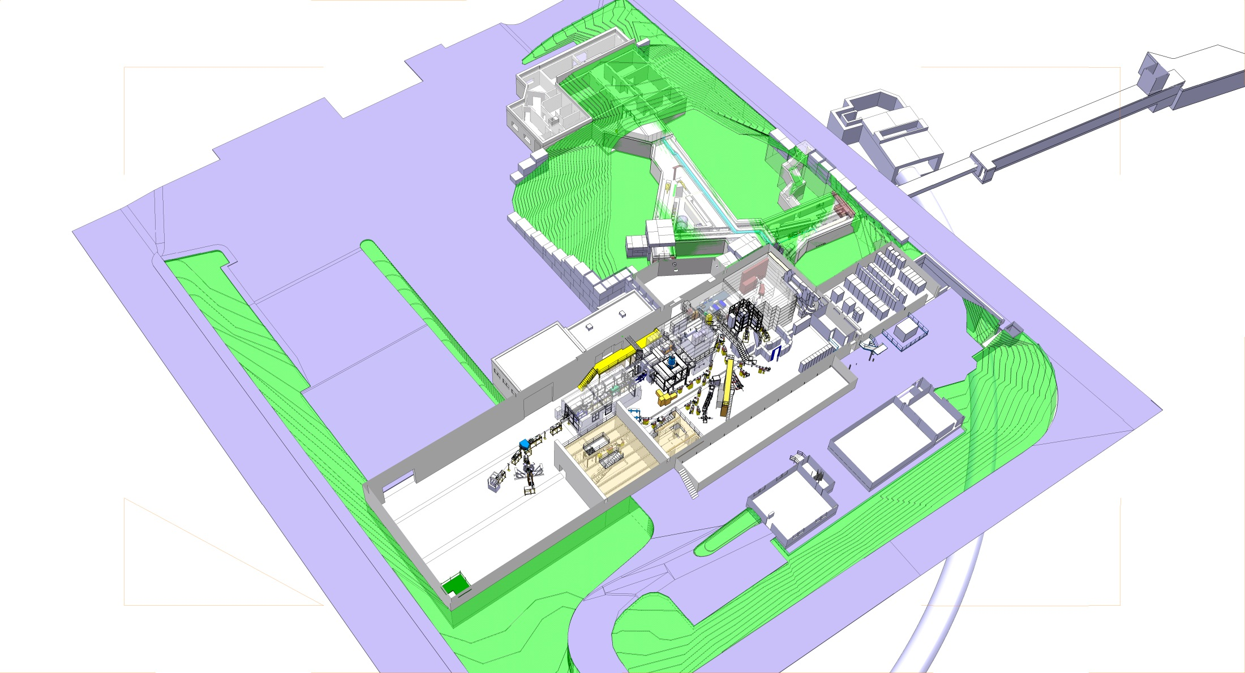
Status today : Rex-Isolde 3 Mev/u

Slide 7
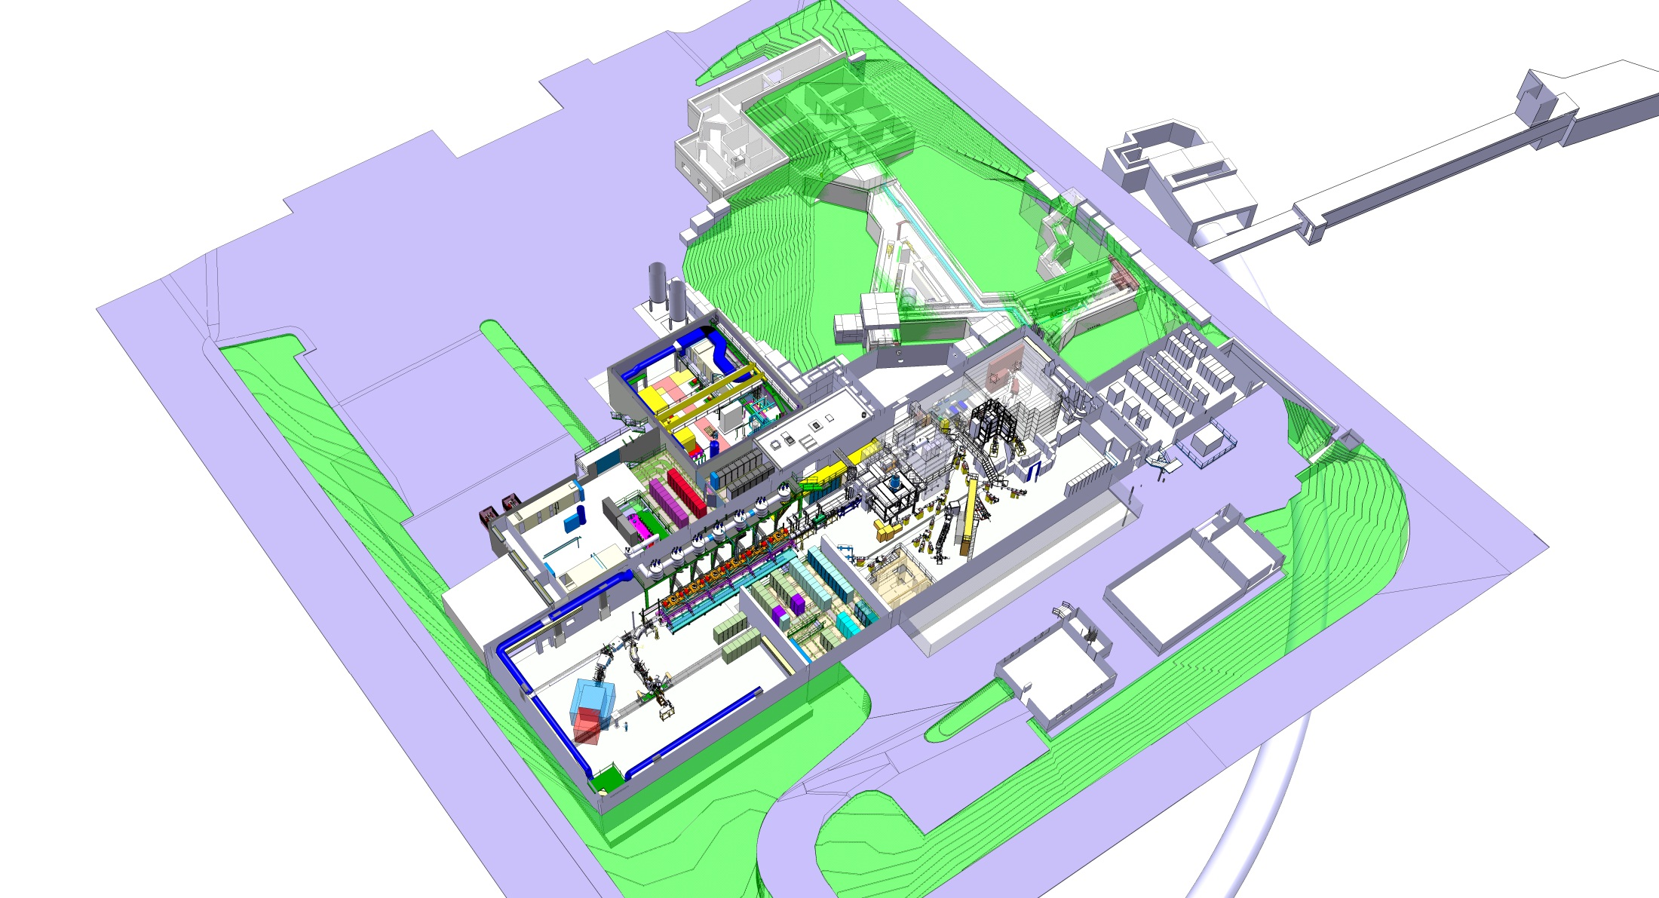
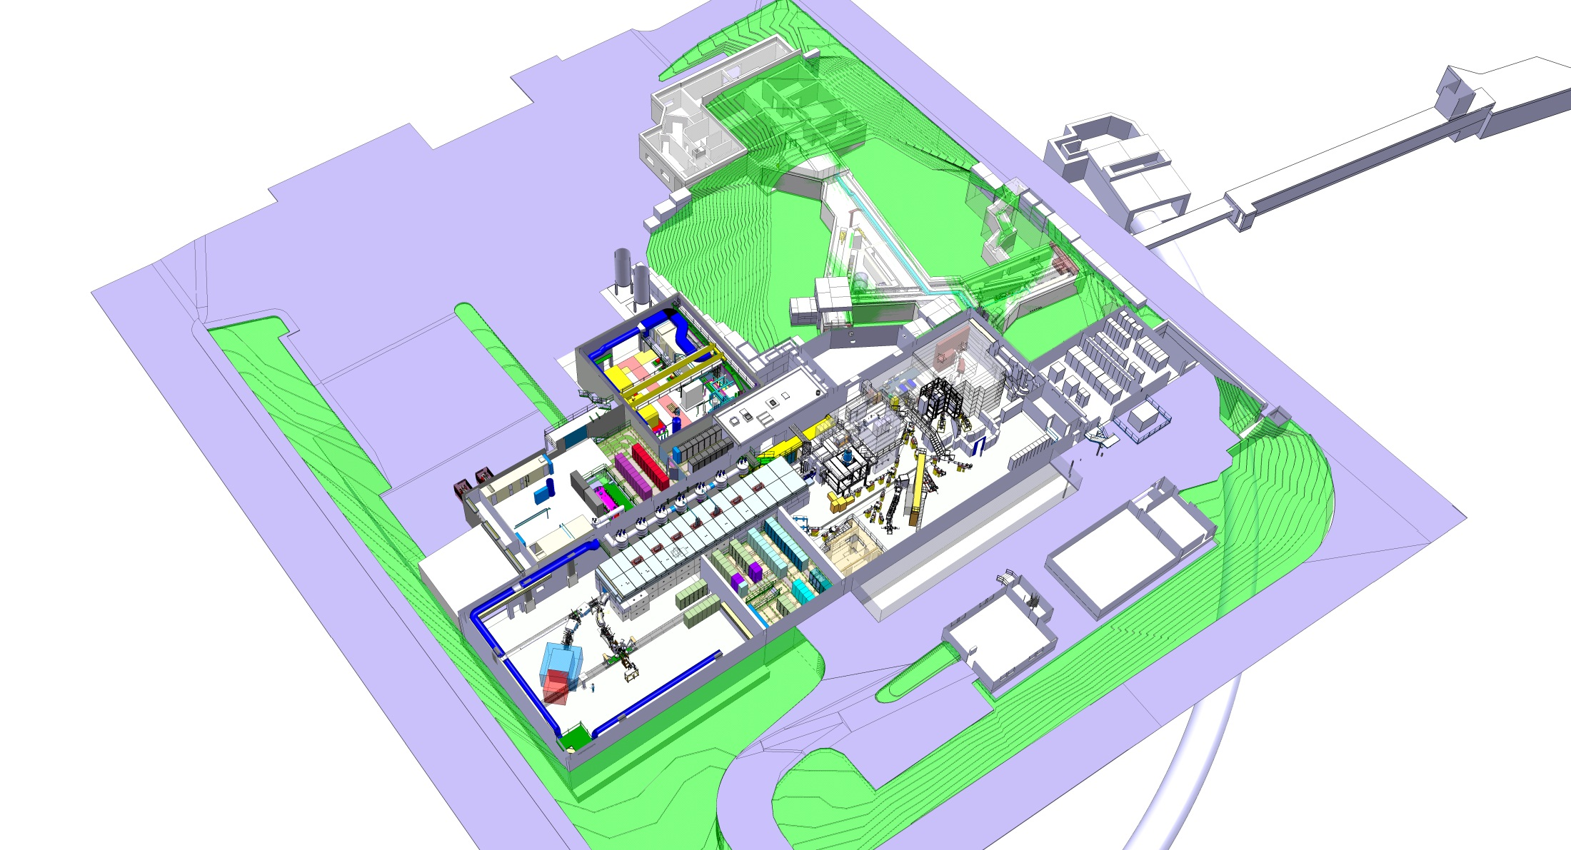
HIE-Isolde : Upgrade of LINAC 10 Mev/u

Slide 8

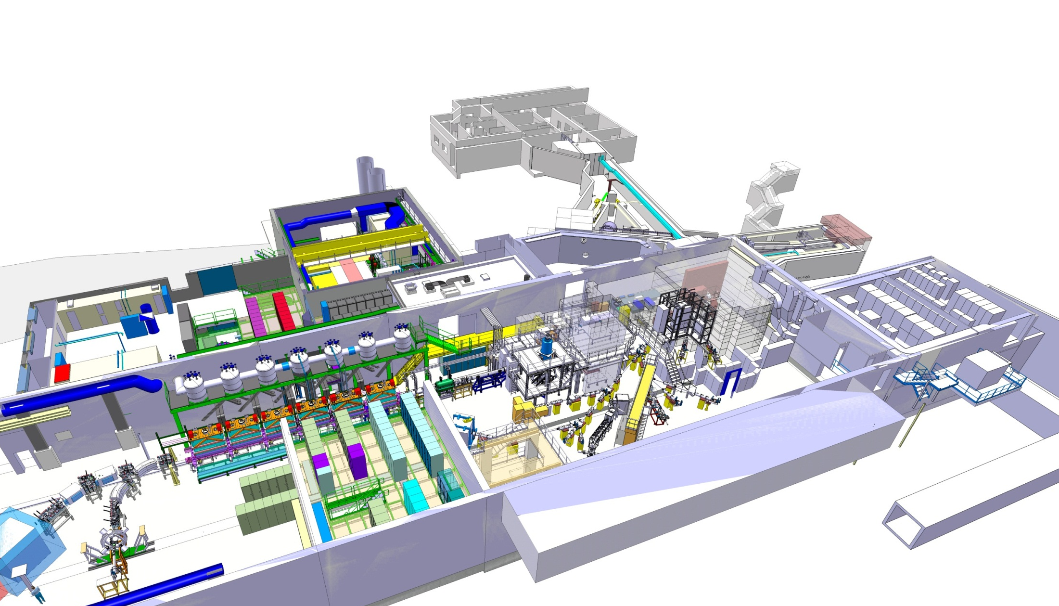
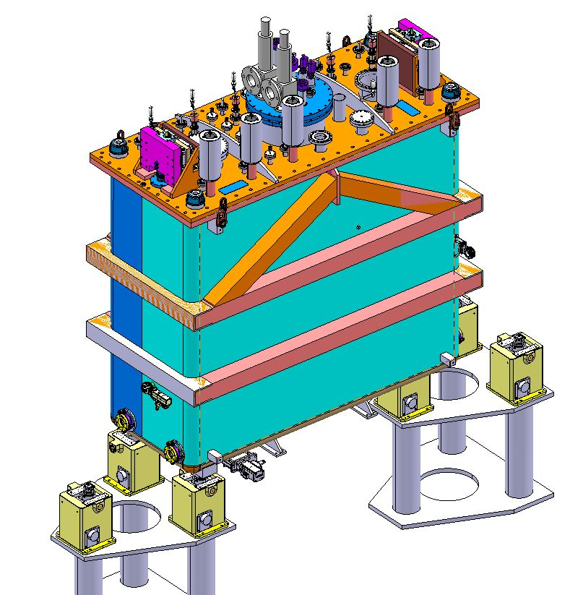
HIE-Isolde Cryomodule
LINAC : 6 highB + 2 lowB cryomodules in series
Courtesy S.Maridor

Slide 9
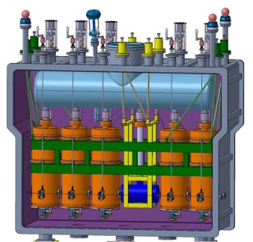
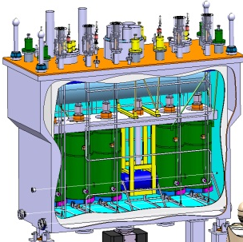
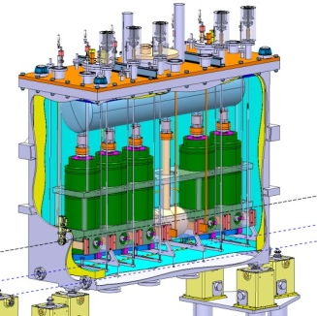
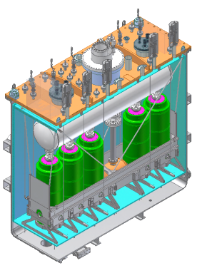
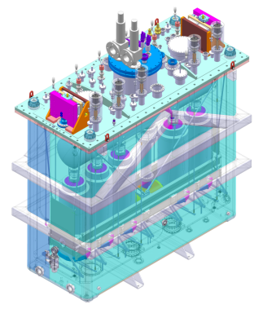
Evolution
Gilles Villiger
Pierre Tibaron
Arnaud Bouzoud
Laurent Faisandel
08/2010
01/2012
01/2013

Slide 10

Cryomodule life cycle:
Cryomodule installation
Interfaces connection
Transport under vacuum
3
2
4
Alignment onto the beam line
Clean room assembly
5
1
Vacuum pump down
6
7
Cool down
8
Adjustments
13
9
Operation
Clean room disassembly
10
12
Warm-up
Transport
11
Interfaces disconnection

Slide 11
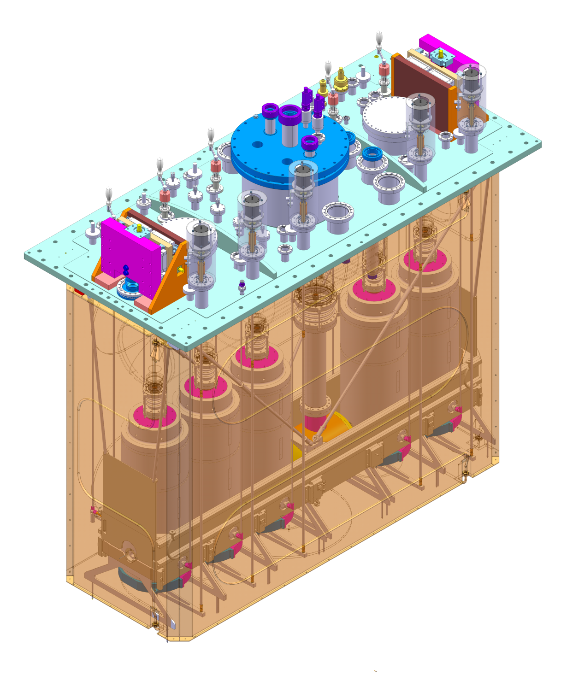
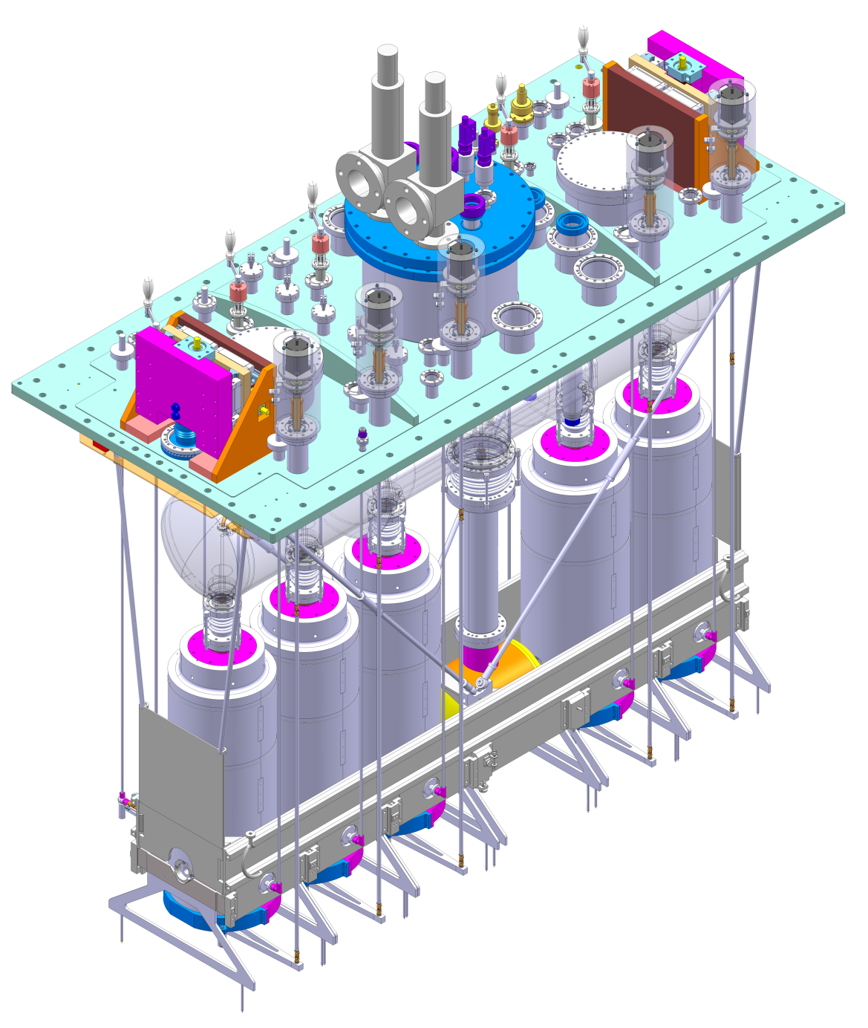
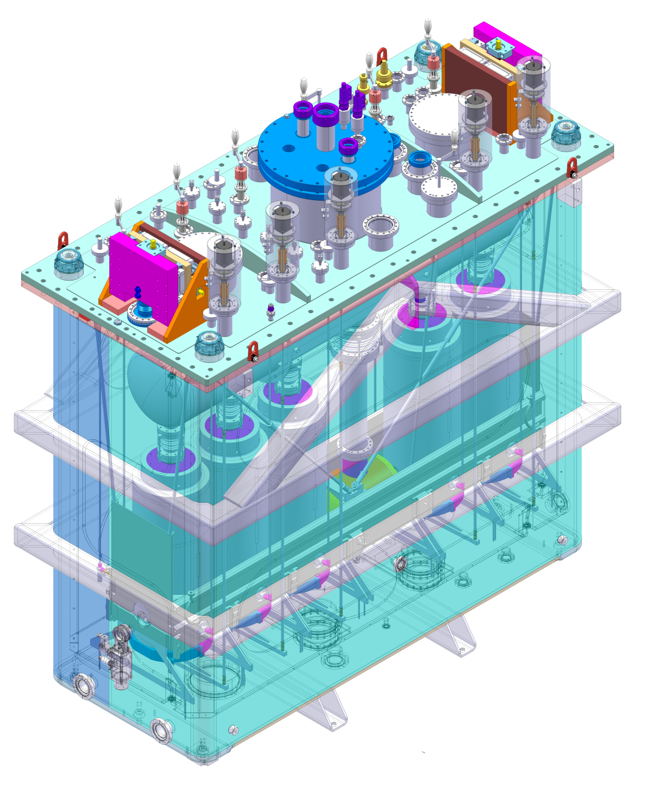
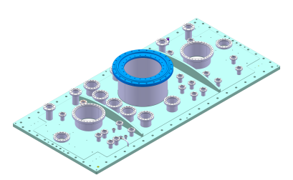
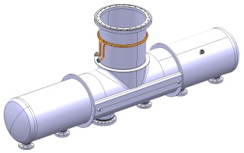
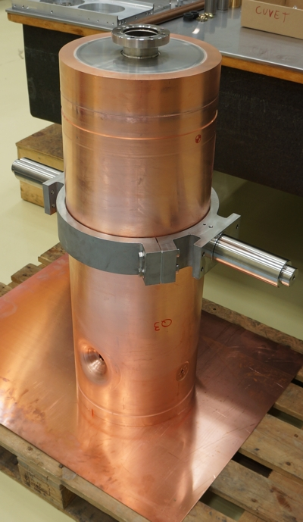
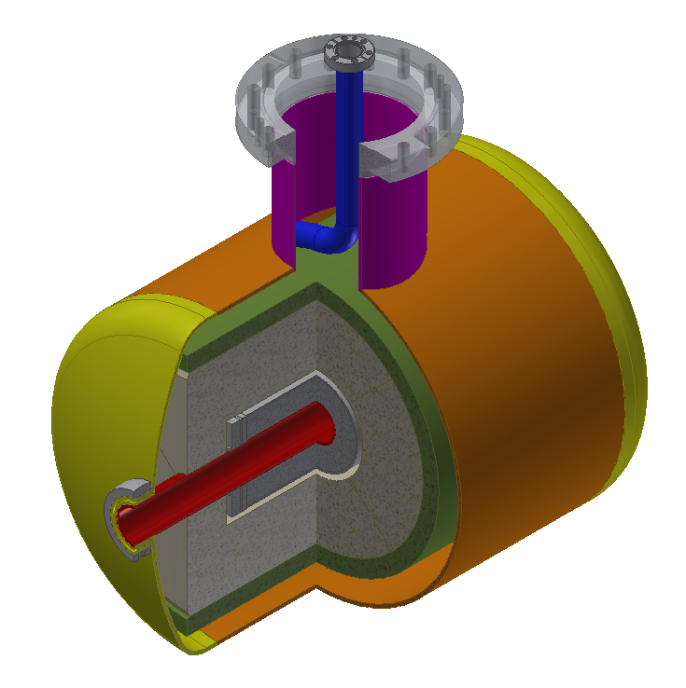
The high-B cryomodule
5 QWR cavities
1 solenoid
Supporting frame assembly
Helium reservoir
Top plate
Thermal shield
Vacuum vessel

Slide 12
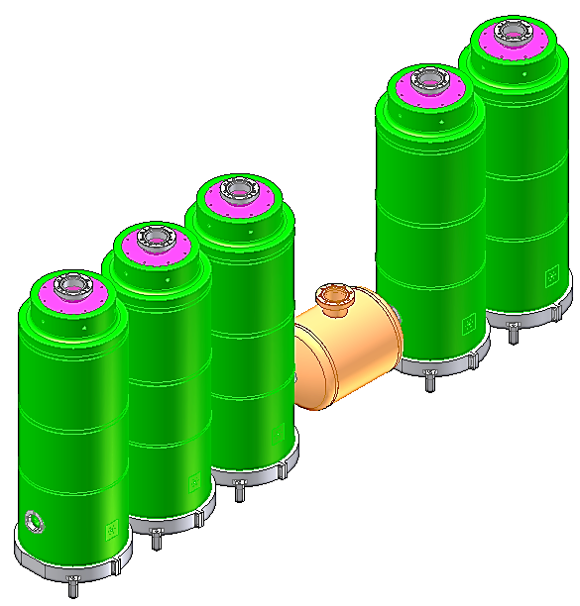
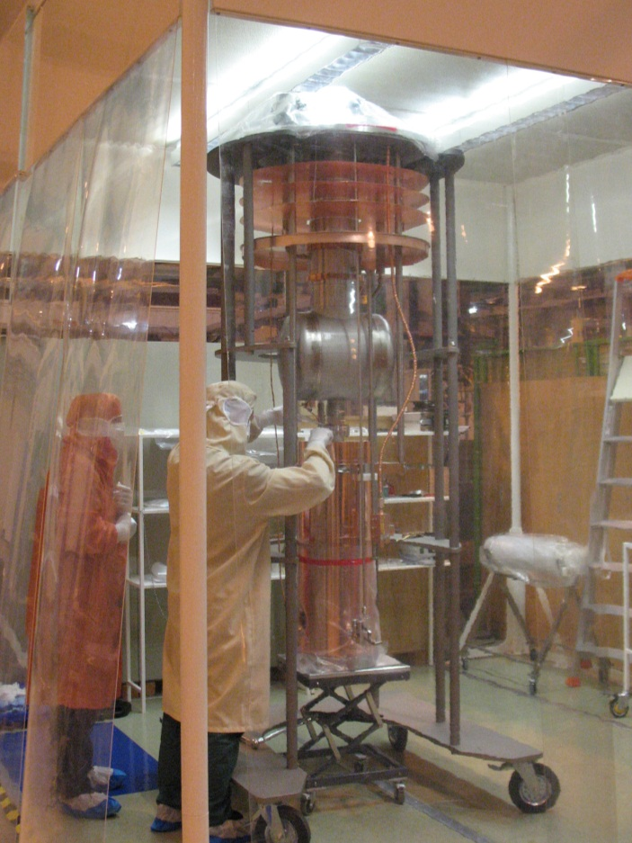
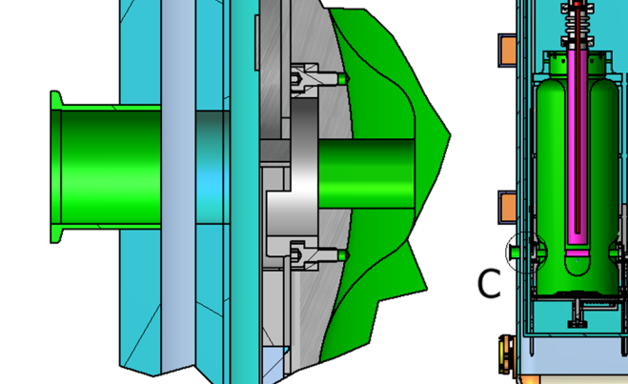
Main specifications
Alignment
      Cavities in Ø 0.6 mm
      Solenoid in Ø 0.3 mm
Vacuum
      Beam vacuum
      5.10-8 mbar
Cryogenics
      Superconductive components
      Liquid-Gas Helium 4.5K
Cleanliness
    Cavity sensitivity
    Clean room compatibility
Dimensions at warm
Vacuum Vessel
(Multi Layers)
Thermal shield
Cavity
Frame
10mm
10mm

Slide 13
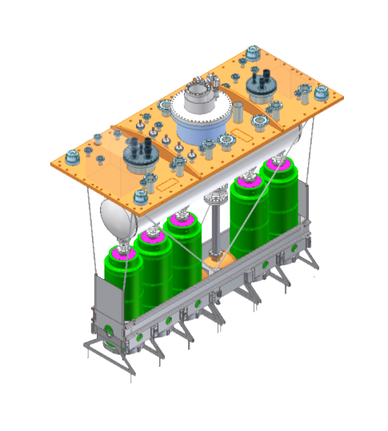
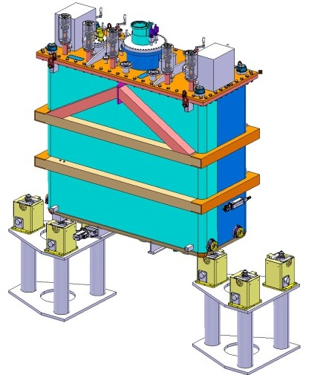
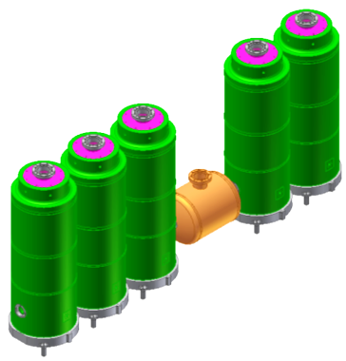
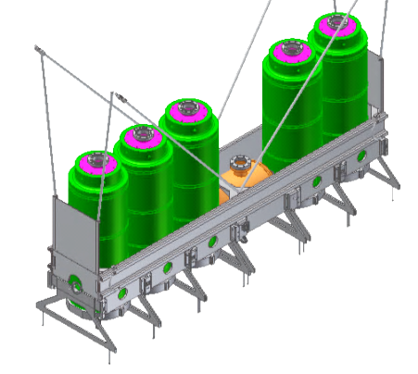
Alignment Procedure
    Alignment of cavities and solenoid onto a common axis within the frame
    Alignment of the frame, cavity and solenoid assembly under top plate (ref: vertical plane through top plate longitudinal axis)
    Alignment of the cryomodule onto beam line (via survey targets on the top plate)
    Adjustment of the frame, cavity and solenoid assembly onto the beam line
    Independent fine adjustment of the solenoid onto the beam line
Warm
Alignment
Pump and cool down
Cold
Adjustment

Slide 14
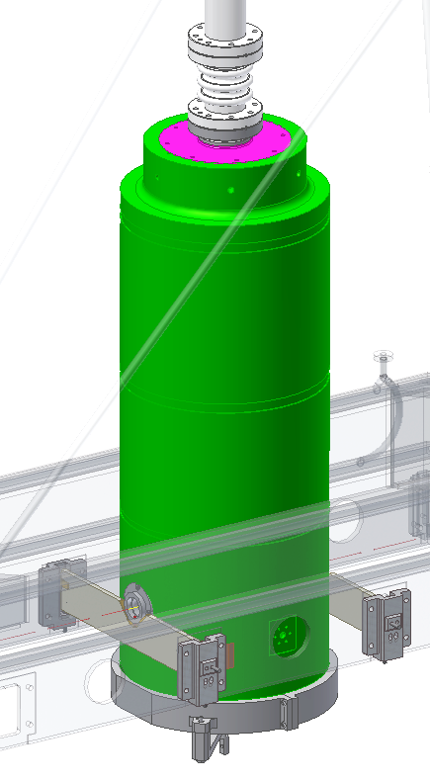
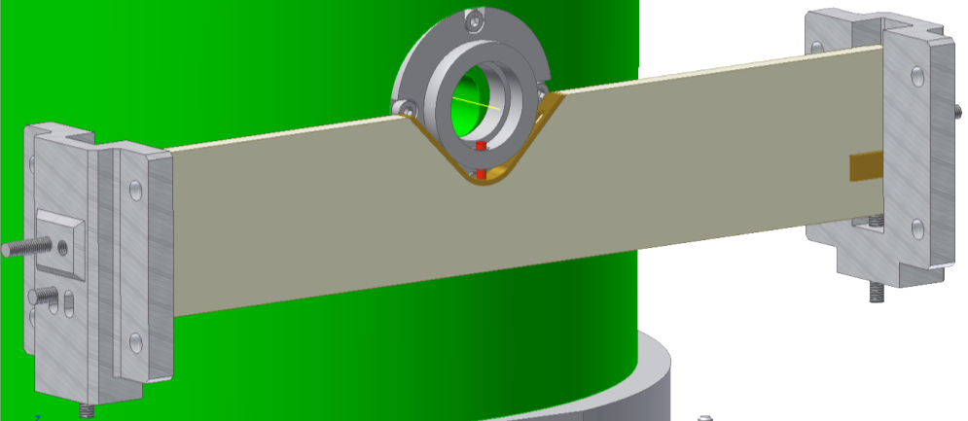
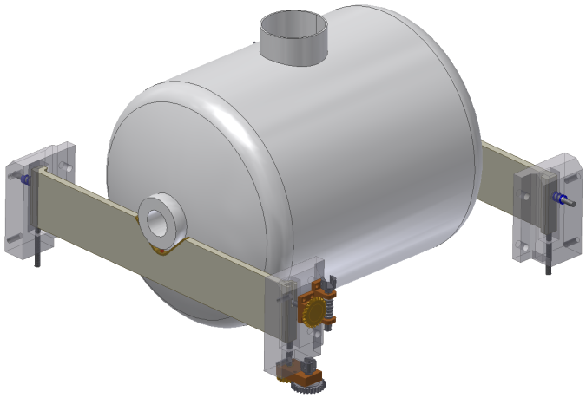
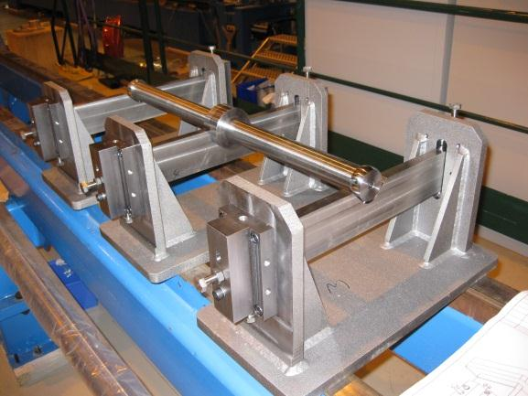
Alignment : components/frame
Requirements
  Align beam ports axis
  Vacuum compatible
Technical solutions
  Adjust beam ports position
  4 DOF adjustment system

Slide 15
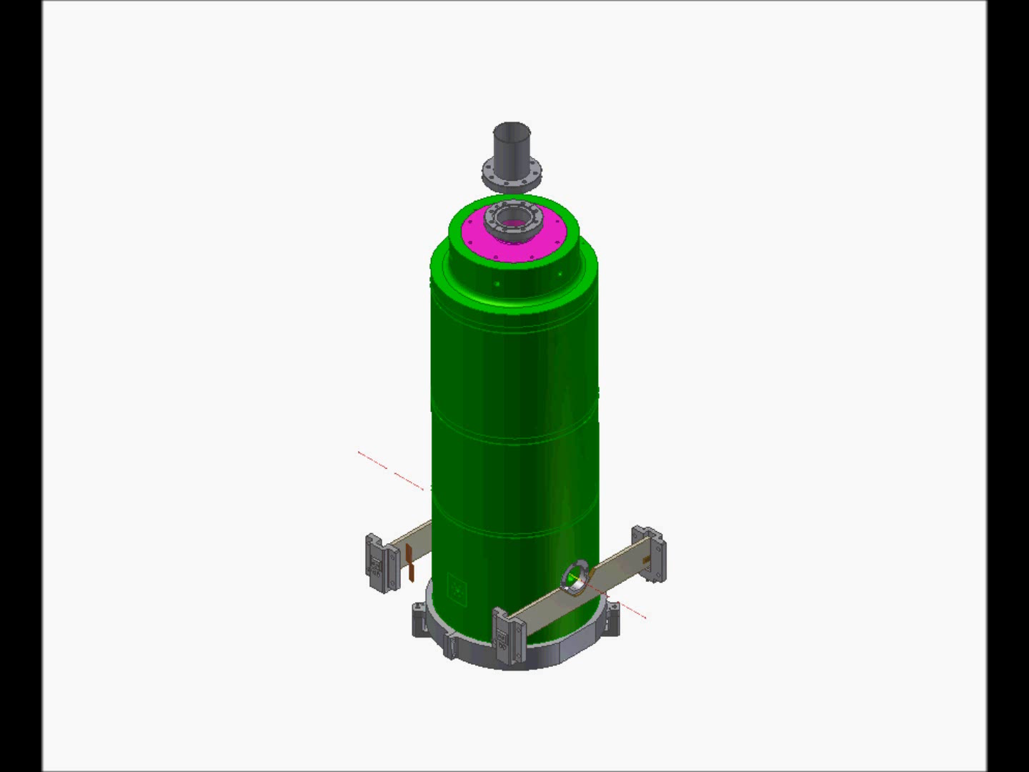

Video Cavity-Frame Interface
Kinematics of the cavity pre-alignment
Alignment / Adjustment Mechanisms / Cavities-Frame Interface / Video

Slide 16

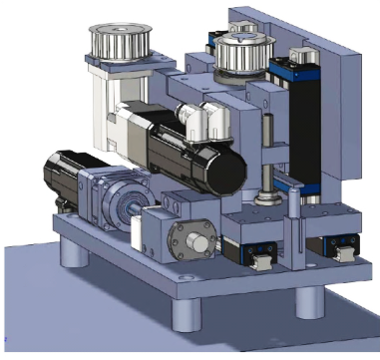
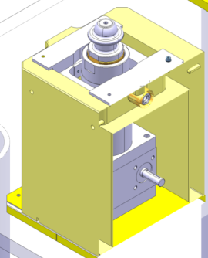
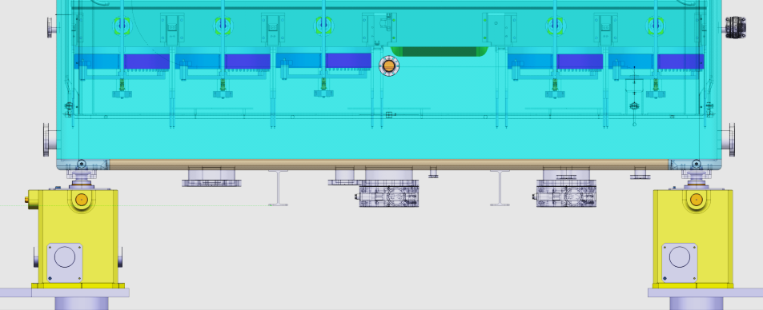
Alignment : frame/cryomodule
Frame position adjustment under the top plate
    Specific 4 DOF adjustment system
Cryomodule positioning onto the beam line
  Classic 3 points support solution
  Linac4 type jacks : SPLHAJ_0001

Slide 17
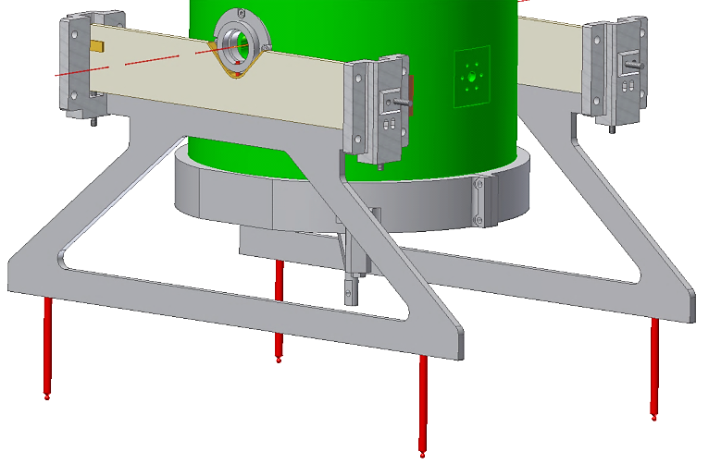
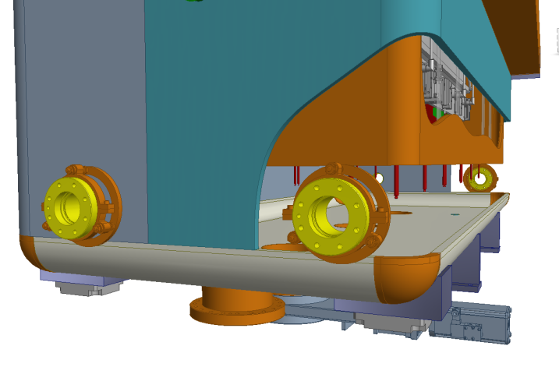
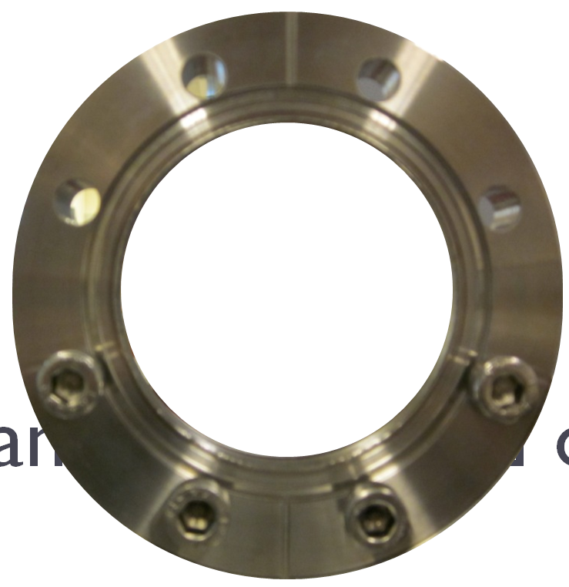
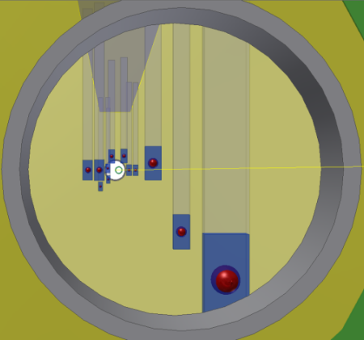
Alignment : survey (BE/ABP)
Monitor beam ports locations
  Permanent monitoring
  Optical method using BCAM devices
Technical solutions
  Targets linked to beam ports
  Extrapolated positions via reconstruction software (BE/ABP)

Slide 18
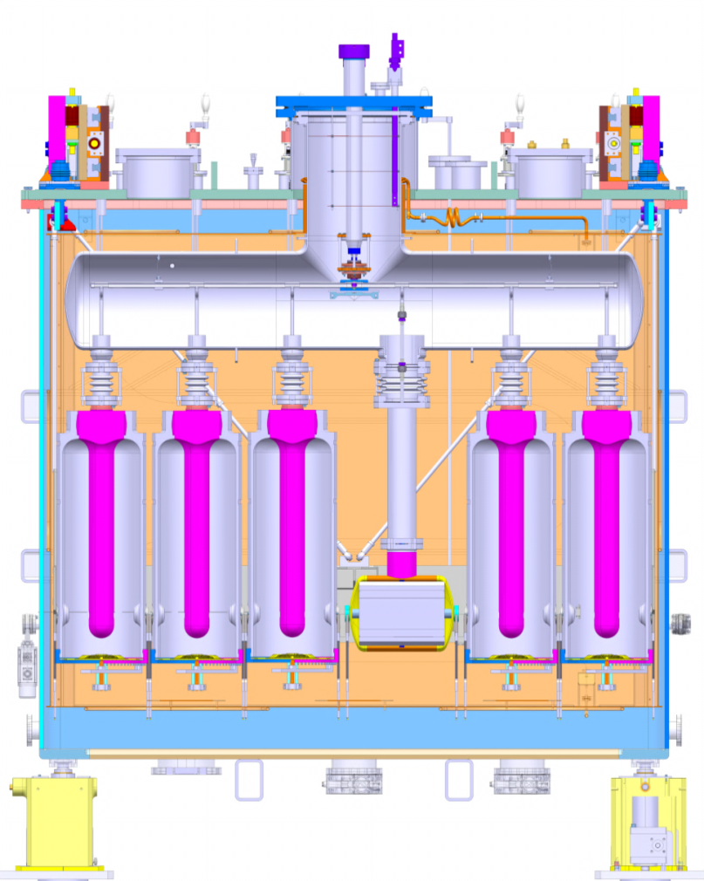
Vacuum
Requirements : 5.10-8 mbar
Technical solutions
  Common insulation and beam vacuum
  Externally controlled
  Procedure
    1.10-6 mbar via turbo-pumps
    5.10-8 mbar via cryo-pumping
Helicoflex®
CF + Cu gasket
Pressure gauges
Double Viton seal
Valves
Pumping ports, venting, He cond.

Slide 19
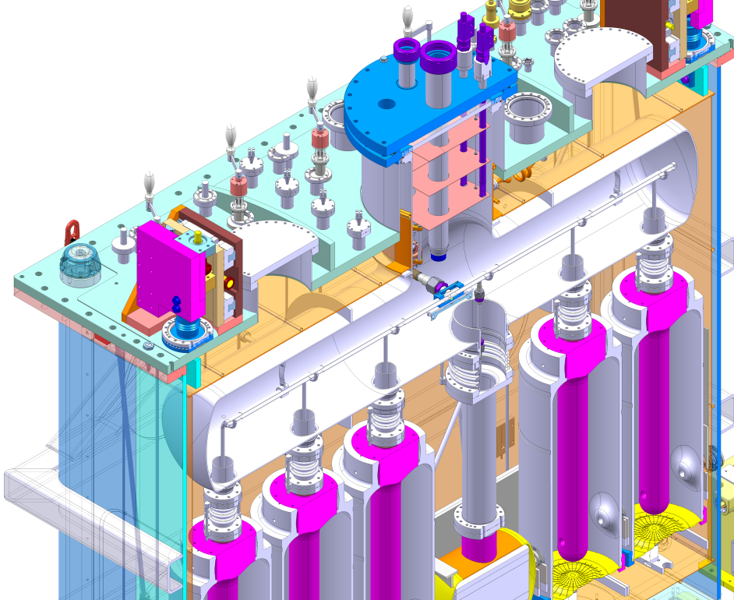
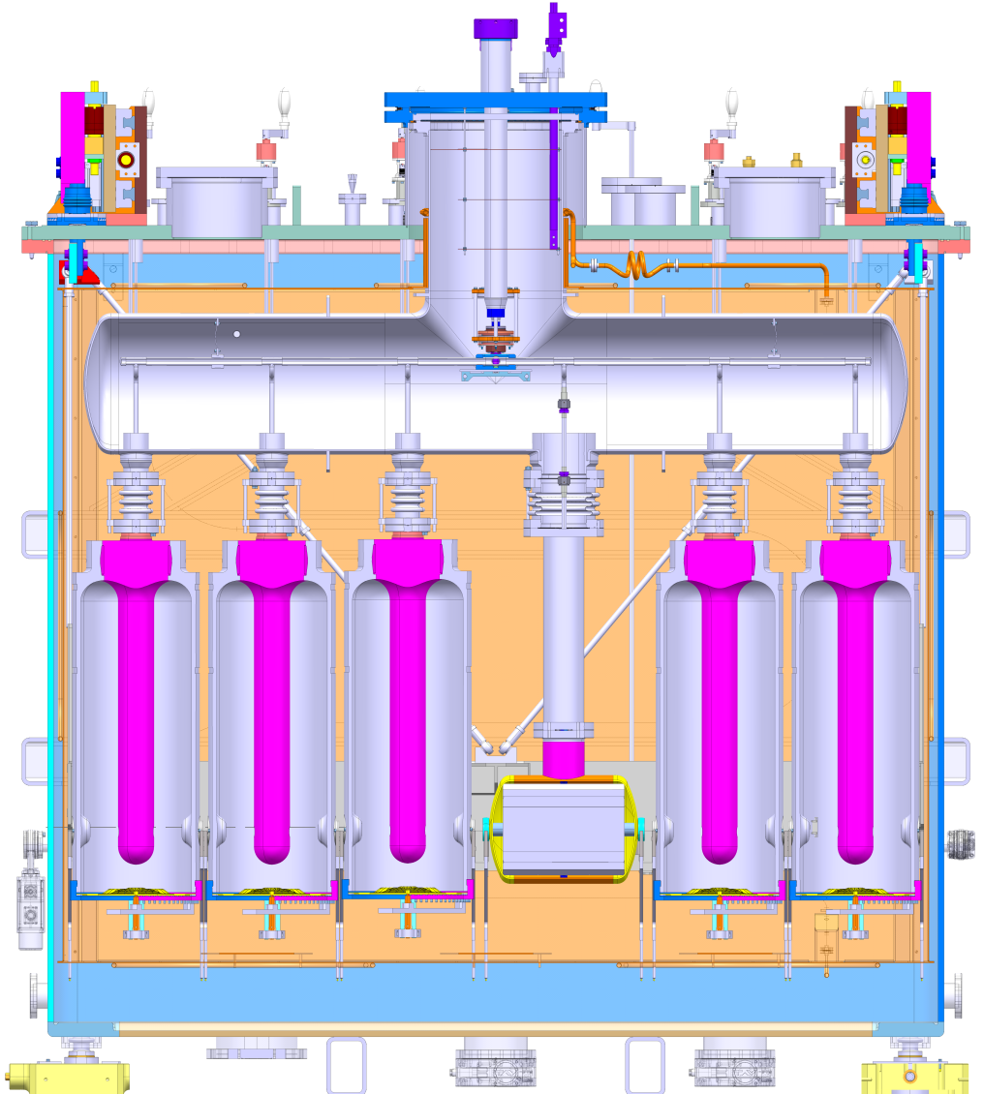
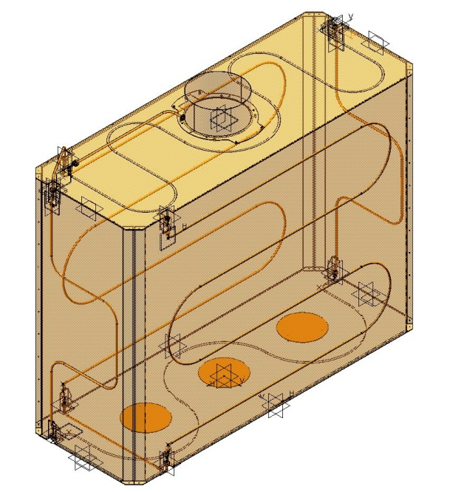
Cryogenics : 50-75 K / 4.5K circuits
  GHe 50-75K Circuits : Thermal Shield
    13 bar nominal
    CF + Cu gasket interfaces
  LHe – Ghe 4.5K
    1.3 bar nominal
    150 l of liquid Helium
  No valves

Slide 20
Cryogenics : procedure
Initial status
  300K structures
  1.10-6 mbar vacuum
Shield cool down
  13 bar
  Mix of 300K and 50K GHe
Reservoir + frame cool down
  2.5 bar
  4.5K Helium
Cavities + solenoid cool down
  2.5 bar
  4.5K Helium
Steady-state
  Thermal shield circuit : 13barg, 50-75K
  Cold mass circuits: 1.3 barg, 4.5K
Cavities + solenoid warm-up
  In series with 50-75K circuit
  1.3 barg
Total warm-up
  In series with 50-75K circuit
  1.3 barg
Reservoir
Cav. #5
Cav. #4
Cav. #3
Cav. #2
Cav. #1
Solenoid
Frame
Thermal shield
Vacuum vessel
4.5K
20K
75K
300K

Slide 21
Cryogenics : figures
Pressure-Temperature table status
    Done: identification of P&T values in all circuits for each step
  400W static @50-75K
    300W from radiation
    100W from thermalizations
  15W static @4.5K
    Cryo supplies : 6W (x2)
    He vessel : 6W
  65W static+dyn. @4.5K
    10W / cavity

Slide 22
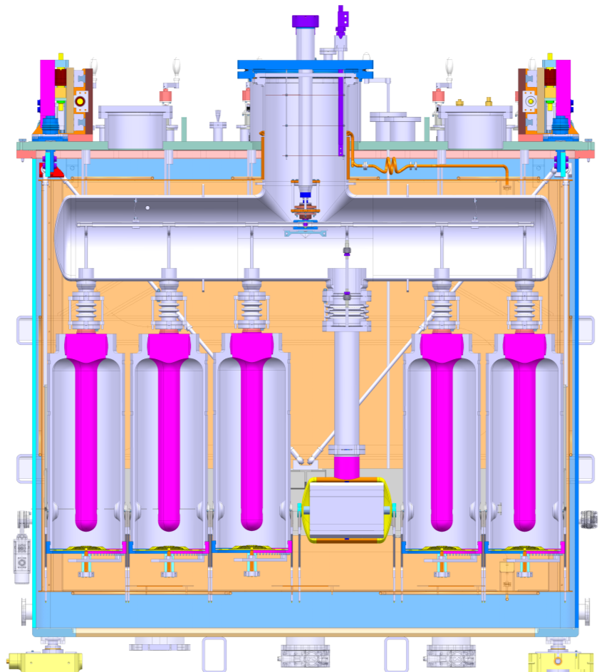
Safety aspects
Protection in jumper box
Norms
  European directive 97/23/EC
  Cern rule IS_47_E_6.6 ➔ 2 devices
  Remote control via motorization
Calculations

Slide 23

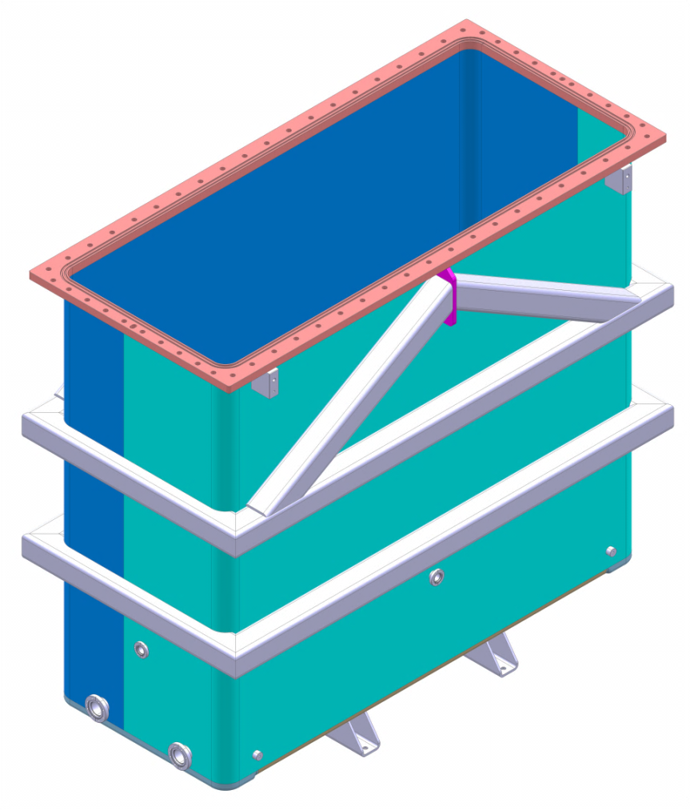

Main components : Vacuum Vessel
Constraints
  Vacuum & cleanliness
  Space requirements
Technical solutions
  Rectangular shape
  Tight tolerances
  316L mechanically-polished
-2.4x2.2x1.1 m
-4.5T – 316L polished
-15 mm (40mm) thick plates

Slide 24


Vessel interfaces
-Beam ports
-Vacuum Pirani gauge
-Vacuum Penning gauge
-Vacuum Inter-pumping port
-Vacuum pumping port
-Vacuum He conditioning
-Vacuum RGA
-Vacuum venting
-Vacuum roughing
-RF pick-up
-RF supply
-RF tuner
-RF coupler
-Survey OF
-Survey level
-Survey targets
-Survey viewports
-Adjust frame
-Adjust solenoid
-Bayonets
-Instrumentation
-Current leads
-Safety P relief device
-Transport interface
-Lateral access

Slide 25


Main components : He reservoir
Constraints
  Compatible with RF surfaces cleanliness requirements
  Pressure equipment : 4.5 bar
Technical solutions
  2x0.35x0.8 m - 250l capacity
  Welded 316L electro-polished vessel
  Tight tolerances
  Specific sealing
  Air/He interface by stratification of GHe

Slide 26


Main components : Thermal Shield
Constraints
  Compatible with RF surfaces cleanliness requirements
  Thermal efficiency
  Space available
Technical solutions
  Actively cooled – soldered serpentine
  Porosity free soldering
  Nickel plated copper sheets
2/4mm-Copper sheets
Nickel Plated
DN10 copper tube
300kg bolted assy
Porosity free soldering test
performed at Cern

Slide 27


Supporting Frame
Interfaces for cryogenic fluid
  Manufacturing
    316L welded structure
    Machined after heat treatment
    Electro-polished
  Active cooling
    Uniform Cooling
      hollow profiles
      Forced flow liquid helium
      CF connections
Interfaces for cryogenic fluid
Adjustable plates
Copper sheet
thermalization
Bimetallic low friction
contacts
Electro-polished
Bolted supports

Slide 28

Interfaces & Instrumentation

Slide 29


Instrumentation

Slide 30

Questions

Slide 31



Transport C.Bertone
Suspended transport
  Dedicated tool to take up to 10% slope
Installed with crane in B170
SM18
BA7
65
170
douane
reception

Slide 32


RF services and interfaces (BE/RF)
Outside cryomodule interfaces
    32 x 5 3/8” RF cables to route and connect
    Connector panels for feedthrough integrity
Inside cryomodule
    Services in beam vacuum & thermalized to 50K
    Instrumentation
Status
    Done
    cable definition, routing and thermalization concept
    instrumentation list
    connecting sequence
    In progress
    RF feedthroughs
    Control panels integration
    Pending
    Cable, routing and thermalization drawings
    coupler motor and controls
    Instrumentation selection, installation and connectors
RF supply
Coupler control
Pick-up
Tuner control

Slide 33



Solenoid and Interfaces
Solenoid characteristics
  Properties: 116 A – 13.5 T2.m - NbTi
  Quench protection to be confirmed
    Active : baseline
    Passive : need re-design for integration
  Supplied by Danfysik
Interfaces
  Current leads technology options
    Vapour-cooled 1kA off the shelf : baseline
    Conductive cooled : need important re-design
  Mechanical splice for clean assembly purposes
  Mechanical interfaces
  Services : cryogenics, instrumentation
Status :
    Done : mechanical & cryogenics interfaces, instrumentation list
    In progress : current leads
    Pending : splice details, routing and connection of wires and cables, integration of the quench protection system
Current leads
interface
Bus bar
Splice
NbTi wires

