Slide 1
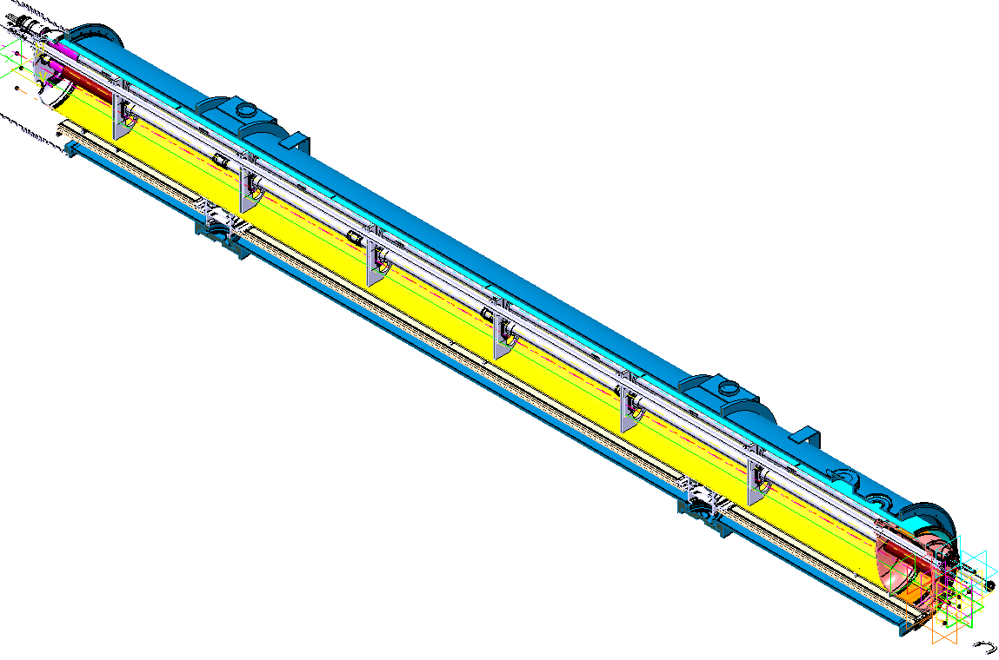
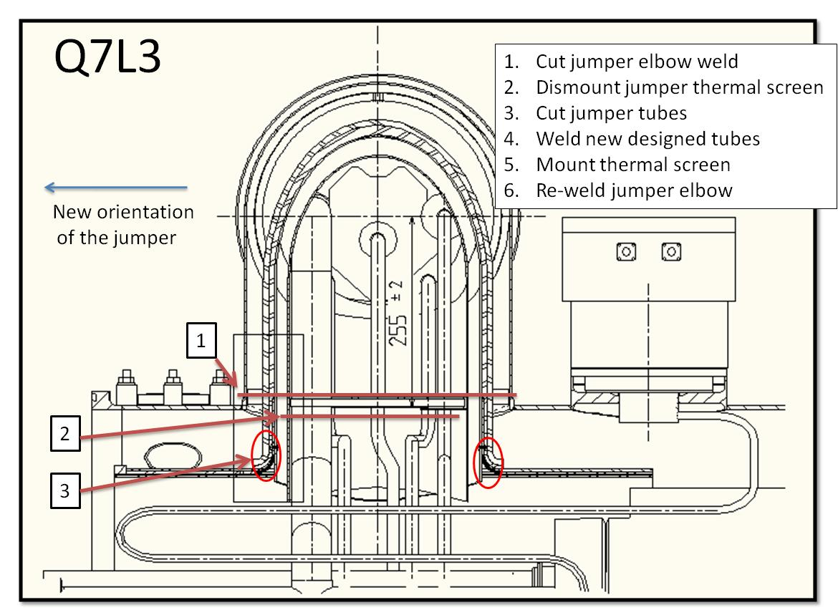
DS Collimators
Progress on design of short connection cryostats
Start of study of modifications of Q7L3 & R3 jumpers
Reviews planned:
Review of the cryogenic by-pass for the LHC DS collimators (26/05/2011)
Review of Collimation project (June2011)
TE-MSC-CI

Slide 2
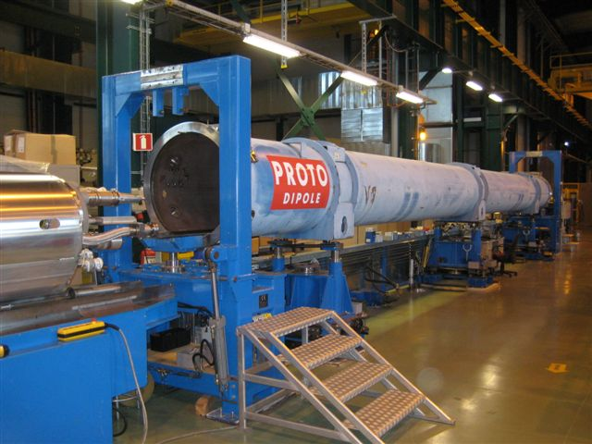
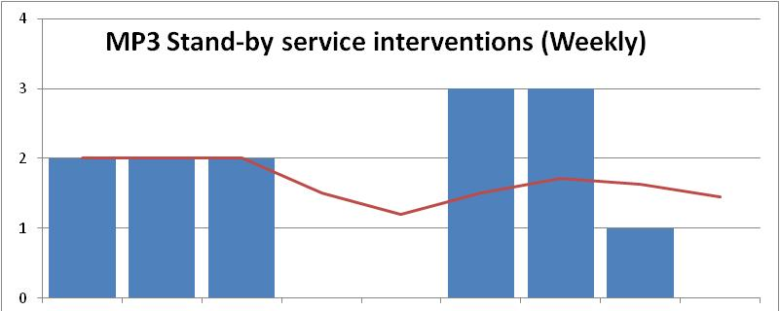
LHC operation
Continuous cryostating and decryostating of spare dipoles (2 per month)
(Re)Start of operations on SSS: cryostating, preparation for cold test
Definition of procedure to modify pre-series vacuum vessels in LHC compatible ones. First one shipped for machining. (Savings of at least 0.3 MCHF)
Decryostating of protopypes cold masses started (1st one completed)
MP3 Piquet service :
Support to operation (≈ 2 interventions per week)
Evolution to be defined
Cryomagnet coordination : https://espace.cern.ch/cryomagnet-coordination/default.aspx
31 spare cryodipoles and 5 SSSs are available (cold tested OK)
Work on identification of magnets to be exchanged during LS1
TE-MSC-CI

Slide 3
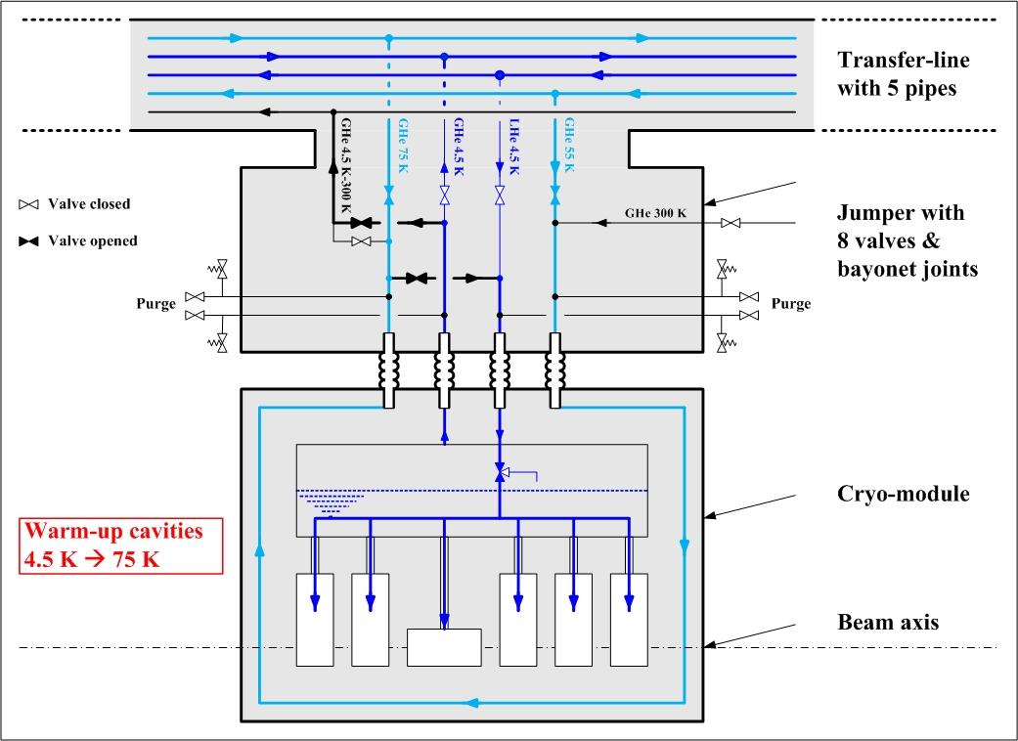
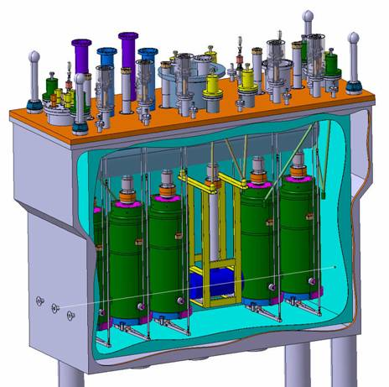
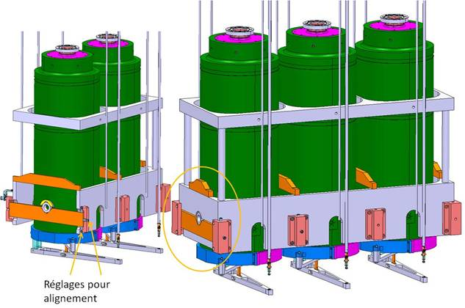
HIE-ISOLDE cryomodule
Progress on supporting of RF cavities
Progress on cryogenics process diagram
Cleanroom location : Implementation in SM18 presented at Site Committee (To be followed up)
TE-MSC-CI

Slide 4
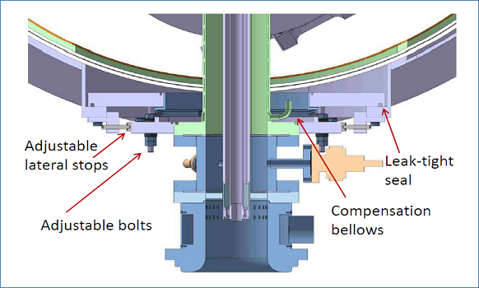
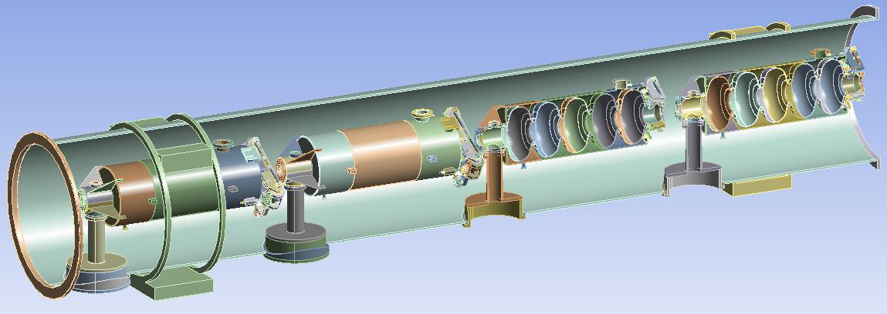
HP-SPL
Visit to JLAB
Participation to Project X Collaboration meeting
Progress in design with CNRS team on the supporting strategies
Prototypes for testing on the mock-up will be made in the Main Workshop
Preparation of 1st mock-up for testing double-walled tube supporting almost ready
TE-MSC-CI

Slide 5
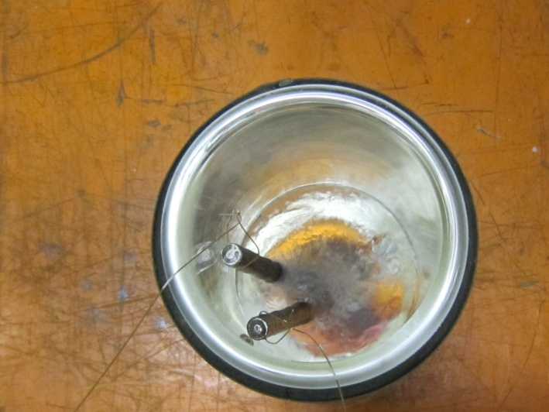
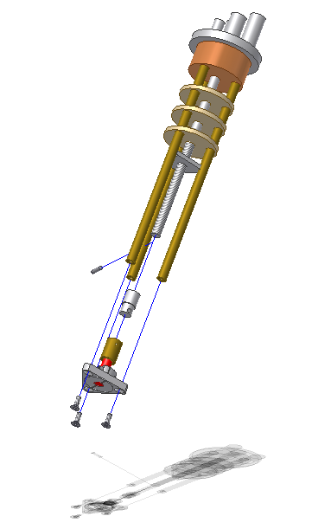
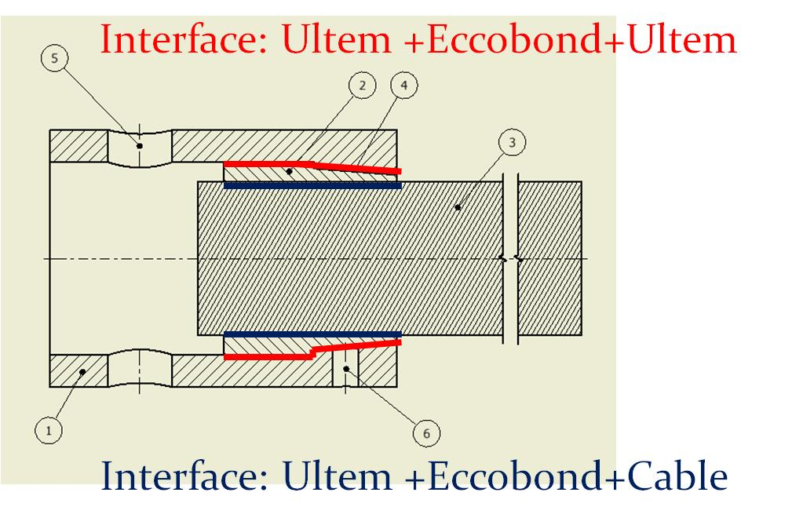
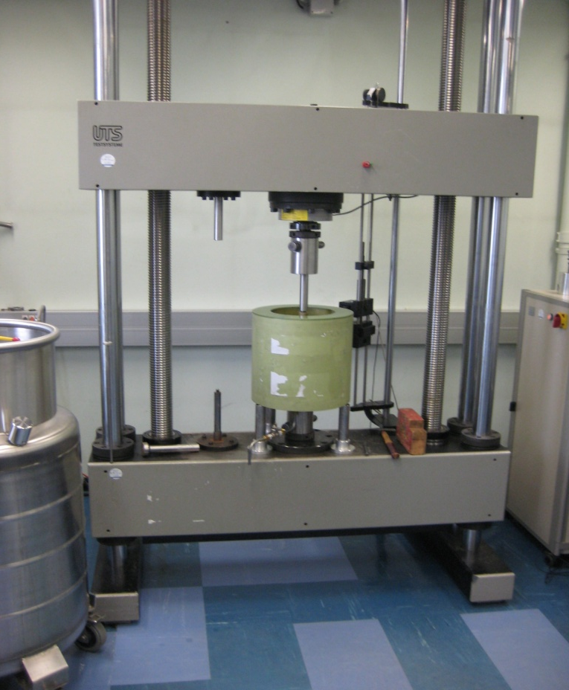
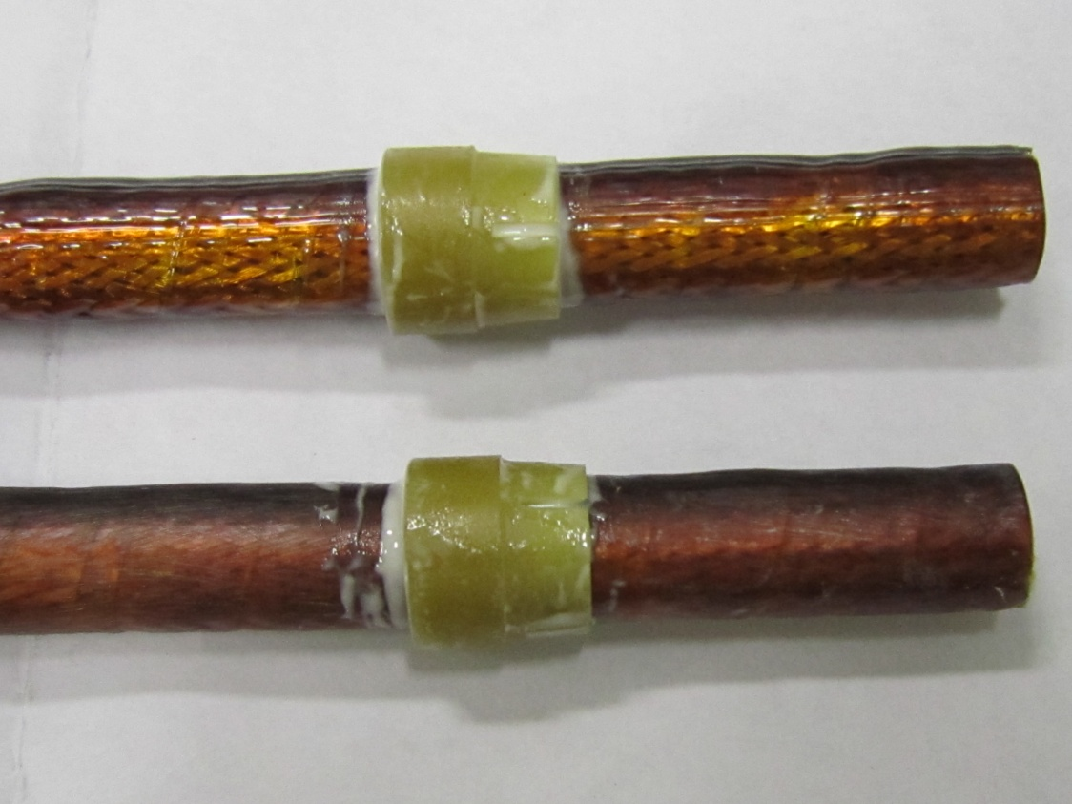
ITER : Plugs [Collaboration with ML section]
Study of cable / ULTEM interface
Study of ULTEM/ stainless steel interface
Adhesion tests
2 students involved
TE-MSC-CI

