Slide 1
High Voltage Plugs for feeders instrumentation lines
Jean-Philippe Tock on behalf of
A Bastard, S Clement, P Cruikshank, N Dalexandro, JB Deschamps, R Gauthier, A Grimaud*, A Jacquemod, C Jarrige*
+ Students, industrial partners
CERN
*Consortium Air Liquide Cryogenic Service / 40-30

Slide 2
Outline
Framework / CERN experience
Cables considered
Integrability of a multi-cable plugs (#15)
Cable porosity
Single cable plug
  Cable
  Design
  Manufacturing
  Tests
On-going and further work (for IO)
Conclusions

Slide 3
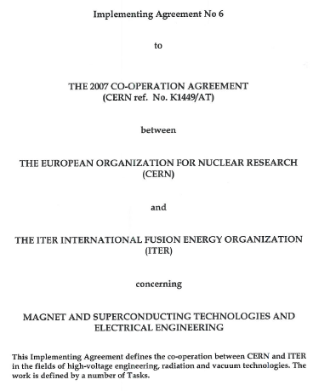
Framework
Implementing Agreement 6 (Jan-2010)
0.35 ppy
Implementing Agreement 9 (2011)
Task 6
0.5 ppy
Implementing Agreement 13 (2012) Task II.1
0.25 ppy
  Use CERN experience
  Total resources : 1.1 ppy equivalent
  (including material, industrial support, …)

Slide 4
Framework
Implementing Agreement 13 (2012) Task II.1
Part II Task 1:
Complete the laboratory development and tests of plugs meeting the IO requirements
Write up of the relevant test reports and technical specifications for the handing over to the installation teams. These technical specifications should also include the details for the assembly of plugs within the feeders general assembly strategy
Participation to meetings and reviews related to instrumentation and in particular to those where the general assembly strategy for feeders is discussed
General consultancy on vacuum separators and related composite matters

Slide 5
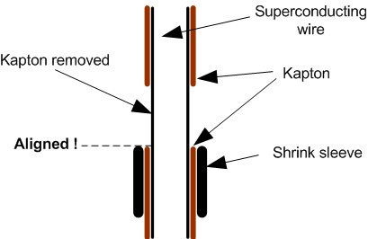
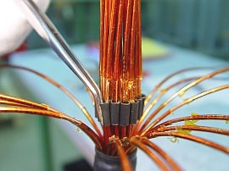

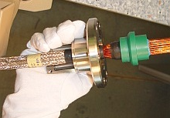
CERN experience
Line N plugs
600 A SC cables
Interface on the copper matrix

Slide 6
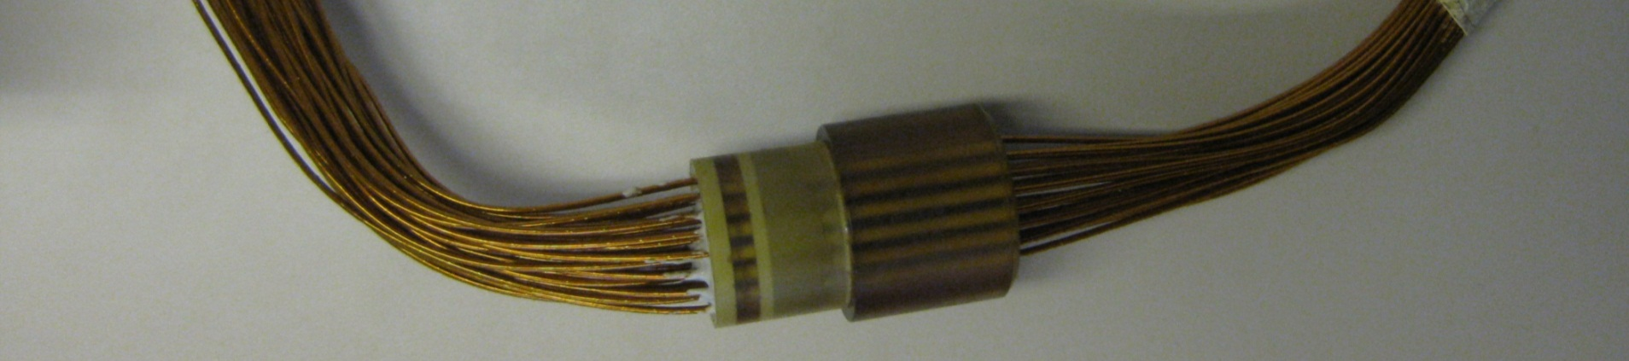
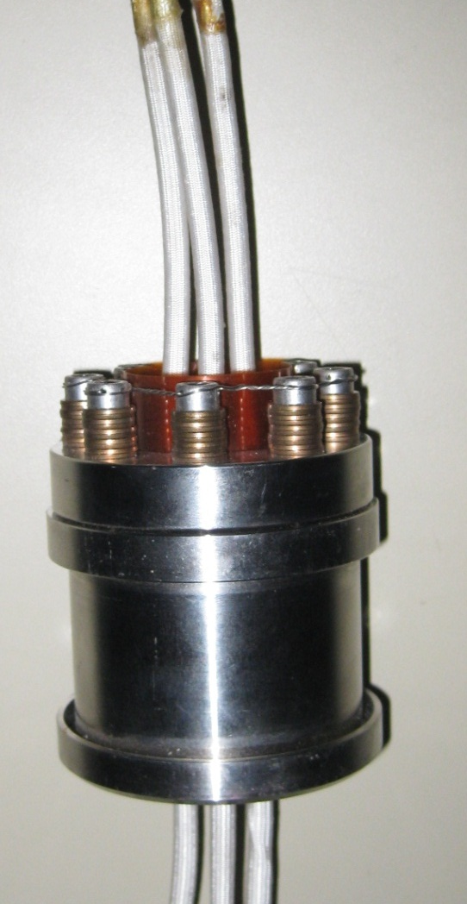
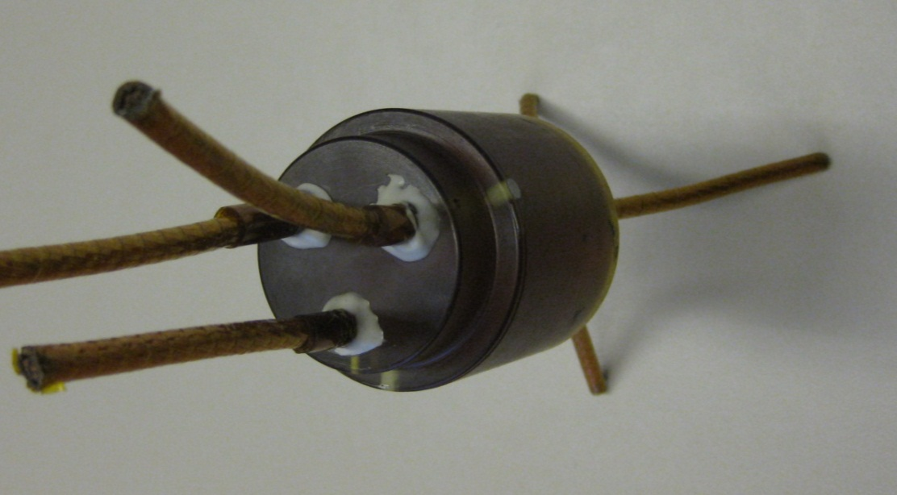
CERN experience
DFB lambda plates
Up to 6 kA SC cables
Interface on the copper matrix

Slide 7
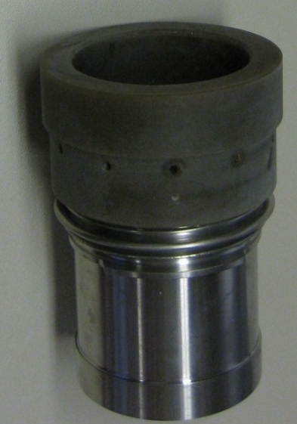
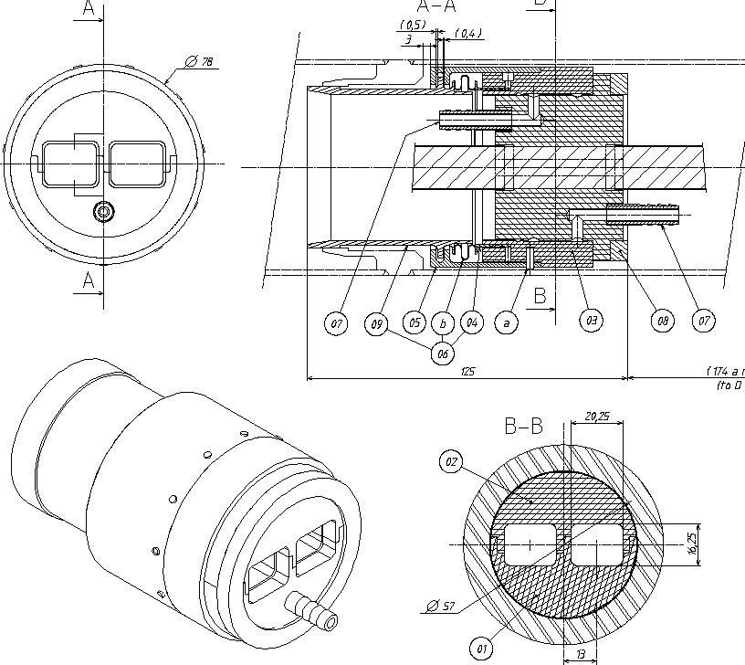
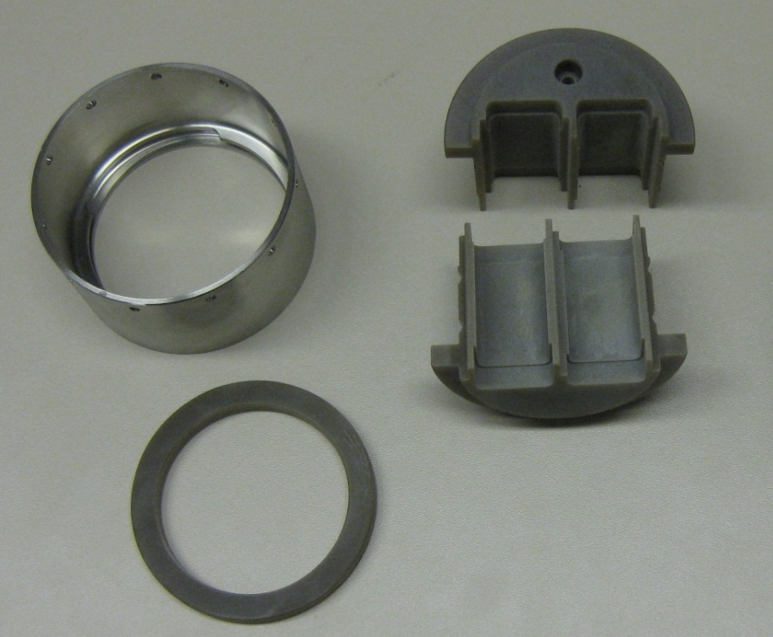
CERN experience
SSS busbars plug
13 kA SC cables
Interface on the copper stabiliser

Slide 8
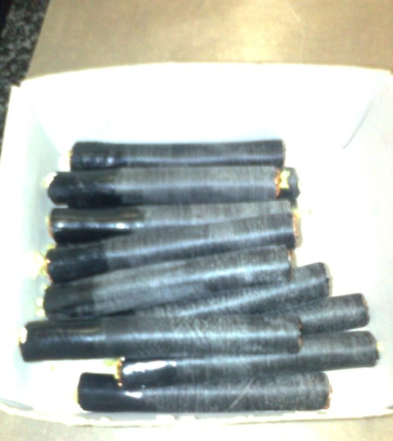
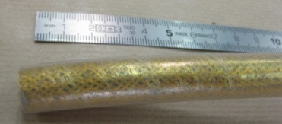
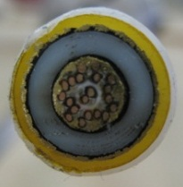
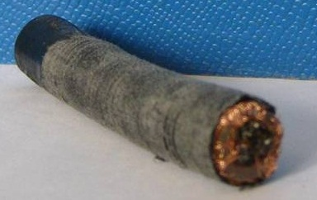
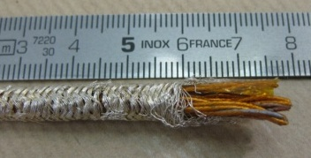
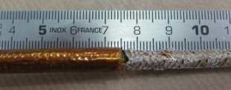
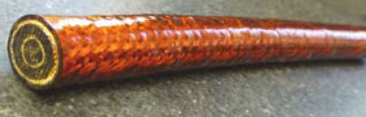
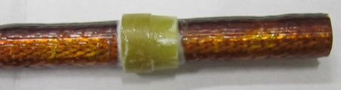
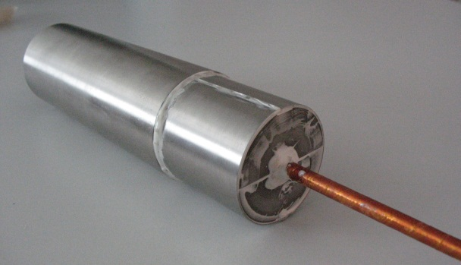
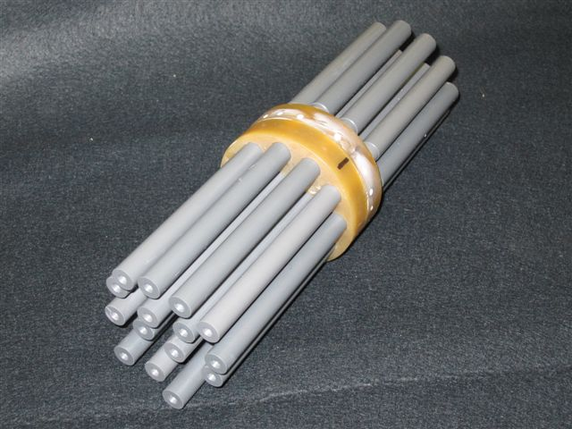
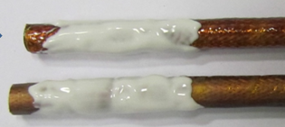
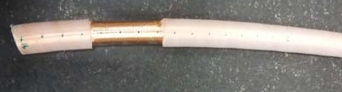
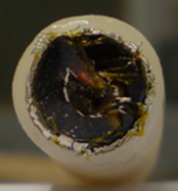
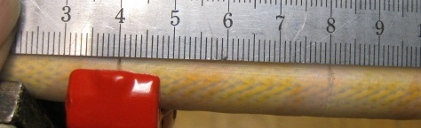
Cables considered
2010 :
Not final ones but similar to start the work
2011 : XL-PE
For 15 cables prototype
2010-11 :
For initial design of single cable plug
2010-11 :
PVC rods For 15 cables mock-up
2012 :XL-PE
For single cable final prototypes (Feb-12) - Last cable (summer 12)

Slide 9
Integration of a 15-cables plug
Principle
Clamps replaced by bolts to save radial space
Metal seals

Slide 10
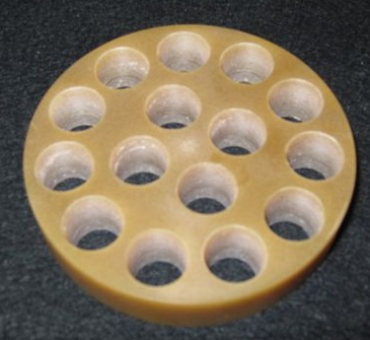
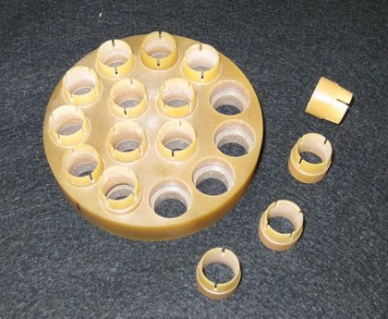
Integration of a 15-cables plug
Cable diameter: 12 mm / Pipe diameter 80 mm
With PVC rods to check concept and integration

Slide 11
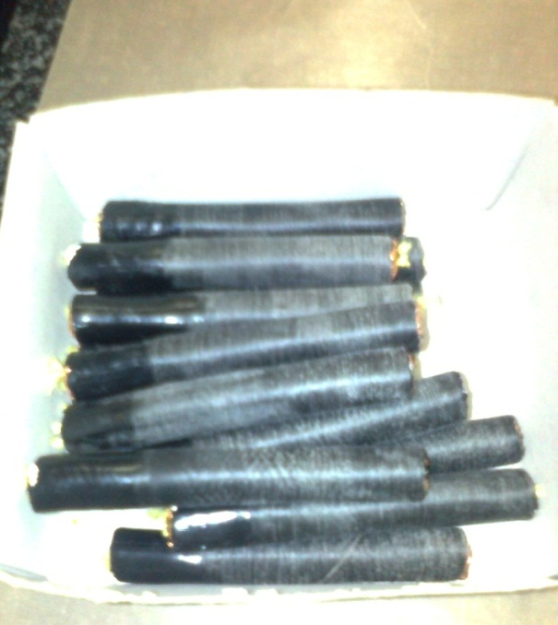
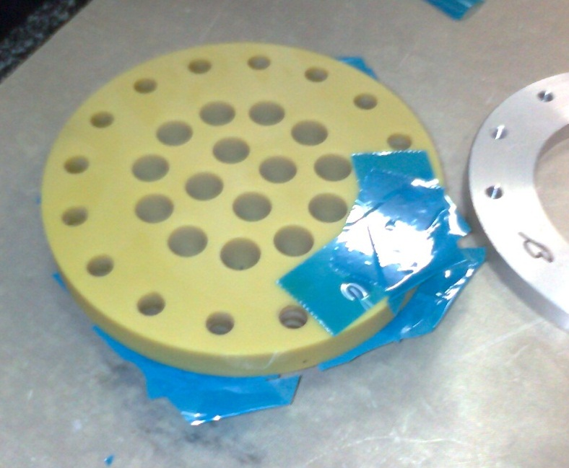
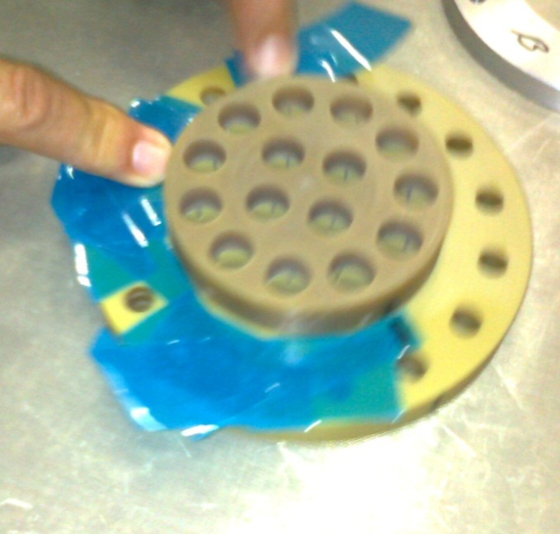
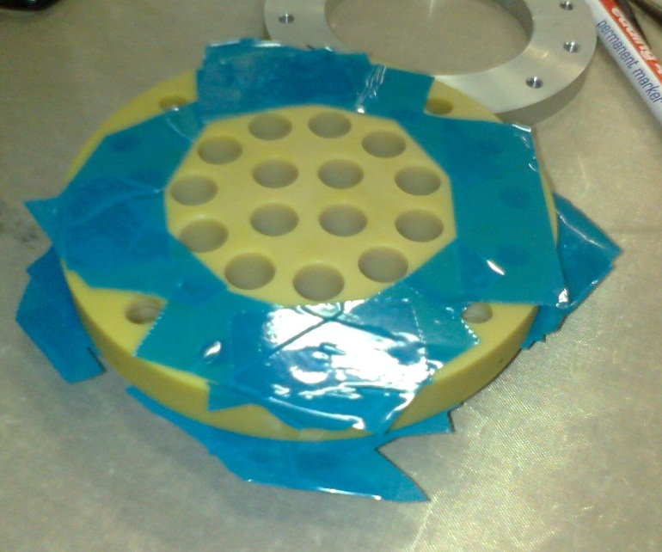
Assembly of first prototype (1/5)
Specific cables were prepared
sanding and diameter reduction
Protection of sealing surfaces

Slide 12
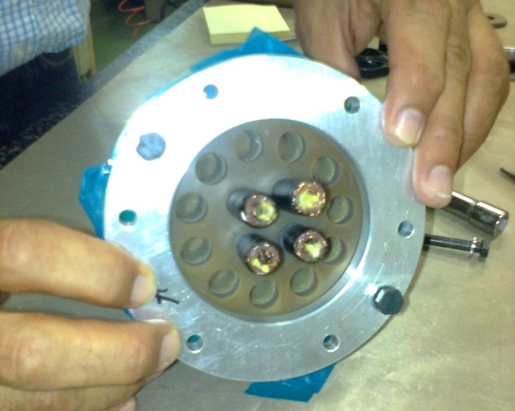
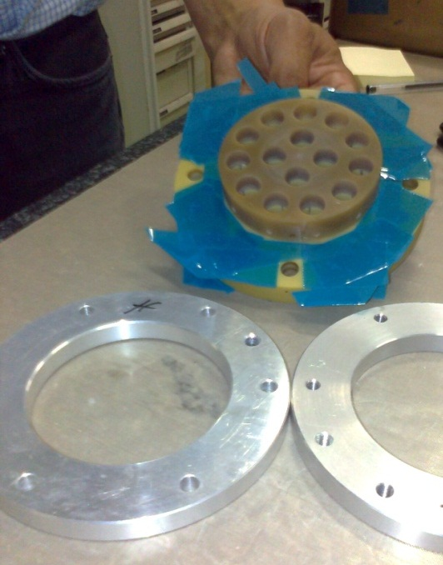
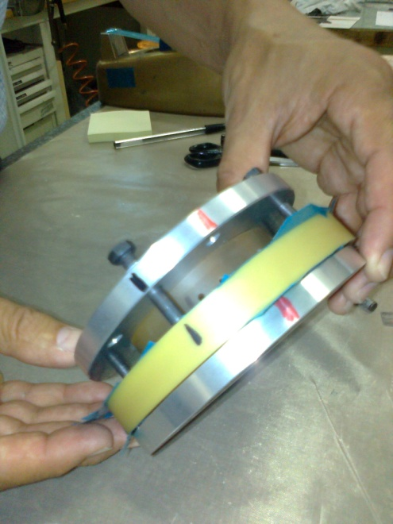
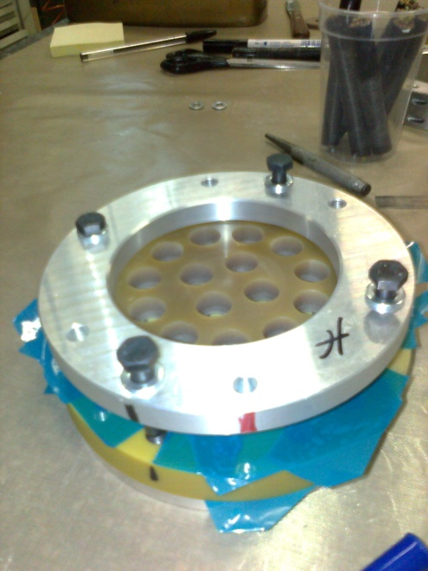
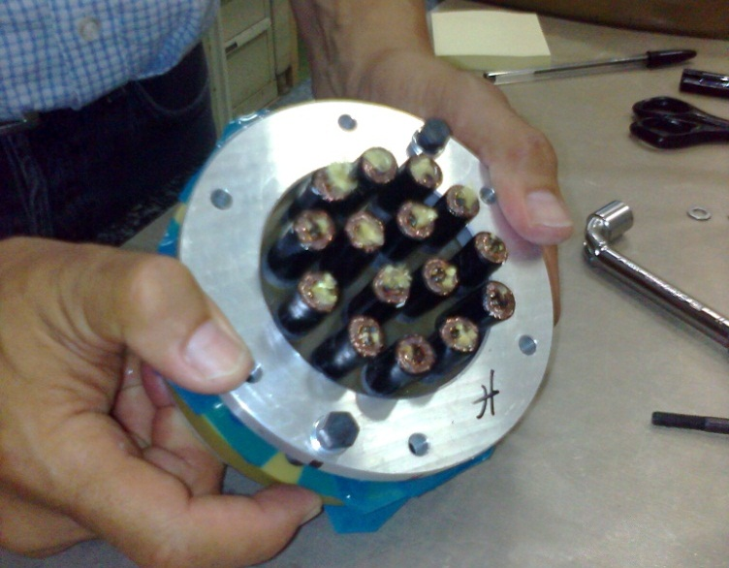
Assembly of first prototype (2/5)
Insertion in compression tooling
Installation of the cables samples
For in-situ assembly, tooling will have to be done in 2 halves (half shells)
In-situ installation along the cable length (5-10 m.) will be more tricky

Slide 13
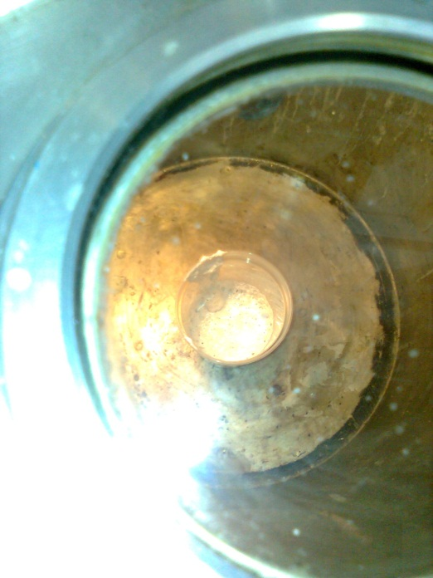
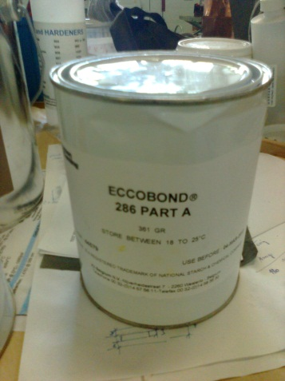
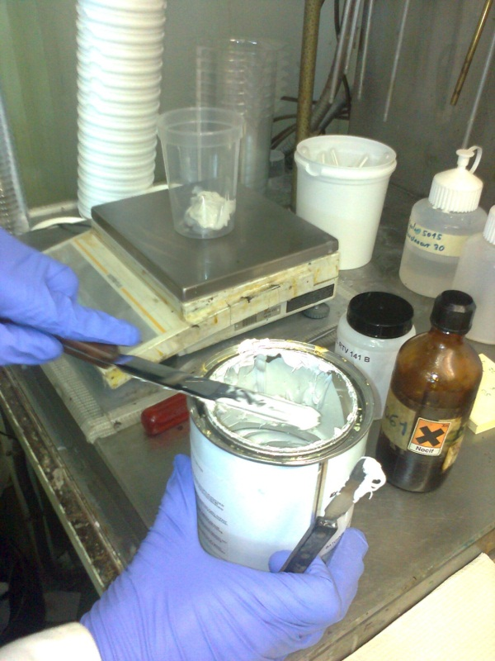
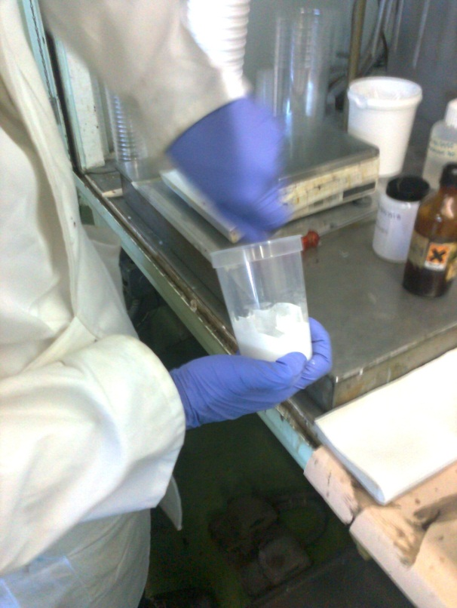
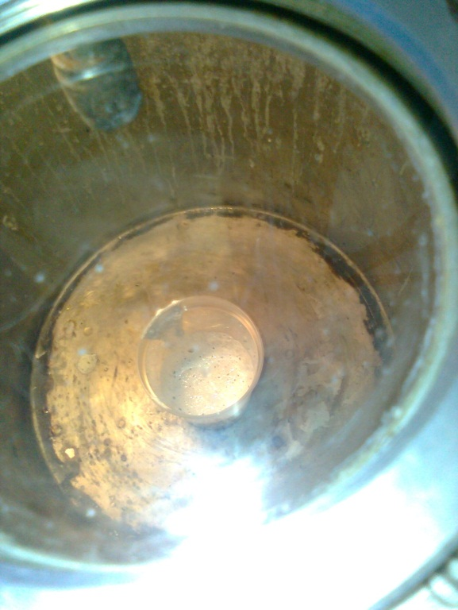
Assembly of first prototype (3/5)
Preparation of the glue
Vacuum treatment to remove air bubbles
Delicate activity ; specific in-situ procedures and tooling will have to be developed and qualified

Slide 14
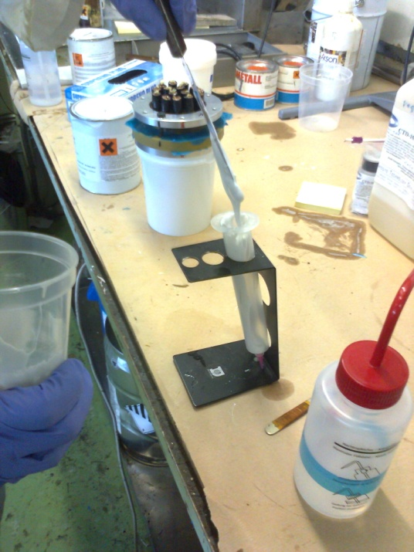
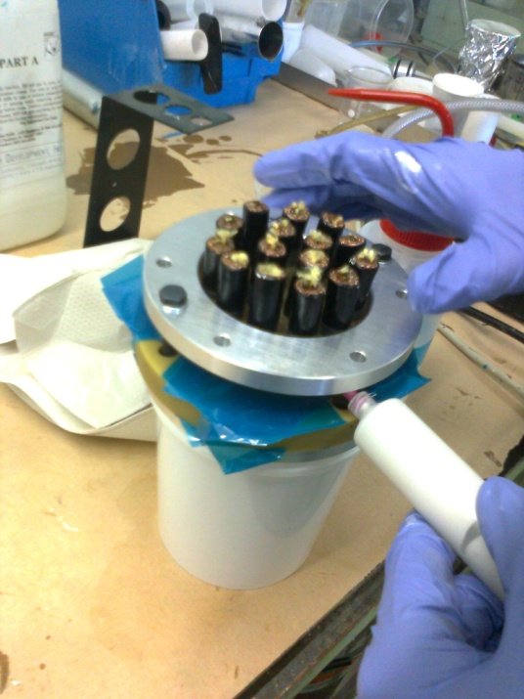
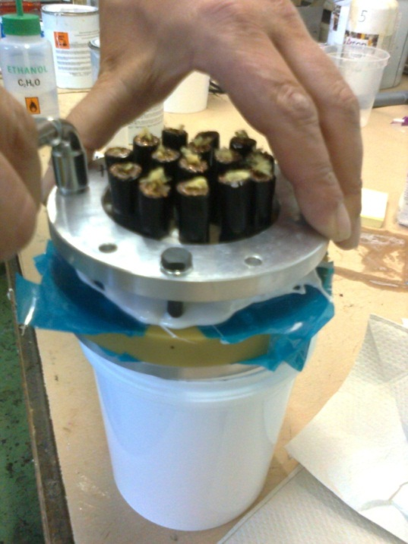
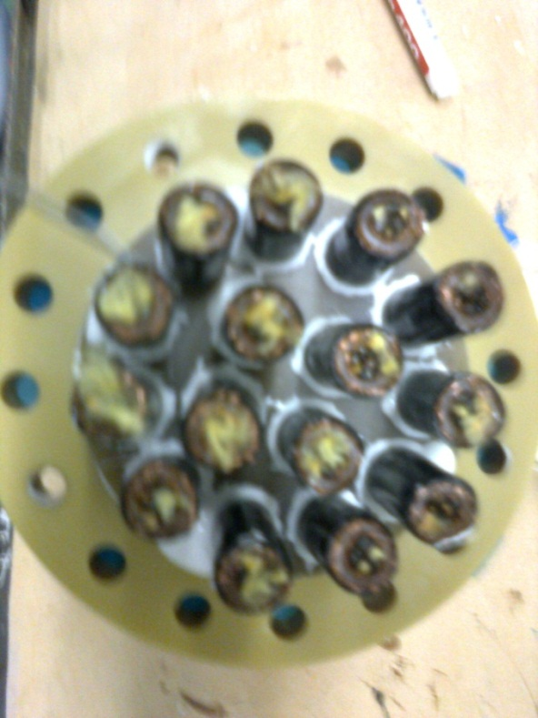
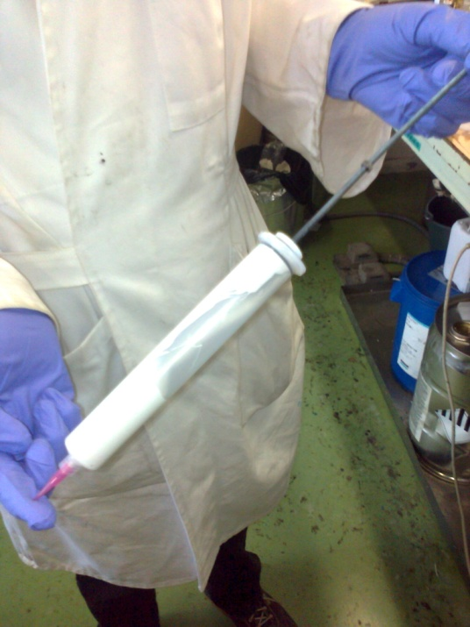
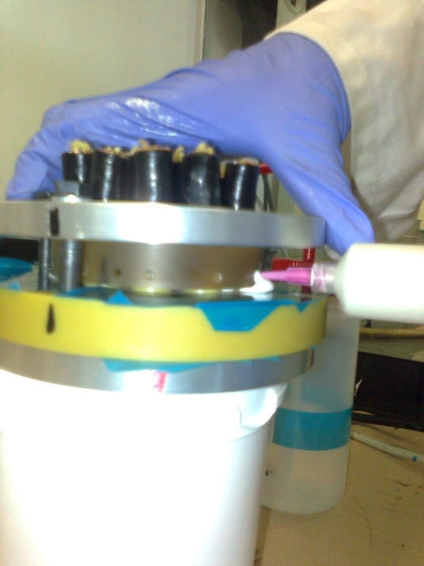
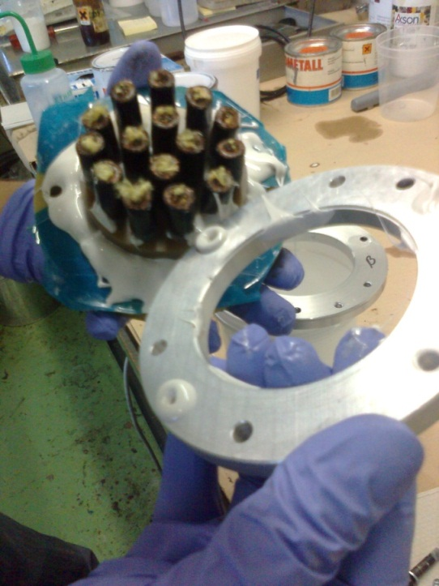
Assembly of first prototype (4/5)
Glue injection
Compression tooling
Specific in-situ procedures and tooling will have to be developed and qualified
Torque to be controlled

Slide 15
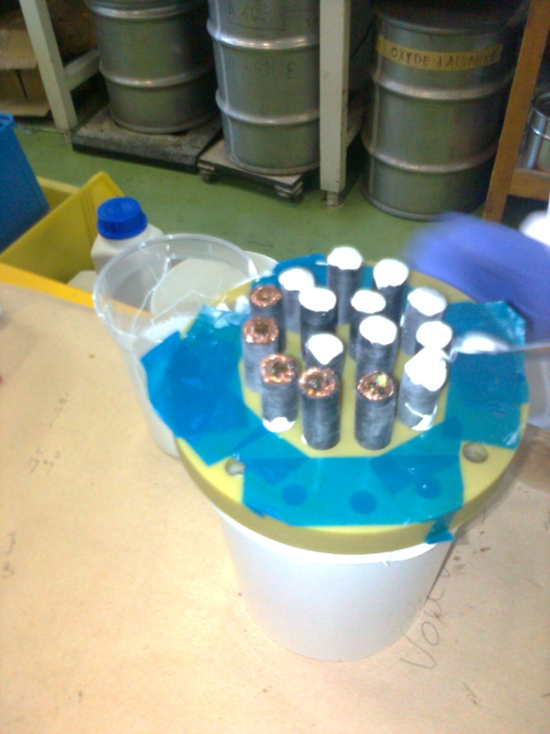
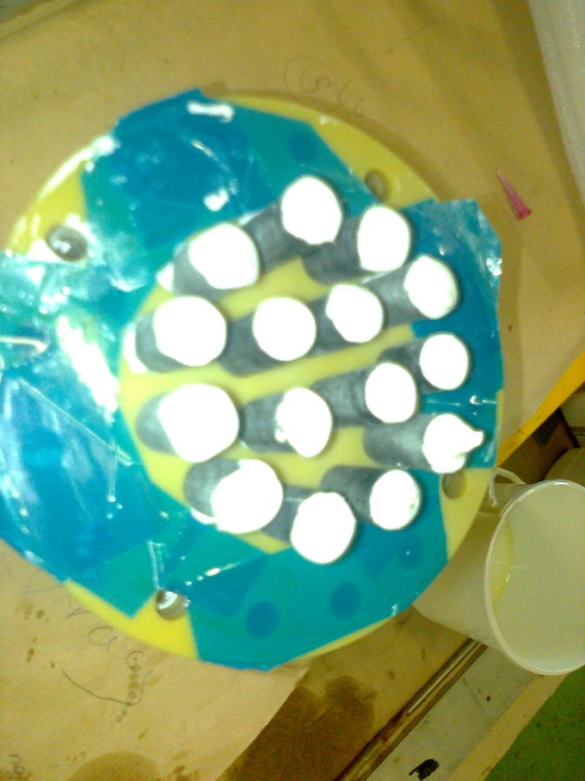
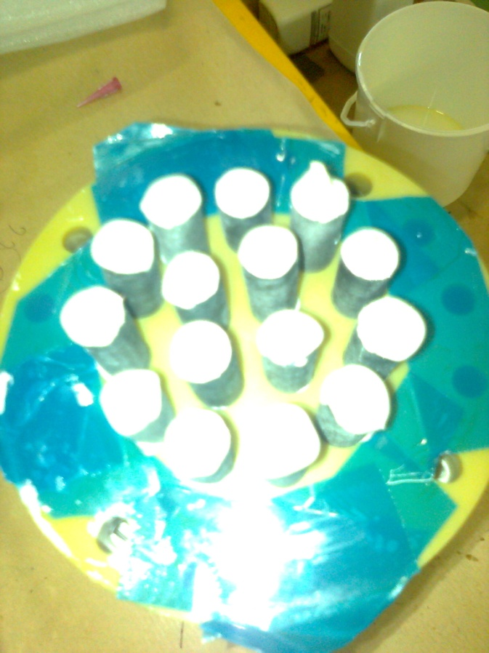
Assembly of first prototype (5/5)
Capping of the cables
Not to be done for installation in ITER because cables extremities are equipped with leak tight connectors

Slide 16

Leak test of first prototype
Revealed several leaks:
  error on the leak test setup (stainless steel flange re-machined)
  sealing surface of the ULTEM piece deformed (corrected/elastomer seal instead of a metal one)
  glue caps leaking (reinforced)
  plugs interfaces (remachined, sand blasting and redone)
After correction of the leaks, the repeated test identified the cable itself as a source of leak (porous outer layer) [See next slide]
  Used VACSEAL to make it leak tight but no improvement
Complete encapsulation of one side with ECCOBOND
  Leak tight ! But not conclusive ! for the plug tightness
  This mainly proves that test setup is working well
It is possible to integrate 15 12-mm cables in a diameter of 80 mm

Slide 17



Cable porosity
Cable is porous = Helium permeable (XL-PE of AXON)
Bidirectional tests
Q = (K.P.A)/t
where: K = permeability,
P = pressure difference,
A= surface,
t = thickness
K = 8 10⁻¹¹ mbar l cm/cm² mbar [Aurum]
Q = 3.4 10⁻⁴ mbar l/s m
For XL-PE: Estimate of 5 10⁻⁵ mbar l/s m (large uncertainty)
Compatible with ITER operating scenarios

Slide 18





Single cable plug : The cable
XL-PE (AXON)
Metrological measurement
Adhesion tests
  Room temperature
  After LN2 shocks
Average diameter : ≈ 12 mm
Max = 12.57 mm / min =11.53 mm

Slide 19







Single cable plug : Design
ULTEM :Polyetherimide (PEI) Used at CERN and qualified
Eccobond 286A
Sanded and stripped

Slide 20




Single cable plug : Manufacturing
Cable stripping
Original goal was to save on diameter (Not useful with new design)
Provides mechanical fixation
Due to porosity of the outside layer, provides better sealing (see results of cut later)
Procedure and criteria have been defined
  Thermal stripper / Pictures for acceptance criteria

Slide 21


Single cable plug : Manufacturing
Cable preparation

Slide 22


Single cable plug : Manufacturing
Cable preparation

Slide 23


Single cable plug : Manufacturing
Plug assembly

Slide 24


Single cable plug : Manufacturing
Procedure
Single cable plug procedure defined by CERN
Adapted by IO for prototype plugs

Slide 25
Single cable plug : Prototypes
 | Sanded | Stripped
Time | J | K
Cost | J | K
In-situ assembly | J | K
Mech fixation | K | J
Leak rate | K | J
Reproducibility | ? | ?
Stripped variant is preferred for better leak tightness
The in-situ assembly procedure will be delicate
Matrix thickness does not influence performance
Recommend to develop mock-ups and train the technicians

Slide 26




Single cable plug : Prototypes
Force Controlled Assembly

Slide 27


Leak test results (1/2)
At manufacturing, all plugs < 10⁻⁵ mbar l/s
Degradation occurs in the first (two cycles)

Slide 28

Leak test results (2/2)
Stripped plugs are performing better than sanded ones
After 2 cycles, the leak rates are stable within a decade
(Demonstrated from 10-5 to 10-1 mbar l/s)
Updated 10.12.2012

Slide 29




PLUGS OBSERVATIONS AFTER CUTTING
Objective: Cutting plugs to observe the glue distribution between the jacket, the inserts and the Ultem matrix.
Procedure: Plugs are cut using a slitting saw then observations are carried out with a Leica microscope in the materials laboratory
Plug 2P
Microscopic observations
Ultem-Ultem interface seems to be free of defect
Important thickness variation of the outer jacket

Slide 30





Plug 2D
PLUGS OBSERVATIONS AFTER CUTTING
There is an important thickness variation of the outer jacket (x2), generating a thickness variation of glue around the braid
All the space between the insert and the cable is completely filled with glue
Some glue is also entered into the braid under the outer jacket (migration of the excess glue during the mounting of the plug)
The braid is perfectly immersed into the glue

Slide 31


X-ray
Radiography was tried as an inspection method (QA) but not conclusive for gluing, could be to check the shielding state

Slide 32




Last CERN activities
3D model of a 15 cables plug
Basic test on the last cable (OK)

Slide 33


Work performed by IO
Adaptation of procedure to multi-cable plug
Adaptation to the final HV instrumentation cable

Slide 34
Further work for IO
Technology transfer to an industrial company
  Strict qualification procedure
  Assembly procedure adapted to in-situ assembly
  Representative mock-ups
  Selection of the contractor based on qualification criteria
  Training
Definition of repair and disassembly procedures
Contracts follow-up

Slide 35
Conclusions
All tasks defined in the agreement have been achieved
A procedure was defined and validated for a single cable plug
  Extra work is required to adapt it to:
    In-situ assembly
    Final cable
    2-7-8 cables
  Disassembly and repair procedures are recommended
  (Spare cables to be included if possible)
The single cable plug prototypes (#6) performance is compatible with the ITER operation scenarios

Slide 36
Thank you for your attention and for the open and fruitful working atmosphere during this collaboration, key to achieve the results presented here

Slide 37
Back-up slides

Slide 38
Back-up slides
Previous versions

Slide 39




Single cable plug : Leak tests
Two test methods: Why is it different?
The best result is representative

Slide 40
Back-up slides
Simplified scheme

Slide 41
Back-up slides
Start adding text here
  First sub-point
    Second subpoint
      Third subpoint
        Fourth subpoint

Slide 42
Start adding text here
  First sub-point
    Second subpoint
      Third subpoint
        Fourth subpoint

