Slide 1
HFM Test Station
Main Cryostat
Arnaud Vande Craen (TE-MSC)
TE-MSC-CMI – Section Meeting 19/02/2013

Slide 2
Summary
Introduction
Concept
Design

Slide 3
Introduction

Slide 4
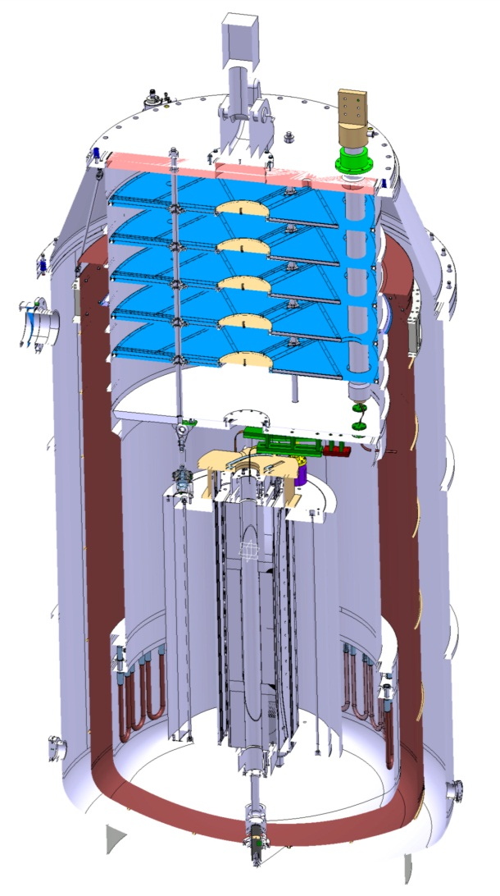
What ?
High Field Magnet Test Station
Vertical Cryostat
Temperature : 1.9 K
Maximum pressure : 5 bar
As much polyvalent as possible

Slide 5
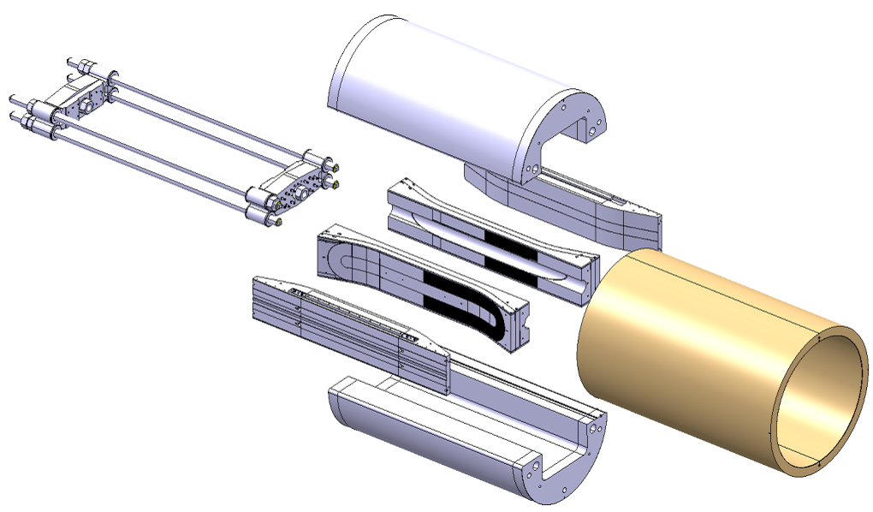
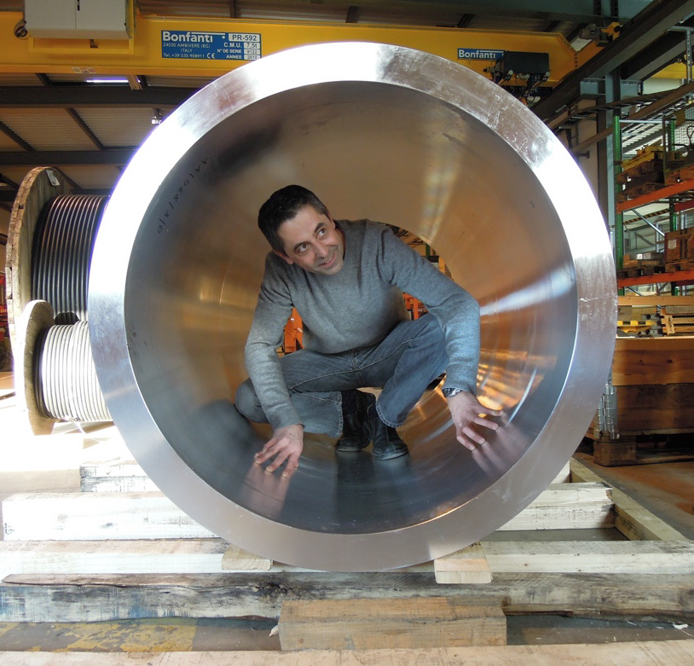
Why ?

Slide 6
Why ? (2)
FRESCA 2 Magnet
  Up to
    2.5 m long
    1.5 m diameter
    8 tons
  Nb₃Sn strands
  Maximum current : 20 kA
  Maximum field : 13 T
    (LHC ≈ 8.3T)

Slide 7
Why ? (3)
Large cryostat for magnet test
  Polyvalent
    FRESCA 2 (CERN)
    HTS dipole insert (CERN)
    LD1 (Berkeley)
  Temperature control (cool down)
    Magnet sensitive to strain
  Maximum current test
  Field analysis (future)
  Quench
    Protection
    Detection
    Analysis

Slide 8
How ?
Main cryostat
  Magnet cool down
  Magnet powering
Valve box
  Cryogenic control
Cold buffer
  Store helium in case of quench
2 power supply
  Main magnet (20 kA)
  Insert magnet (10 kA)

Slide 9
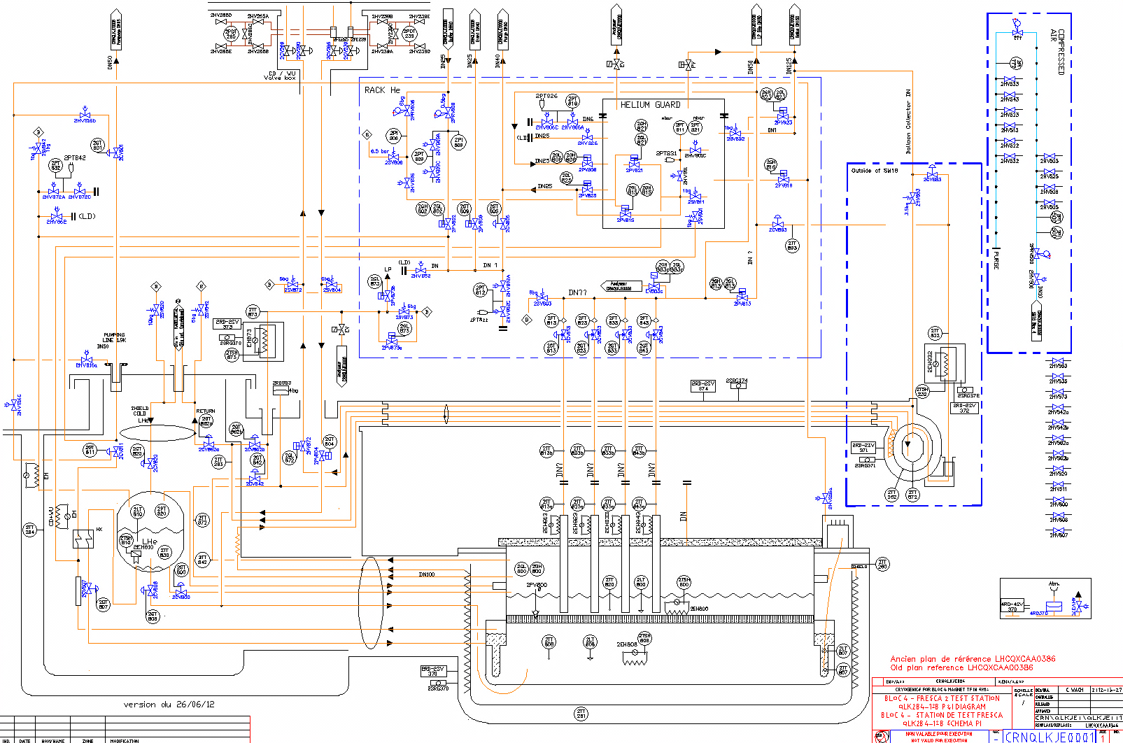
How ? (2)
Cold buffer
Main cryostat
Valve box

Slide 10
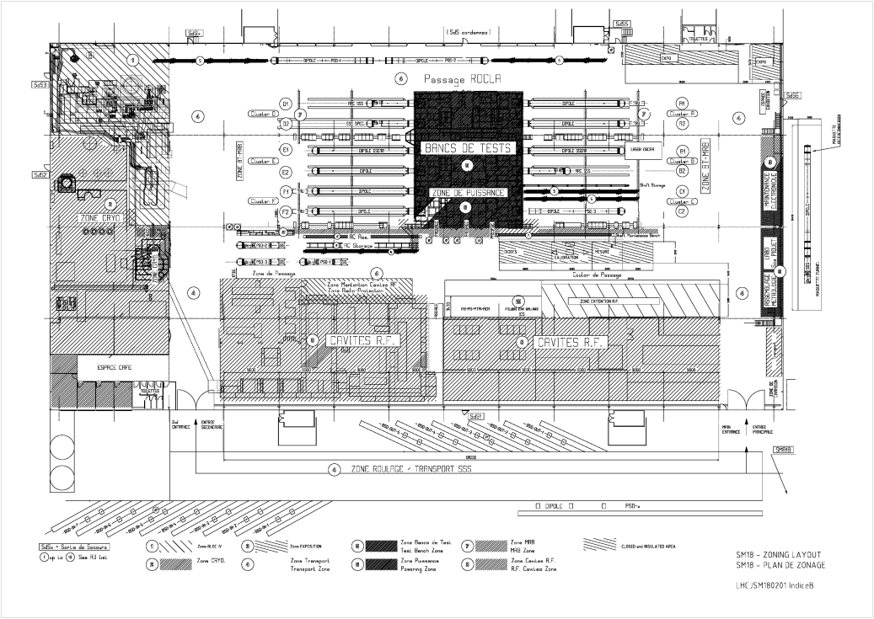
Where ? (1)
Vertical test benches
Horizontal test benches

Slide 11
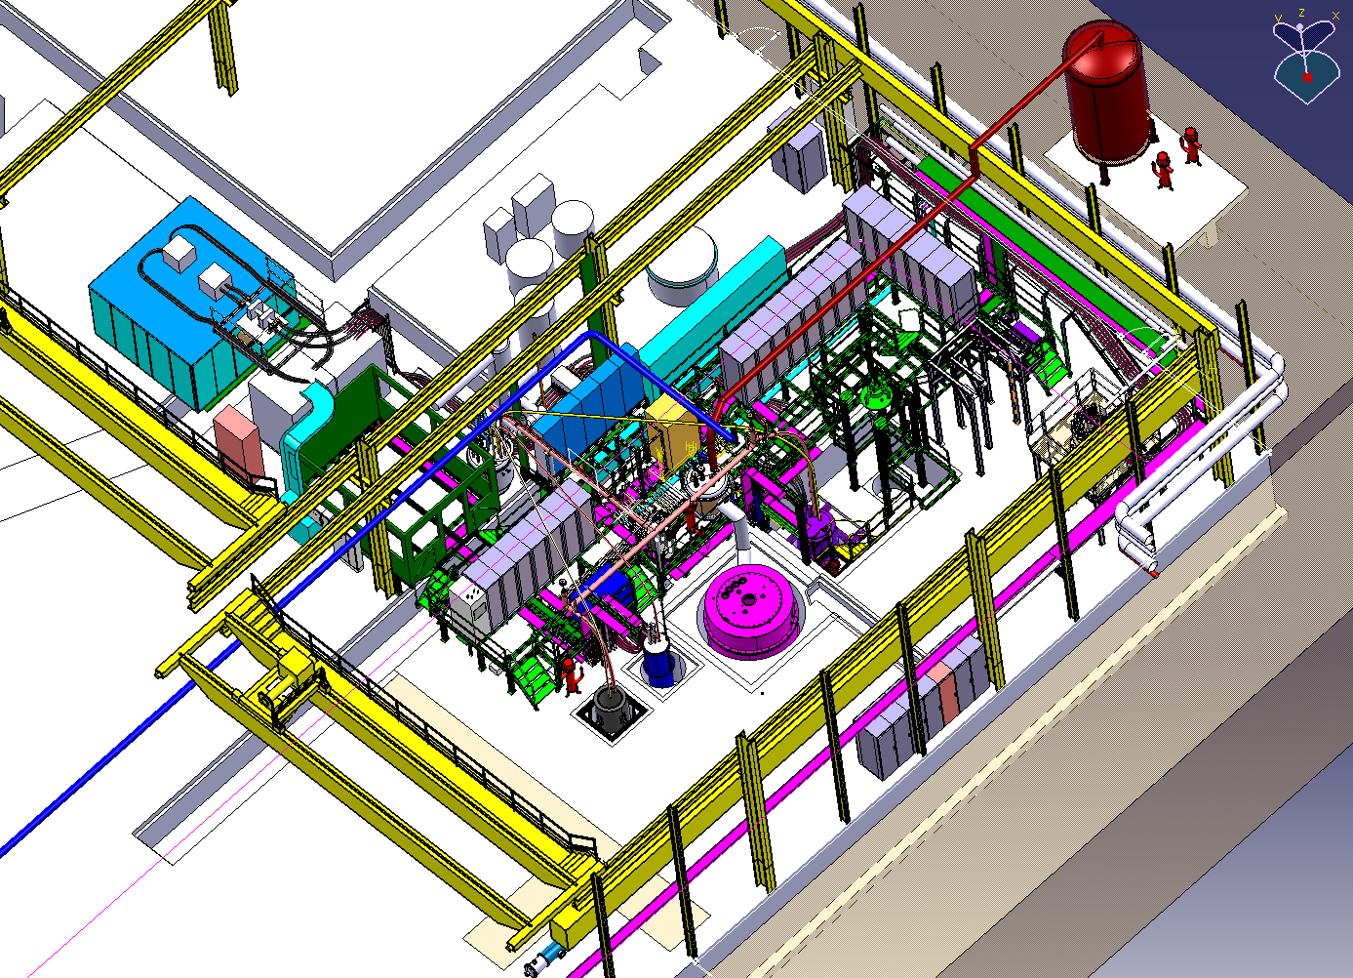
Where ? (2)
Cold buffer
20 kA power Converter
Dump Resistor
Cryogenic Control
Cryogenic rack
Control Room
Valve box
Pumping line
HFM cryostat
10 kA power Converter
Installed

Slide 12
Concept

Slide 13
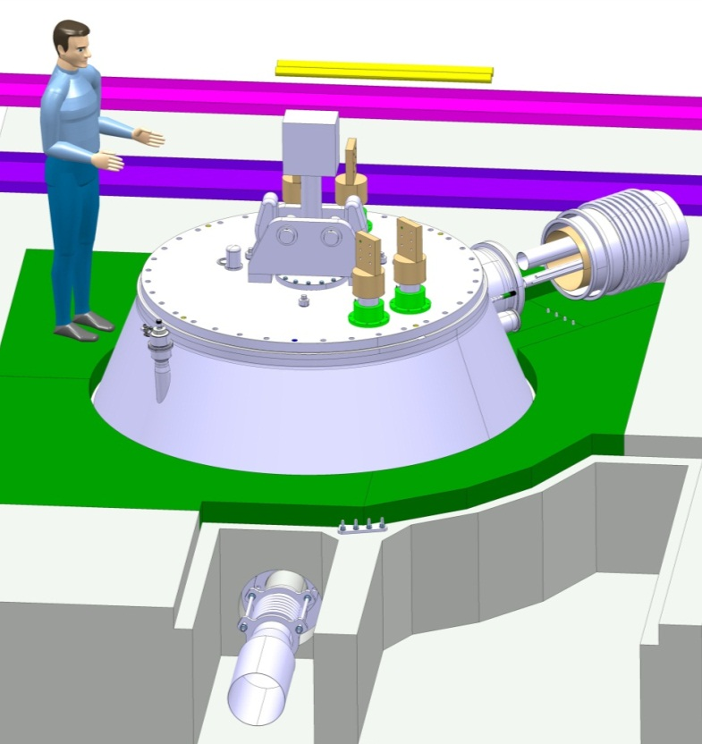
Philosophy
Vertical test station
  Easy magnet insertion
  Easy electrical connection
    Current leads
    Instrumentation
  Limit cryogenic connections during magnet insertion
  No dedicated helium vessel for magnet

Slide 14
Principle
Claudet bath
  Helium @ 1 bar
    4.2 K – 300 K
    1.9 K (controlled)
  Helium @ 16 mbar
    1.8 K

Slide 15
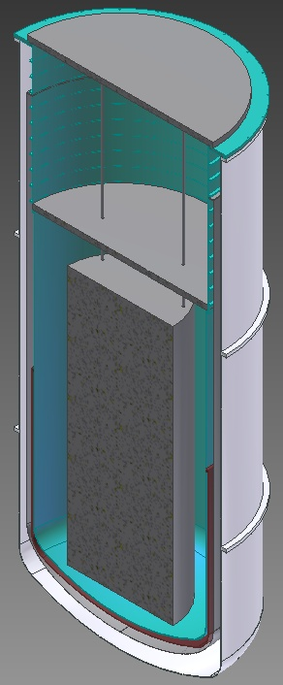
Concept (1)
1
Neck
Lambda plate
Lower volume
Heat exchanger
2
3
4

Slide 16
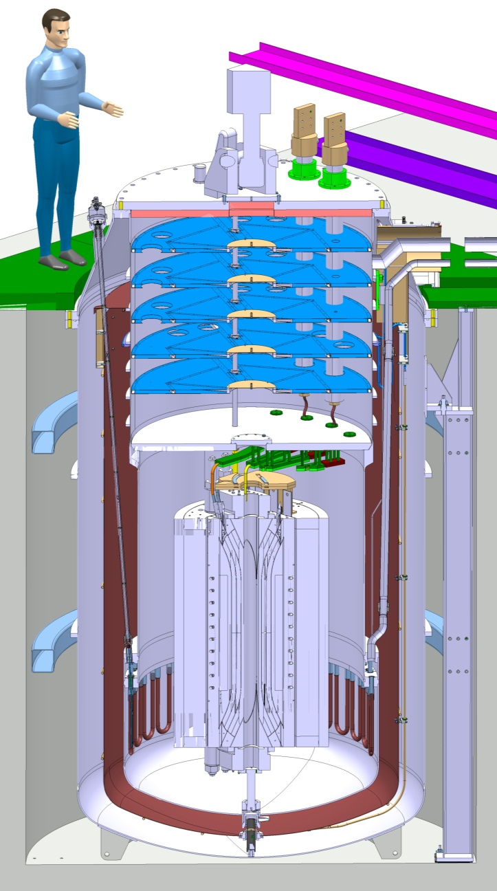
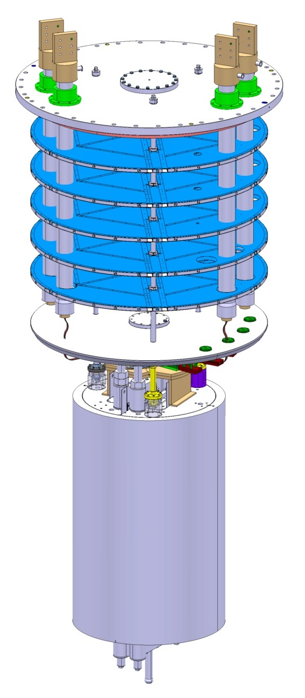
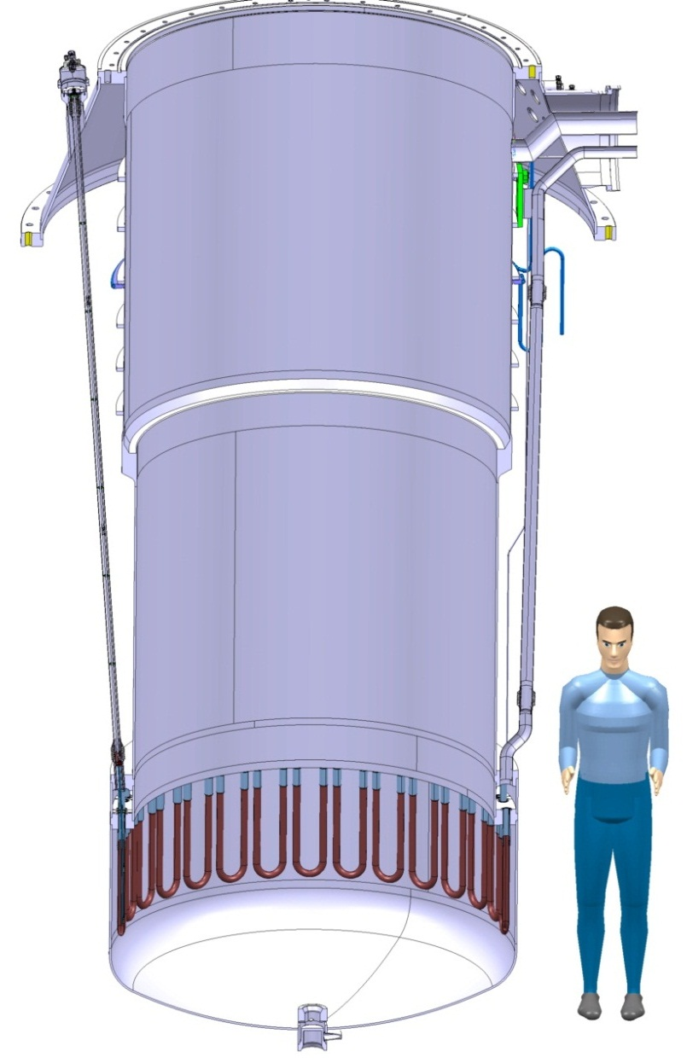
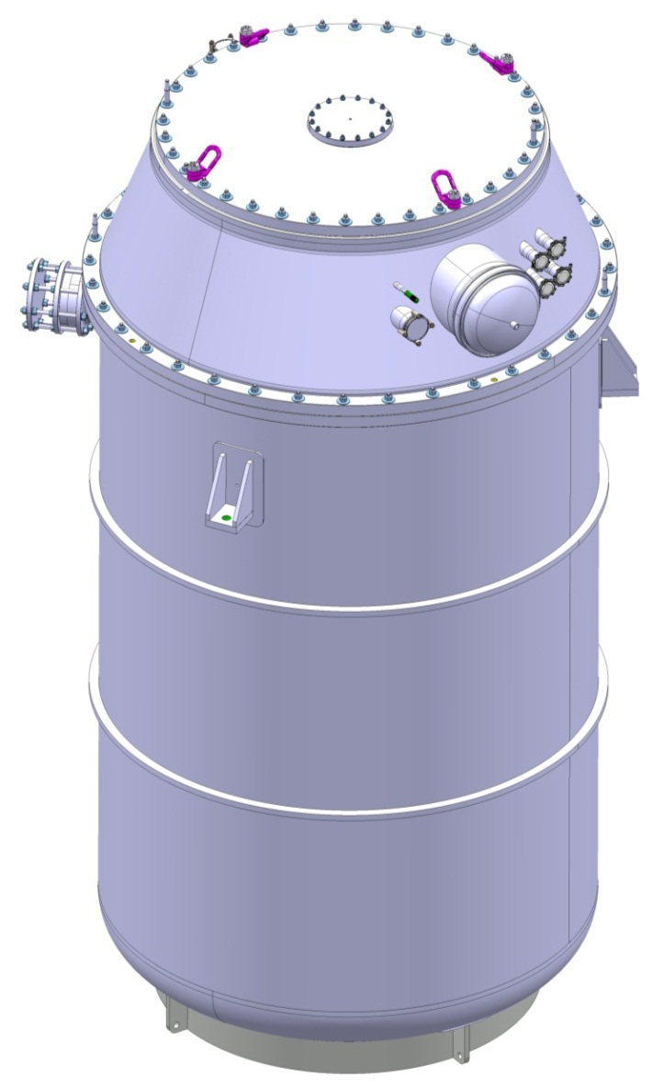
Concept (2)
Vacuum vessel
  Supported by brackets
Helium vessel
  Hanging to top cover
Magnet
  Hanging to lambda plate
Lambda plate
  Hanging to top plate
Top plate
  Fixed to top cover

Slide 17
Design

Slide 18

Vacuum vessel
Dimensions
  4.6 m height
  2.3 m diameter
  4.8 tons
Stainless steel (304L)
Conical cover
3 supports
Static vacuum

Slide 19
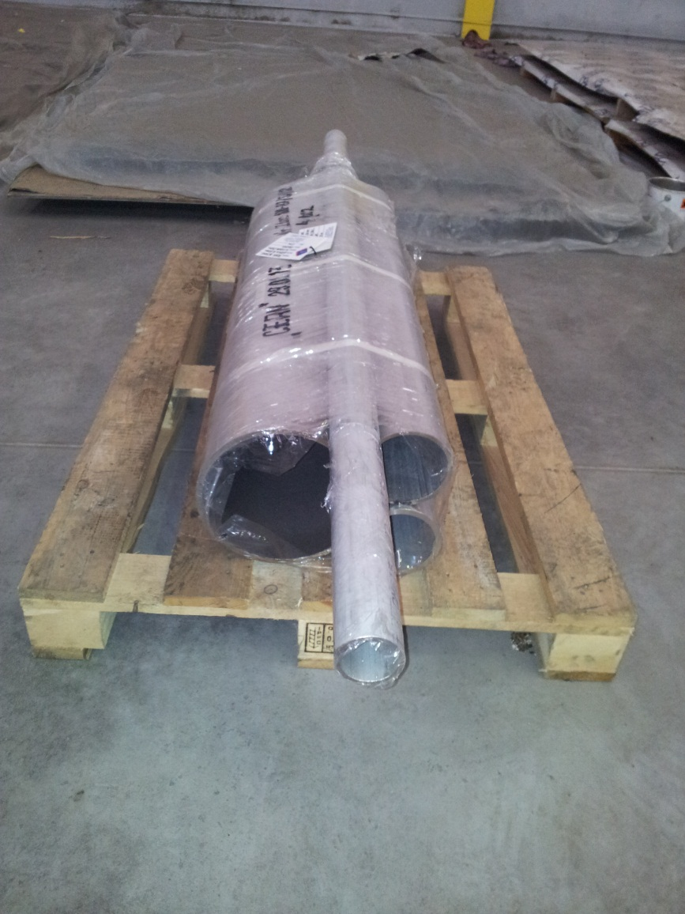
Vacuum vessel (2)
Conical cover
  Support magnet weight
  Limit deformation
Vacuum vessel protection
  Burst disk (DN200)
  Exhaust line (DN300)
Jumper
  Connection to valve box
  Regroup all cryogenic lines

Slide 20
Helium vessel
Neck
  3 mm thick
  1.6 m diameter
  1.6 m long
  Thermalisation (limit heat in leak)
Lower volume
  6 mm thick
  1.5 m diameter
  2.5 m long
Max pressure : 5 bar
300K
4.2K
1.9K

Slide 21
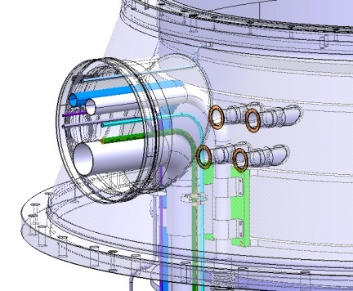
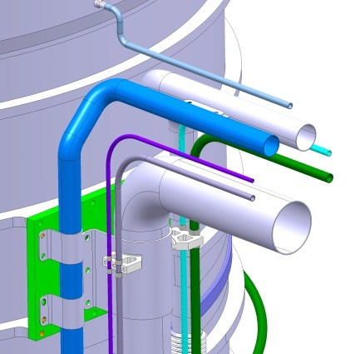
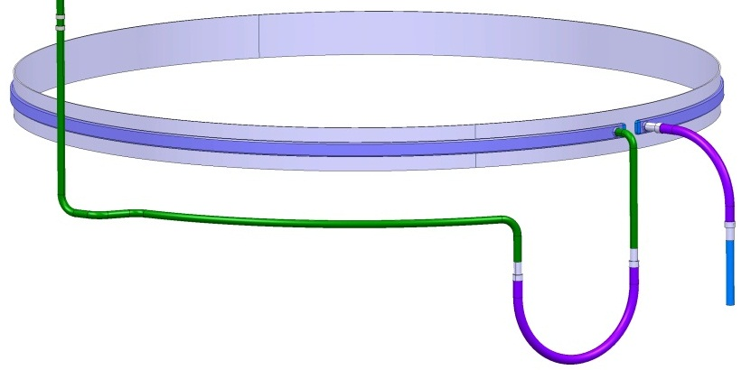
Helium vessel (2)
Jumper
  Regroup all lines
Fixed point
  Avoid lines movement
Thermalisation
  Welded ?
  Brazed ?

Slide 22
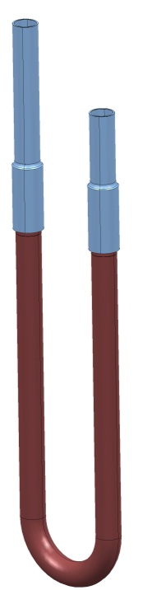
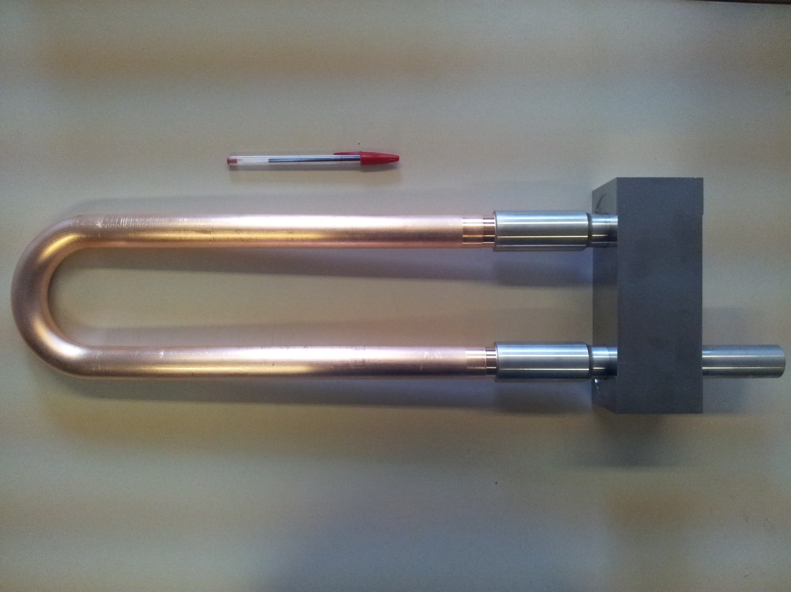
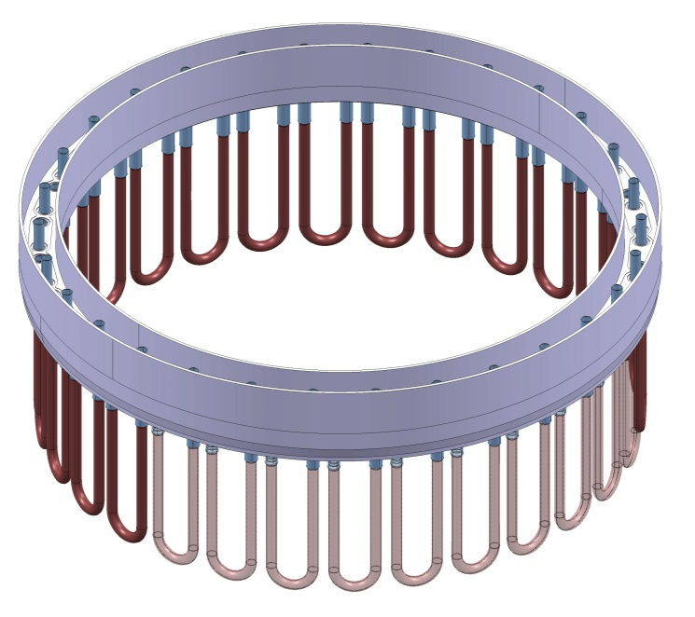
Helium vessel (3)
Heat exchanger
  Copper tube brazed to stainless steel tube
  U shape welded to flange (30 x)
  Closed box to pump
  Cooling power ≈ 100 W @ 1.9K
    (1.5 day Cool-Down)

Slide 23
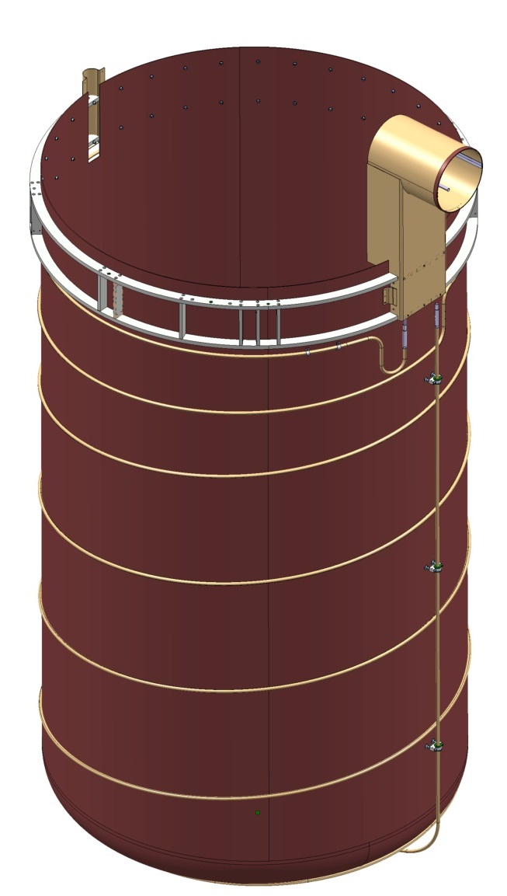
Thermal shield
Actively cooled
Supported from top cover
Stainless steel structure
Copper
  Sheet
  Pipe brazed

Slide 24
Insert
Top plate
  Current leads (20 kA & 10 kA)
  Instrumentation
Radiative screens
  Limit heat in leak
Lambda plate (50 mm thick)
  Stainless steel
  Lambda valve
  Splices
  Instrumentation
Mechanical support
  Lambda plate to top plate
  Magnet (15 tons) to lambda plate

