Slide 1
TE/MSC/CMI Section meeting
Guidelines for mechanical design and fabrication of cryostats
Conformity with pressure regulations
May 21, 2013
by D. Ramos

Slide 2
Scope and Outline
Why are cryostats bound to regulations and their implications
Designing and checking the design
Specifying the right material
Welding specification, qualifications and inspection
Fabrication tolerances
Cleaning and packaging
Leak testing
Pressure testing

Slide 3
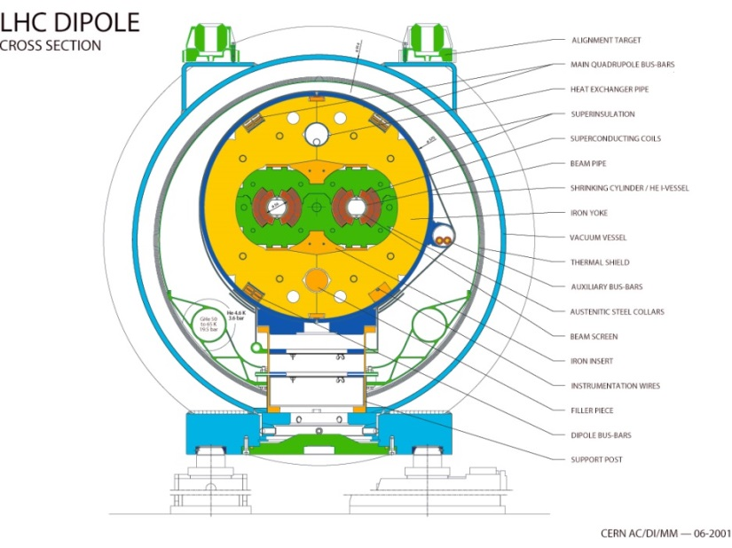
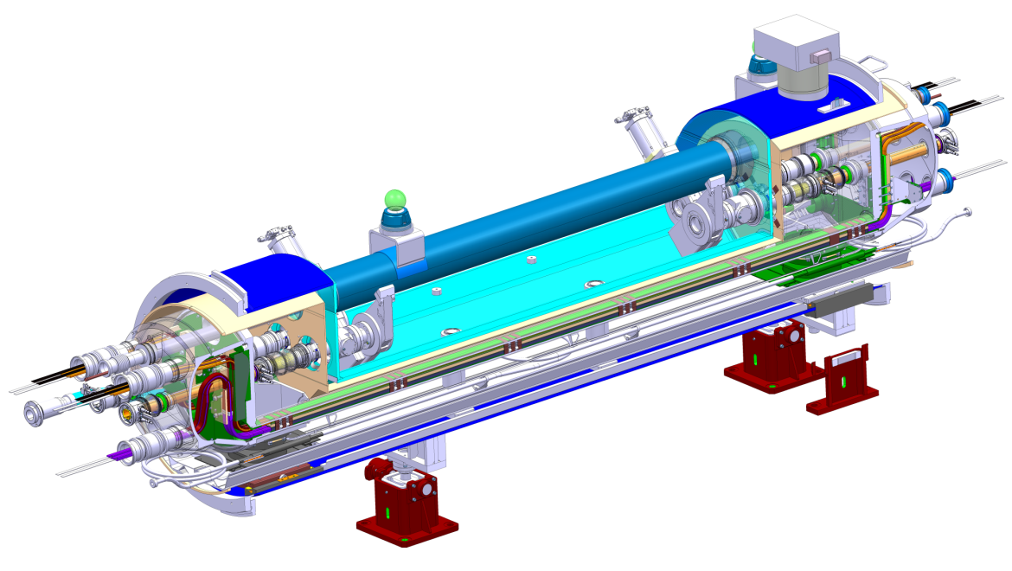
What are we talking about: Vacuum insulated vessels
Cryostats for accelerators often determined by deformation and not strenght, nevertheless regulations apply anyway…

Slide 4
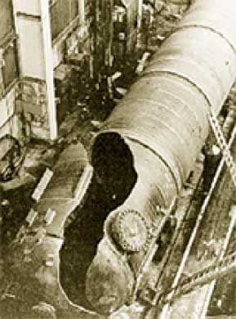
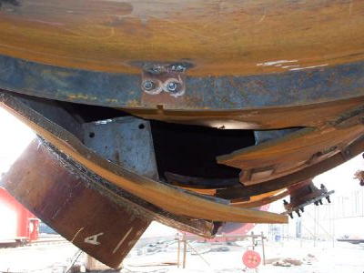
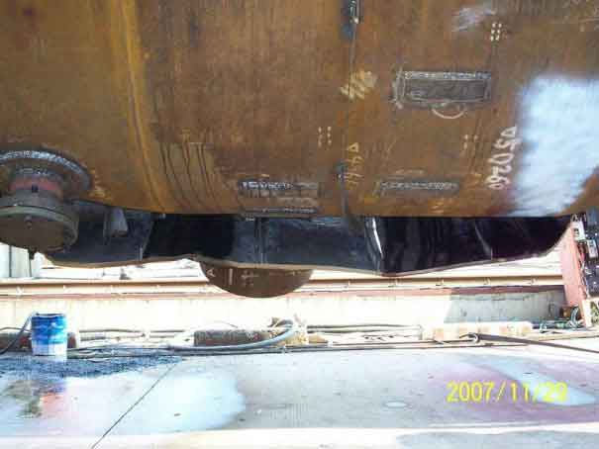
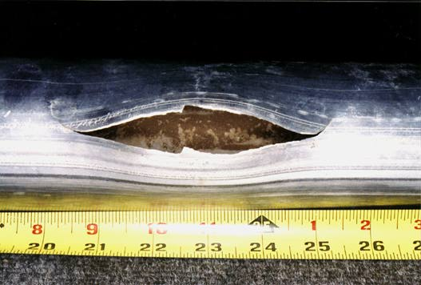
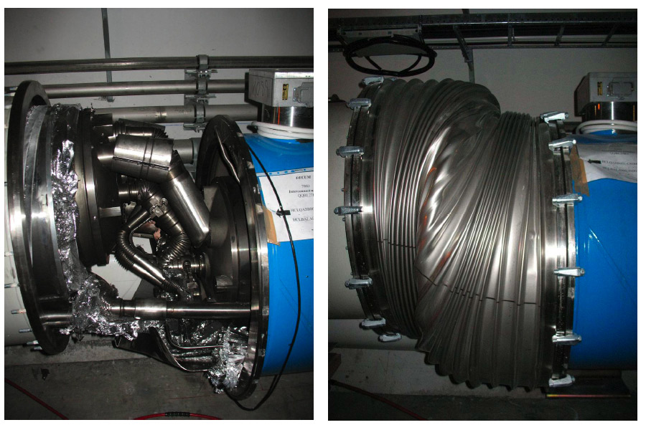
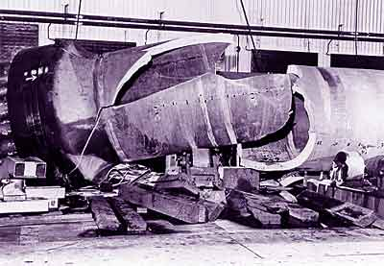
Failure from internal pressure

Slide 5
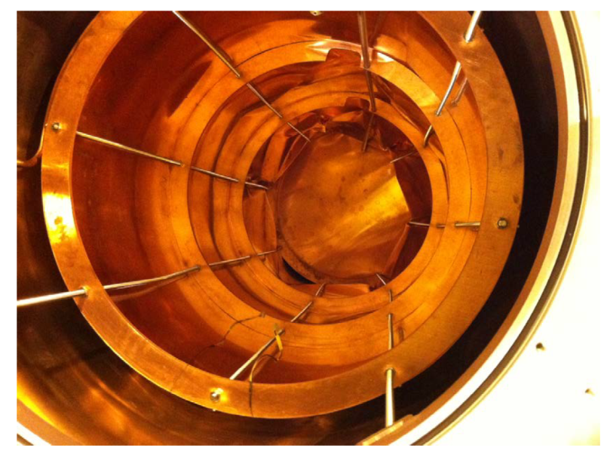
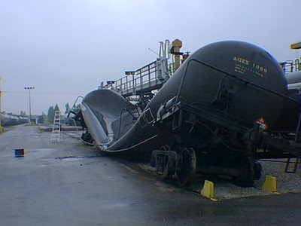
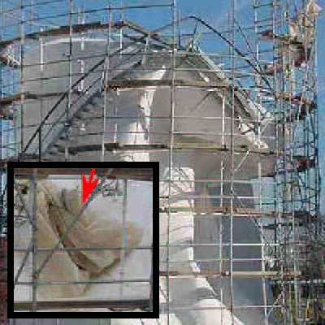
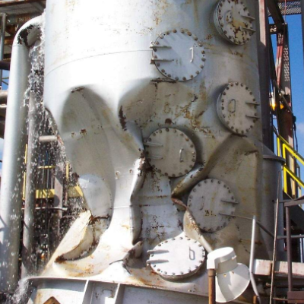
Failure from external pressure

Slide 6
Regulations for pressure bearing equipment
Some examples of legislation for pressure equipment around the world
Pressure European Directive 97/23/EC (often called PED), obligatory in the EU since 2002
ASME BPVC(USA), first published in 1915
CODAP (France)
AD Merkblatt (Germany)
PD 5500 (UK)
Where national law before EU directives. These standards are still in use but the PED requirements must be fullfiled.
At CERN we have our own rules. In general:
Rules at CERN impose the aplication of EU directives whenever possible
A classification of special equipment applies to equipment excluded from EU directives or “equipment of special safety relevance”
Think of them from the beginning: they restrict not only what you can do but also how you can do it!
Common misconceptions:
An overpressure test before putting into service is not enough to ensure safe operation over the lifetime of the equipment!
Neither a calculation alone, even with “large safety factor”!

Slide 7
Safety Rules at CERN
https://espace.cern.ch/Safety-Rules-Regulations/en/rules/byDomain/Pages/cryogenic.aspx

Slide 8
Pressure European Directive
Applies to internal pressure $≥$ 0.5 bar
Vessels must be designed, fabricated and tested according to the essential requirements of Annex I (Design, safety accessories, materials, manufacturing, testing, etc)
Establishes the conformity assessment procedure depending on vassel category. The category depends on the stored energy (which relates to risk), expressed as Pressure x Volume in bar.L
Design your system to fall in the lowest possible category: minimise pressure, fluid volume or both
Category | Conf. assessment module | Comment
SEP | None | The equipment must be designed and manufactured in accordance with sound engineering practice. No CE marking and no involvement of notified body.
I | A | CE marking with no notified body involvement, self-certifying.
II | A1 | The notified body will perform unexpected visits and monitor final assessment.
III | B1+F | The notified body is required to approve the design, examine and test the vessel.
IV | G | Even further involvement of the notified body.
Conformity assessment gets heavier with risk
For vessels with non-dangerous gases (cryogenic liquids are treated as gas)

Slide 9
PED Harmonised codes and standards
Harmonised standards give presumption of comformity with the PED, within their scope. Uselful standards for cryostat design and fabrication:
EN 13458-1:2002 Cryogenic vessels - Static vacuum insulated vessels - Part 1: Fundamental requirements
EN 13458-2:2002 Cryogenic vessels - Static vacuum insulated vessels - Part 2: Design, fabrication, inspection and testing + EN 13458-2:2002/AC:2006
EN 13458-3:2003 Cryogenic vessels - Static vacuum insulated vessels - Part 3: Operational requirements + EN 13458-3:2003/A1:2005
EN 13445-1:2009 Unfired pressure vessels - Part 1: General
EN 13445-2:2009 Unfired pressure vessels - Part 2: Materials
EN 13445-3:2009 Unfired pressure vessels - Part 3: Design
EN 13445-4:2009 Unfired pressure vessels - Part 4: Fabrication
EN 13445-5:2009 Unfired pressure vessels - Part 5: Inspection and testing
EN 13445-8:2009 Unfired pressure vessels - Part 8: Additional requirements for pressure vessels of aluminium and aluminium alloys
Other codes such as CODAP or ASME can be used, but proof of comformity is at the charge of the manufacturer.
These are often called “product standards” or “codes” as they give rules for the design and fabrication of a complete equipment.

Slide 10
Best practices
Using a coherent set of standards throught the lifecycle of the cryostat is the simplest and safest approach. As an example when using only EN harmonised standards:
Error margins of pressure relief devices are taken into account in the design rules
The design rules are only applicable if the material has enough ductility
Materials certified for pressure vessels have measured minimum fracture thoughness
Safety factors inclued in buckling formulae take into account shape imperfections up to the allowable toleraces layed out on the manufacturing section of the standards
The extent of welding inspection must be compatible with the joint coefficient used in thickness calculations
Coherence of test pressure and testing procedure with the design rules

Slide 11
Design Loads
See EN 13458-2 section 4.2.3 for a detailed list of load cases to be considered in the design of the vacuum vessel and inner vessel. Some examples:
Inner vessel
Pressure during operation (with and without liquid)
Reactions at the supports (including seismic loads)
Loads imposed by piping
Cooldown: inner vessel warm – piping cold
Filling and withdrawal: Inner vessel cold – piping cold,
Storage: inner vessel cold – piping warm
Pressure test
Shipping and handling
Outer pressure due to leak in insulation vacuum space
Vacuum vessel
External pressure: 1 bar
Internal pressure: safety valve set pressure
Support reactions (incl. wind seismic, etc)
Loads imposed by piping
Loads and the inner vessel support points during cooldown and operation
Shipping and handling
External loads (wind, seismic, etc)
Gross mass
Other loads may have to be taken into account (e.g. particular warm-up or cool-down cases, magnet quenches, Lorentz forces, etc.).
A risk analysis (imposed by CERN rules) can be very useful to avoid overlooking important load cases

Slide 12
Exceptional load cases
Reduced safety factors can be used for exceptional load cases: typically 1.05 instead of 1.5 for normal load cases.
Limited plastic deformations can be expected.
Not allways obvious to determine or decide if a load can be taken as exceptional, but one should keep in mind:
An exceptional load event must be followed by an inspection before restarting operation.
Ex: Is a magnet quench an exceptional load? Even if it is not expected to occur everyday, we don’t want to warmup for inspection every quench! Better to treat a quench pressure as normal load.

Slide 13
Calculations*
Example of stress analysis: He vessel of the QTC cryostat
By formula
The most standard approach and easiest to cross check
Not always straightforward to understant how the formula was derived
Often long and tedious calculation procedures: spreadsheets and comercial software packages are a must
Only deals with pressure loads
Rarely enough to calculate a magnet cryostat or a cryomodule (weight, interface loads, particular geometry, etc.)
Stress analysis (ex: EN 13458-2 Annex A or EN 13445-3 Annex C)
Evaluation of stresses using a finite element code
Linear elastic analysis
Decomposition of stresses in primary, secondary, membrane, bending etc.
Comparison with different allowable stresses depending on the load classification
Design by analysis – Direct route (EN 13445-3 Annex B)
Applicable to any component under any action
When manufacturing tolerances specified by the code are exceeded
Finite element models including material and geometrical non-linearities
Edms 1133291
Example of direct route: HFM vacuum vessel, edms 1278597
* “Design checks” is actually a better term. The verification of the final design must be done through one of these routes but it may be practical to use other formulas/methods during the preliminary design phase.

Slide 14
Material selection for pressure bearing parts
Proper materials shall be selected to ensure minimum ductility and fracture toughness throughout the specified temperature range.
A useful list of standards is given below. Materials specified according to these standards confer presumption of conformity, within their scope, with the related essential requirements of the PED:
Plates and sheets | • EN 10028-1:2007+A1:2009 Flat products made of steels for pressure purposes - Part 1: General requirements • EN 10028-3:2009 Flat products made of steels for pressure purposes - Part 3: Weldable fine grain steels, normalized • EN 10028-7:2007 Flat products made of steels for pressure purposes - Part 7: Stainless steels
Tubes | • EN 10216-5:2004 Seamless steel tubes for pressure purposes - Technical delivery conditions - Part 5: Stainless steel tubes • EN 10217-7:2005 Welded steel tubes for pressure purposes - Technical delivery conditions - Part 7: Stainless steel tubes
Forged blanks | • EN 10222-1:1998 Steel forgings for pressure purposes - Part 1: General requirements for open die forgings • EN 10222-5:1999 Steel forgings for pressure purposes - Part 5: Martensitic, austenitic and austenitic-ferritic stainless steels
Castings | • EN 10213:2007 Steel castings for pressure purposes
Pipe fittings | • EN 10253-4:2008 Butt-welding pipe fittings - Part 4: Wrought austenitic and austenitic-ferritic (duplex) stainless steels with specific inspection requirement
Bars | • EN 10272:2007 Stainless steel bars for pressure purposes
Aluminium | • EN 12392:2000 Aluminium and aluminium alloys – Wrought products – Special requirements for products intended for the production of pressure equipment (choose materials included in the list given in EN 13445-8 section 5.6)

Slide 15
Material selection (contin.)
EN 13458-2 Annex K gives a list of base materials approved for use in cryostats.
Mechanical property values used in the design shall be the minimum values given by the material standards. Usage of actual property values is usually not allowed.
Physical properties of steels are given in EN 13445-3 Annex O, including corrections for temperature.
EN 13458 refers to EN 1252 for requirements on toughness properties of base materials and welded joints, depending on the operating temperature:
EN 1252-1:1998 Cryogenic vessels - Materials - Part 1: Toughness requirements for temperatures below -80°C (Austenitic stainless steels: Only welds impact tested; test at saturated liquid N₂ even if working temperature is lower)
EN 1252-2:2001 Cryogenic vessels - Materials - Part 2: Toughness requirements for temperatures between -80°C and -20°C (Austenitic stainless steels: Only welds impact tested, and only if ferrite content of filler metal >10%)
All pressure bearing materials shall be procured with inspection certificates type 3.1 or 3.2 according to EN 10204, and traceability must be ensured throughout the fabrication process.

Slide 16
Pressure vessel materials, yes, but not allways enough!
Courtesy S. Sgobba

Slide 17
Specifications developed for vacuum applications at CERN
Some cryostat components demand for even more strict requirements. Ex: absence of macroinclusions, limitations to size and amount of microinclusions, imposed manufacturing processes, minimum quality assurance tests, etc.
Some materials at the CERN stores are procured with traceability and specifications to avoid leaks across the material and minimise welding deffects:
CERN specification | EDMS no. | Usage
316LN_sheets_English_ed_4 | 790774
316LN_blanks_English_ed_4 | 790775 | 3D-Forged blanks for Conflat flanges
316LN_bars_English_ed_4 | 790773
304L_bar_English_ed_5 | 790544
304L_sheets_English_ed_5 | 790767
316L_bellows_English_ed_4 | 790771 | Thin foil for bellows convolutions
Presently these CERN specifications do not require conformity with PED harmonised standards but the conformity is often stated by default in the material certifcates.

Slide 18
Design stresses for some materials
Design stresses for plates less than 12 mm thick applicable to membrane stress (safety factor 1.5 included) according to EN 13445-3
For stainless steels:
$$f=\frac{R_{p1.0}}{1.5}$$
$$f_{test}=\frac{R_{p1.0}}{1.05}$$
Material | R_{p1.0} (MPa) | f (MPa) | f_{test} (MPa)
1.4306 (304L) | 240 | 160 | 228
1.4435/1.4404 (316L) | 260 | 173 | 247
1.4406/1.4429 (316LN) | 320 | 213 | 304
$f=min⁡(\frac{R_{p0.2}}{1.5},$ $\frac{R_{m}}{2.4})$
$$f_{test}=\frac{R_{p0.2}}{1.05}$$
For aluminium-magnesium alloys:
Material | R_{p1.0} /R_{m} (MPa) | f (MPa) | f_{test} (MPa)
AW 5083-O/H111 | 125/270 | 83 | 119

Slide 19
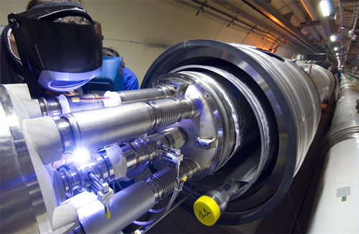
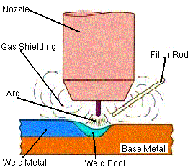
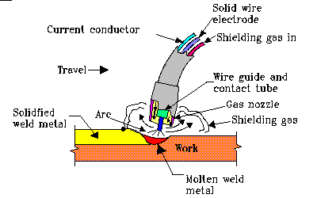
Welding
Tungsten inert gas welding
Tungsten Inert Gas (TIG) and Metal Inert Gas Welding (MIG) are the most commonly used processes in cryostat fabrication
Full quality assurance of welds involves:
Specification of quality levels for imperfections suitable to the application
Qualification test of welding procedures and welders
Welding inspection
Metal inert gas welding

Slide 20
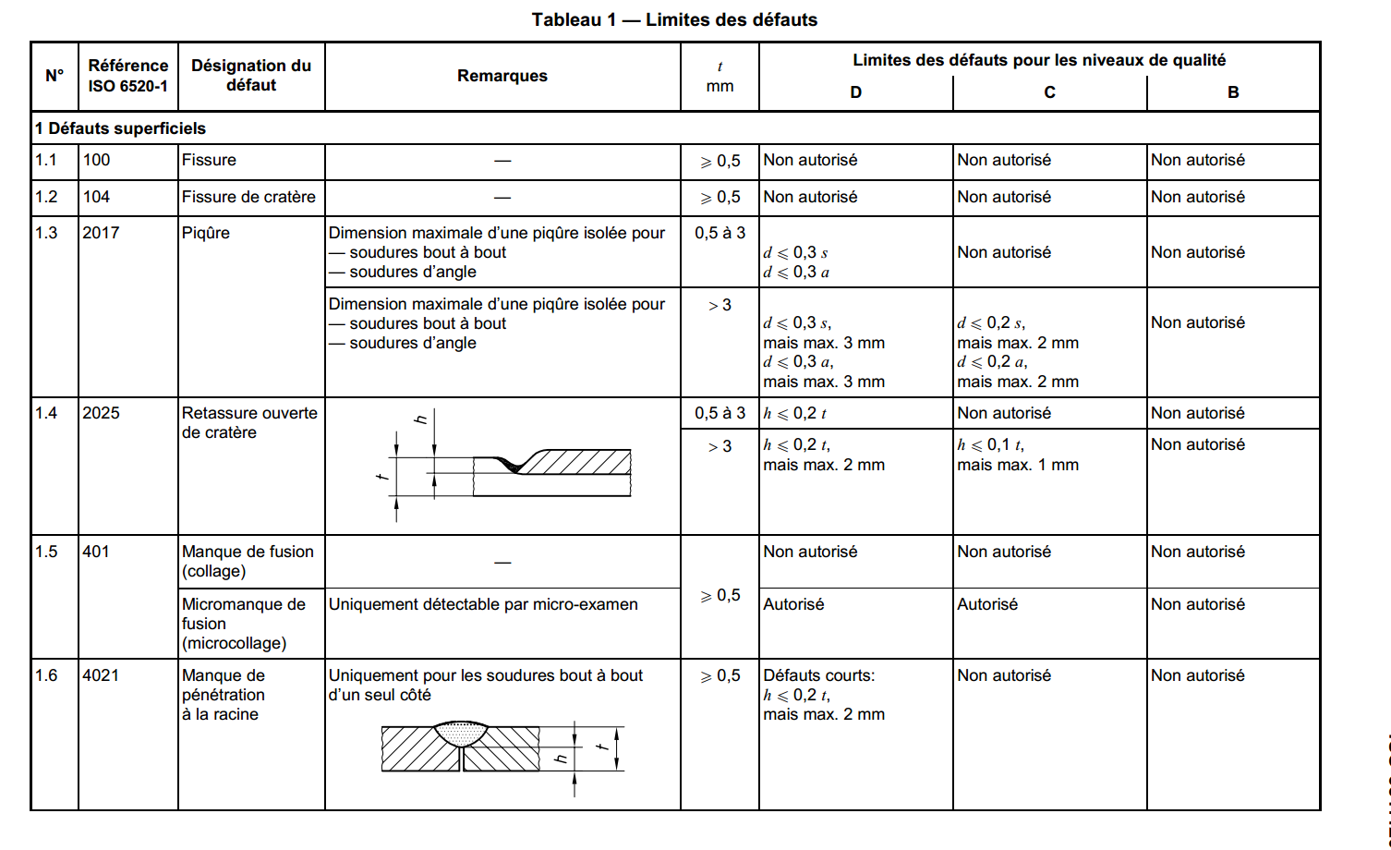
Quality levels for imperfections
Current practice at CERN is to specify quality level B for leak tight welds
EN 13445 and EN 13458 give their own quality level specifications: in general, less demanding than ISO 5817 level B
…see the standard for the complete table…

Slide 21
Qualification of welding personnel and welding procedures
Some examples of applicable standards:
 | Steel | Aluminium
Welding procedure approval | EN ISO 15614-1:2004 Specification and qualification of welding procedures for metallic materials - Welding procedure test - Arc and gas welding of steels and arc welding of nickel and nickel alloys | EN ISO 15614-2:2005 Specification and qualification of welding procedures for metallic materials - Welding procedure test - Arc welding of aluminium and its alloys
Qualification of welders | EN 287-1:2004 Qualification test of welders - Fusion welding - Steels | EN ISO 9606-2:2004 Qualification test of welders - Fusion welding - Aluminium and aluminium alloys
Qualification of welding operators | EN 1418:1998 Welding personnel - Approval testing of welding operators for fusion welding and resistance weld setters for fully mechanized and automatic welding of metallic materials

Slide 22
Welding inspection
From EN 13458: Visual inspection of all welds to EN 970, is required. X-ray examination is required for the inner vessel and shall be carried out in accordance with EN ISO 17636-2:2013. Volumetric inspection is not required on the outer jacket (vacuum vessel)*.
Non-destructive testing personnel shall be qualified for duties according to EN ISO 9712 (replaces EN 1435). It is common at CERN to ask for level 2 as a minimum.
The following table shows a possible specification for welding inspection of a cryostat in stainless steel:
Vacuum vessel/ Inner vessel | Surface imperfections | Volumetric imperfections
Method | Visual inspection | X-rays
Extent of examination | 100 % / 100 % | None / as per EN 13458-2, section 6.3.3
Covered by | EN ISO 17637 (replaces EN 970) | EN ISO 17636-2:2013 (replaces EN 1435)
Qualification of personnel | Required competence but certification is not mandatory | EN ISO 9712, NDT level 2 (Replaces EN 473)
Acceptance levels | EN 5817, quality level B
* But may be recommended in particular cases (ex: HIE-Isolde cryomodule)

Slide 23
Design of pressure bearing welds
EN 13445-3 annex A is a good reference for designing pressure bearing welds. EN 1708-1 is also a useful hamonised standard. Some examples:
Longitudinal welds
Circular welds
Flat ends
Nozzles

Slide 24
Design of vacuum facing welds

Slide 25
Brazing
Often the solution to join different materials (ex: copper to stainless steel; stainless steel to ceramics…)
Vacuum brazing (no flux required) gives the most reliable joints, but at a cost
Thorough cleaning after brazing with flux is mandatory. Poor cleaning often results in the development of leaks in stainless steel due to corrosion!
Useful standards for brazing specification and execution:
Example of flame brazed stainless steel to copper transition for a thermal shield cooling circuit (HIE-Isolde cryomodule)
EN 13134:2000 Brazing - Procedure approval
EN 13133:2000 Brazing - Brazer approval
EN 12797:2000 Brazing - Destructive tests of brazed joints
EN 12799:2000 Brazing - Non-destructive examination of brazed joints
EN ISO 18279:2003 Brazing - Imperfections in brazed joints

Slide 26
Fabrication tolerances
Formulas for external pressure stability and finite element models using the “direct route” assume a maximum deviation from nominal shape
Tolerances in the drawings must be coherent with the standard used in the calculations!
Some examples from EN 13458-2 section 5.5:

Slide 27
Cleaning
Example of cleaning procedure specification for the HIE-Isolde vacuum vessel:
All internal surfaces shall be delivered in a clean condition, compatible with ultra-high vacuum applications. Cleaning shall be performed following a written procedure, including as a minimum:
Degreasing in a detergent solution with ultrasonic agitation.
Rinsing with demineralized water according to ASTM D1193-99 Type II, at a temperature higher than 30 ºC, first with a water jet and then by immersion in a bath with ultrasonic agitation.
Drying in clean air.
External surfaces shall be cleaned following a written procedure, including as a minimum:
Cleaning with high-pressure spray of detergent solution.
Rinsing with demineralised water jet.
Drying.
Some reference standards:
EN 12300:1999 Cryogenic vessels - Cleanliness for cryogenic service
ISO 15730:2000 Metallic and other inorganic coatings – Electropolishing as a means of smoothing and passivating stainless steel.

Slide 28
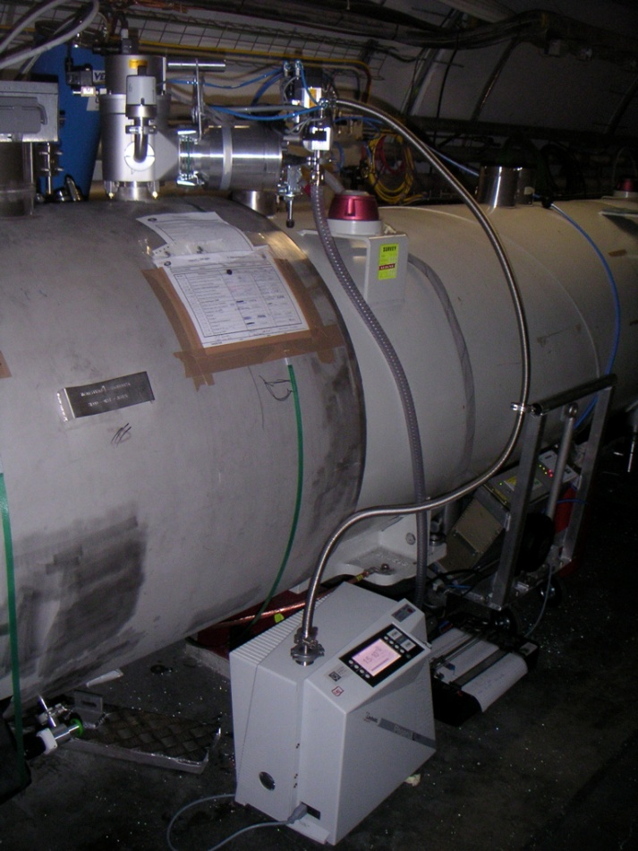
He leak detection methods
Sniffer
in helium
cloud
Sniffing
(leak localisation)
He
5 bar
He
Leak Detector
helium
Vacuum
(leak detection)
Vacuum
Helium
pistol
Q
Part
to test
q = helium flux in mbar. l/s
He
Leak Detector
Courtesy of P.Cruikshank

Slide 29
Leak testing
Example of leak testing specification (HIE-Isolde vacuum vessel):
All parts shall be leak tested according to EN 13185, by evacuation of the internal volume (EN 13185, technique A.1) and using helium as tracer gas. The final test shall be performed on clean components, after electropolishing.
Testing shall be performed with a calibrated helium leak detector with sensitivity better than 2x10-11 Pa m3 s-1. The calibration certificate shall be included in the inspection certificate.
The test protocols that the contractor intends to follow must be submitted to CERN for approval before the tests are carried out.
An automatic recorder shall be used to produce a chart showing the complete evolution over time of the vacuum leak test. This chart shall be included in the leak test report.

Slide 30
Pressure testing
According to EN 13458-2 the test pressure shall be the higher of
The test procedure is given in EN 13458-2 section 6.5.
Where the test is carried out hydraulically the pressure shall be raised gradually to the test pressure holding it there for 30 min. Then the pressure shall be reduced to the design pressure so that a visual examination of all surfaces and joints can be made. The vessel shall not show any sign of gross plastic deformation or leakage. The test may be carried out pneumatically on a similar basis. As pneumatic testing employs substantially greater stored energy than hydraulic testing, it shall normally only be carried out where adequate facilities and procedures are employed to assure the safety of inspectors, employees and the public.

Slide 31
Some standards for accessories and components
EN 14917:2009 Metal bellows expansion joints for pressure applications
EN 12434:2000 Cryogenic vessels - Cryogenic flexible hoses
EN 13371:2001 Cryogenic vessels - Couplings for cryogenic service
EN 1626:2008 Cryogenic vessels - Valves for cryogenic service
ISO 1609 Vacuum Technology – Flange dimensions
ISO 3669 Vacuum technology – Bakable flanges – Dimension

Slide 32
Thank you!
Questions?

Slide 34
Useful textbooks
Chattopadhyay, Pressure vessels – Design and practice, CRC press, 2005
Zeman, Pressure vessel design – Direct route, Elsevier, 2003

