Slide 2
Thermal Contact Conductance in Bolt Joints

Slide 3

An expert is a man who has made all the mistakes which can be made, in a narrow field.

Slide 4
Summary
Theoretical Heat flow
Real Heat Flow
Theoretical Models
Semi-Empirical Model
Empirical Model
Materials
Test Setup
Results
Discussion/Conclusion

Slide 5


Theoretical Heat flow
Fourier Law of Heat Conduction
3 Dimensional
Multilayer Conduction
Single Material Conduction
Unidimensional

Slide 6
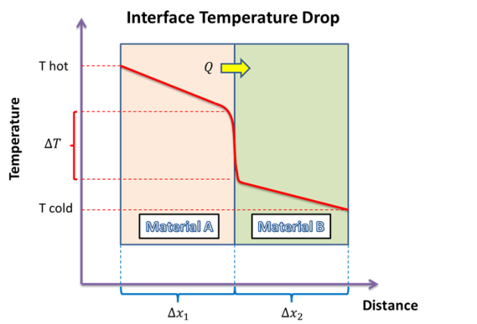
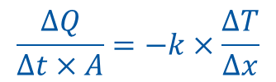
Real Heat Flow
$$\frac{∆Q}{∆t×A}=−k×\frac{∆T}{∆x}$$
Major Interface Parameters Affecting Conduction
Surface Roughness
Force
Temperature
Microhardness
Oxide Layers
Thermal Constriction/Dilatation

Slide 7

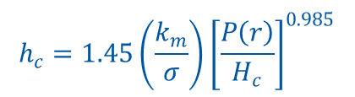

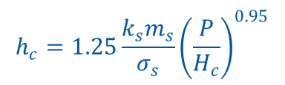
Theoretical Models
Elastic: Fletcher and Gyorog
$$h_{c}=\frac{k_{s}}{δ_{0}}{\left[5.22×{10}^{−6}\frac{δ_{0}}{r}+0.036\frac{P}{E}αT_{m}\right]}^{0.56}×exp\left[170\frac{α×P×T_{m}×r}{E×δ_{0}}\right]$$
$$δ_{0}=5.194×{10}^{−7}+8.060×{10}^{−2}s−6.220×{10}^{−2}s^{2}+2.108×{10}^{−6}s^{3}$$
$$s={\left(FD+2R_{a}\right)}_{rough}−\frac{1}{2}{\left(FD+{2R}_{a}\right)}_{smooth}$$
Plastic: Modified CMY Model
$$h_{c}=1.25\frac{k_{s}m_{s}}{σ_{s}}{\left(\frac{P}{H_{c}}\right)}^{0.95}$$
For: ${10}^{−6}≤\frac{P}{H_{c}}≤2.3×{10}^{−2}$
Rocca Mikic Model for Bolted Joints
$$h_{c}=1.45\left(\frac{k_{m}}{σ}\right){\left[\frac{P\left(r\right)}{H_{c}}\right]}^{0.985}$$

Slide 8
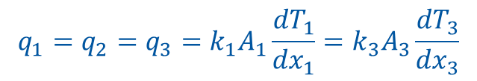
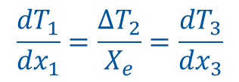
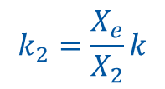
Semi-Empirical Model
Equivalent Fin Method (EFM)
$$q_{1}=q_{2}=q_{3}=k_{1}A_{1}\frac{{dT}_{1}}{{dx}_{1}}=k_{3}A_{3}\frac{{dT}_{3}}{{dx}_{3}}$$
$$\frac{{dT}_{1}}{{dx}_{1}}=\frac{{∆T}_{2}}{X_{e}}=\frac{{dT}_{3}}{{dx}_{3}}$$
$$k_{2}=\frac{X_{e}}{X_{2}}k$$
Not suited for significative thermal conductivity variations.

Slide 9
Empirical Model
Based on Empirical Joint Design
Rule of Thumb: Bolt Spacing for general construction should be at least 1,5 D to the edge and 4 D between bolts.
1.5 D
1.5 D
2 D
4 D

Slide 10
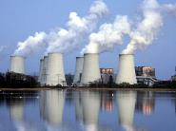
Empirical Model
Step 1: Power Requirement Needed
Step 2: Estimate Temperature at the Joint

Slide 11
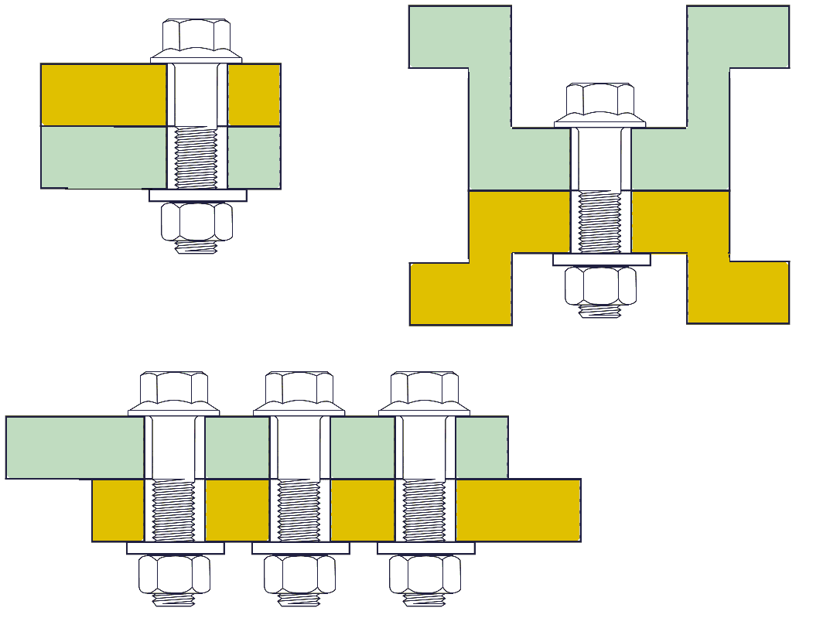
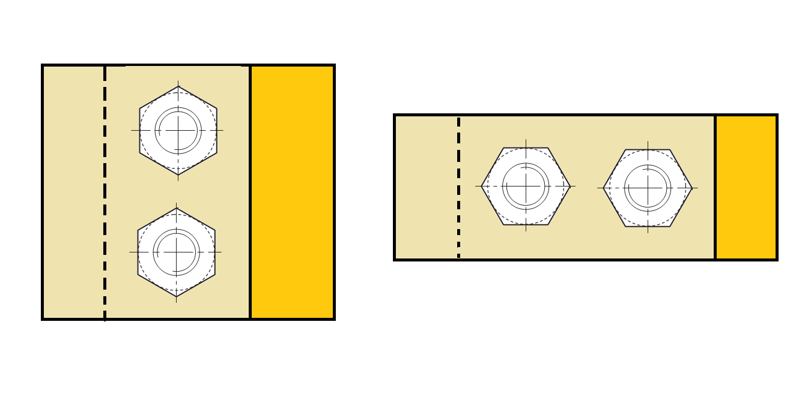
Empirical Model
Step 3: Select Type of Joint
    Configuration (Parallel, Perpendicular, Inverted, etc…)
Inverted Flow
Radial Flow
Perpendicular
Parallel
Direct Flow

Slide 12





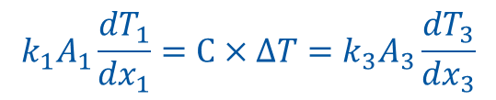
Empirical Model
Step 4: Select Bolt Size
Step 5: Determine in Database Heat Transfer for Bolt Size, Material and Joint Temperature
Step 6: Divide Database Heat Transfer by Power Requirement to determine number of Bolts
$$C=\frac{Q}{∆T}$$
$$Q_{1}=Q_{2}=Q_{3}$$
Step 7: Validate Design
$$k_{1}A_{1}\frac{{dT}_{1}}{{dx}_{1}}=C×∆T=k_{3}A_{3}\frac{{dT}_{3}}{{dx}_{3}}$$
$$C=h×A$$

Slide 13
Materials
44.01.30 - ALUMINIUM 99,5 % (EN AW-1050 A , state: H-24 half-hard)
Tensile Strength | 75 MPa (min)
Ultimate Strength | 105 to 145 MPa
Elongation at Break | 9%
Hardness (Brinell) | 38BH (min)
44.09.56.B – COPPER (OXYGEN-FREE ELECTRONIC COPPER - Cu-OFE - EDMS 790780)
Tensile Strength | 200 to 240 MPa
Ultimate Strength | 240 to 280 MPa
Elongation at Break | 25% (min)
Hardness (Brinell) | 60 HBS (min)
44.59.32.A - STAINLESS STEEL (304 L LOW CARBON) – EN 10088
Tensile Strength | 200 MPa
Ultimate Strength | 500 to 670 MPa
Elongation at Break | 45% (min)
Hardness (Brinell) | 192 BH (max)

Slide 14
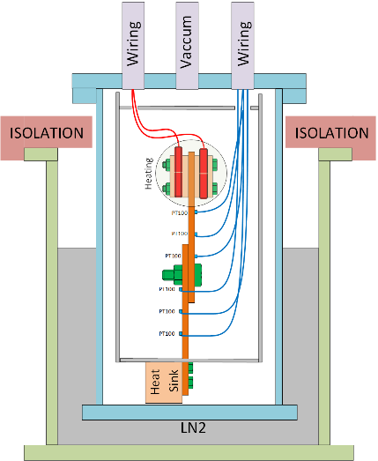
Test Setup
Three access ports available.
Two Wiring ports with 24 signal entries
(One for the PT100 probes) (24 used)
(One for Electric Power) (16 Used, 8 available)
Vaccum port can be modified to permit another 24 Signal entry
Heaters Protected with MLI
Cryostat
Radiation Shield

Slide 15
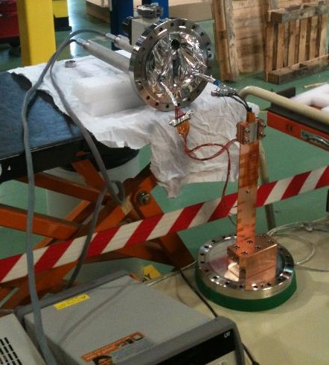
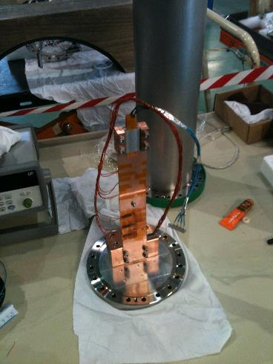
Test Setup

Slide 16
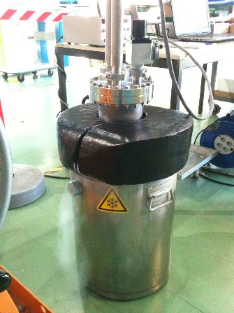
Test Setup

Slide 17
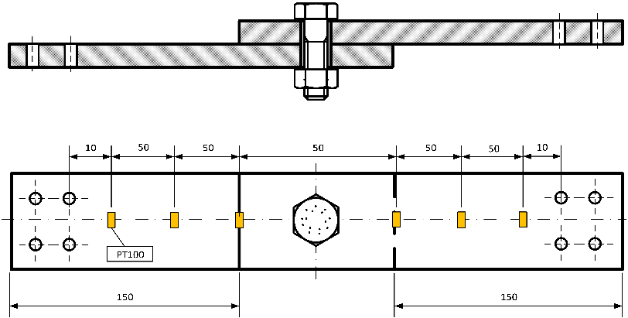
Test Setup
All data presented for M4 A4-70 Stainless Steel Bolt, (Torque 3 N m), unless otherwise referred.

Slide 18
Results: Cu-Cu
M4 A4-70 Stainless Steel Bolt, (Torque 3 N m)
Very good linearity
Delta T with visible difference
Power transmitted (7 to 31W)
Temperature [K]
Distance [mm]

Slide 19
Results: Cu-Cu
Equation | Extrapolated Temperature [K] | Equation | Extrapolated Temperature [K] | Delta T [K] | Mean Joint Temperature [K] | Heat Power [W] | Conductance [W/K] | h [W/K m²]
y = -0,193x + 130,72 | 106,6 | y = -0,176x + 126,37 | 104,4 | 2,2 | 105,5 | 7,1 | 3,2 | 92420
y = -0,247x + 145,02 | 114,1 | y = -0,223x + 139,3 | 111,4 | 2,7 | 112,8 | 9,5 | 3,5 | 101506
y = -0,305x + 160,72 | 122,6 | y = -0,275x + 153,73 | 119,4 | 3,2 | 121,0 | 12,0 | 3,7 | 108232
y = -0,362x + 176,63 | 131,4 | y = -0,328x + 168,53 | 127,5 | 3,8 | 129,5 | 14,5 | 3,8 | 109469
y = -0,418x + 191,83 | 139,6 | y = -0,379x + 182,63 | 135,3 | 4,3 | 137,4 | 17,1 | 4,0 | 115404
y = -0,477x + 207,82 | 148,2 | y = -0,433x + 197,5 | 143,4 | 4,8 | 145,8 | 19,9 | 4,1 | 120150
y = -0,534x + 223,6 | 156,9 | y = -0,488x + 213,17 | 152,2 | 4,7 | 154,5 | 22,6 | 4,8 | 140242
y = -0,593x + 239,48 | 165,4 | y = -0,54x + 227,37 | 159,9 | 5,5 | 162,6 | 25,6 | 4,7 | 135891
y = -0,652x + 255,47 | 174,0 | y = -0,595x + 242,6 | 168,2 | 5,7 | 171,1 | 28,2 | 4,9 | 142781
y = -0,708x + 270,77 | 182,3 | y = -0,646x + 256,93 | 176,2 | 6,1 | 179,2 | 31,1 | 5,1 | 148556
Temperature [K]
Power [W]
Temperature [K]
Heat transfer coefficient [W/K m²]

Slide 20
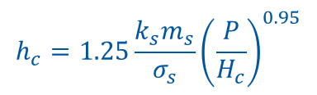







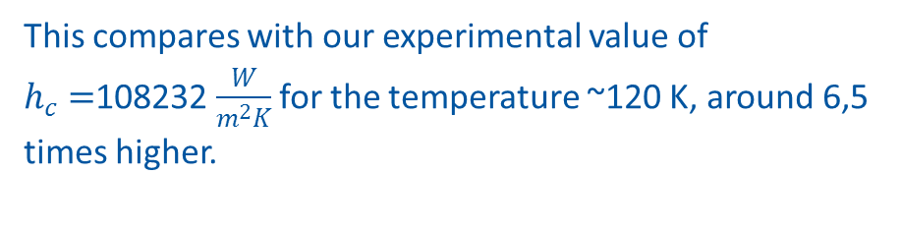
Results: Cu-Cu
Comparison between data obtained and a theoretical model.
Plastic: Modified CMY Model
$$h_{c}=1.25\frac{k_{s}m_{s}}{σ_{s}}{\left(\frac{P}{H_{c}}\right)}^{0.95}$$
For: ${10}^{−6}≤\frac{P}{H_{c}}≤2.3×{10}^{−2}$
$$R_{a}=200μm$$
$$→ h_{c}=700538 [\frac{W}{m^{2}K}]$$
$$K_{s}=430 W/m^{2}K$$
$$P=68 MPa$$
$$H_{c}=280 MPa$$
This compares with our experimental value of $h_{c}=$108232 $\frac{W}{m^{2}K}$for the temperature ~120 K, around 6,5 times higher.
$$m_{s}=1$$

Slide 21
Results: Al-Al
M4 A4-70 Stainless Steel Bolt, (Torque 3 N m)
Extraordinary linearity
Very small difference in extrapolated values
Oxide layer might play a huge role in conductance at the joint
Temperature [K]
Distance [mm]

Slide 22
Results: Al-Al
Equation | Extrapolated Temperature [K] | Equation | Extrapolated Temperature [K] | Delta T [K] | Mean Joint Temperature [K] | Heat Power [W] | Conductance [W/K] | h [W/K m²]
y = -0,201x + 130,08 | 104,955 | y = -0,182x + 127,27 | 104,52 | 0,435 | 104,7375 | 7,06561 | 16,24278161 | 162427,8161
y = -0,272x + 147,7 | 113,7 | y = -0,244x + 143,87 | 113,37 | 0,33 | 113,535 | 9,48664 | 28,74739394 | 287473,9394
y = -0,332x + 163,53 | 122,03 | y = -0,301x + 159,33 | 121,705 | 0,325 | 121,8675 | 12,04913 | 37,07424615 | 370742,4615
y = -0,395x + 180,05 | 130,675 | y = -0,361x + 175,63 | 130,505 | 0,17 | 130,59 | 14,48128 | 85,184 | 851840
y = -0,457x + 196,05 | 138,925 | y = -0,42x + 191,53 | 139,03 | -0,105 | 138,9775 | 17,14986 | -163,332 | -1633320
y = -0,518x + 212,3 | 147,55 | y = -0,481x + 208,07 | 147,975 | -0,425 | 147,7625 | 19,8986 | -46,82023529 | -468202,3529
y = -0,579x + 228,18 | 155,805 | y = -0,539x + 223,83 | 156,455 | -0,65 | 156,13 | 22,55159 | -34,69475385 | -346947,5385
y = -0,639x + 244,28 | 164,405 | y = -0,6x + 240,27 | 165,27 | -0,865 | 164,8375 | 25,6106 | -29,60763006 | -296076,3006
y = -0,698x + 260,2 | 172,95 | y = -0,659x + 256,43 | 174,075 | -1,125 | 173,5125 | 28,18465 | -25,05302222 | -250530,2222
y = -0,754x + 275,8 | 181,55 | y = -0,718x + 272,53 | 182,78 | -1,23 | 182,165 | 31,08573 | -25,27295122 | -252729,5122
Power [W]
Temperature [K]
Temperature [K]
Heat transfer coefficient [W/K m²]

Slide 23
Results: SS-SS
M4 A4-70 Stainless Steel Bolt, (Torque 3 N m)
Poor linearity in the data obtained.
Experiment should be repeated. (Shield Deformation)
Huge temperature gradients with very small heat input.
(0,5 to 1,5 W)
Very small difference in extrapolated values
Temperature [K]
Distance [mm]

Slide 24
Results: Al-Cu
M4 A4-70 Stainless Steel Bolt, (Torque 3 N m)
Temperature
Distance

Slide 25
Results: Al-Cu
Equation | Extrapolated Temp | Equation | Extrapolated Temp. | Delta T | Heat Power | Conductance | h
y = -0,261x + 129,42 | 96,795 | y = -0,126x + 112,5 | 96,75 | 0,045 | 7,06561 | 157,0135556 | 1570135,556
y = -0,343x + 144,58 | 101,705 | y = -0,16x + 121,77 | 101,77 | -0,065 | 9,48664 | -145,9483077 | -1459483,077
y = -0,443x + 164,58 | 109,205 | y = -0,208x + 135,23 | 109,23 | -0,025 | 12,04913 | -481,9652 | -4819652
y = -0,545x + 184,72 | 116,595 | y = -0,255x + 148,43 | 116,555 | 0,04 | 14,48128 | 362,032 | 3620320
y = -0,64x + 204,23 | 124,23 | y = -0,304x + 162,17 | 124,17 | 0,06 | 17,14986 | 285,831 | 2858310
y = -0,734x + 223,5 | 131,75 | y = -0,353x + 175,97 | 131,845 | -0,095 | 19,8986 | -209,4589474 | -2094589,474
Variation of extrapolated Delta T insufficient
Same problem faced in Al-AL for the conductance
Cu-AL should also be evaluated
Heat Power
Delta T

Slide 26
Discussion/Conclusion
Given the problems faced determining thermal conductivity effectively, it was chosen to develop an empirical approach that could avoid the problem.
An empirical approach is easy to use and understand but will require a complete database able to encompass all the majority of joint designs.
Further testing is required to evaluate the approach for Aluminum and Stainless Steel.
Results for Copper validate this approach, at least, for this material.

Slide 27
Discussion/Conclusion
Further testing: Reduce the overlap area of the contact joints. (See if it solves the problem with Al tests and SS 304.
Considerer a method to exact evaluating of the contact area. (I suggest dying liquid).
For the case considerer: M4 bolt, the value of 50% tightening torque (2 Nm) plastified the plates materials in the case of Cu and Al. This can make it hard to develop a database in function of tightening torque.

Slide 28


Thank you for your attention

Slide 29
FAQ
PT100 Overlap
Contact Area
Plates Deformation
Heating Elements
PT100 Fixation
Radiation Shield
Leak Testing

Slide 30
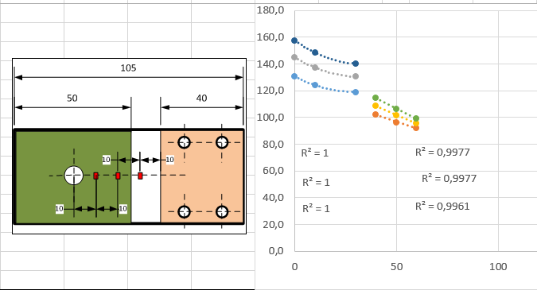
PT100 Overlap
Second degree equation for hot part, linear for cold part.
(Copper OFE)

Slide 31
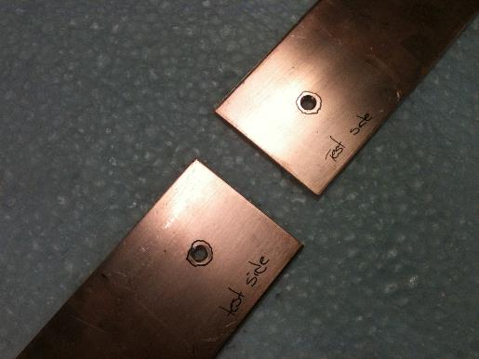
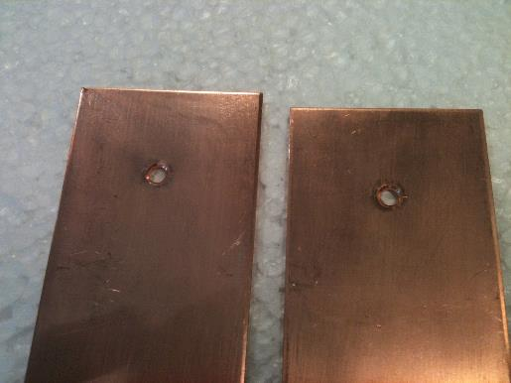
Contact Area

Slide 32
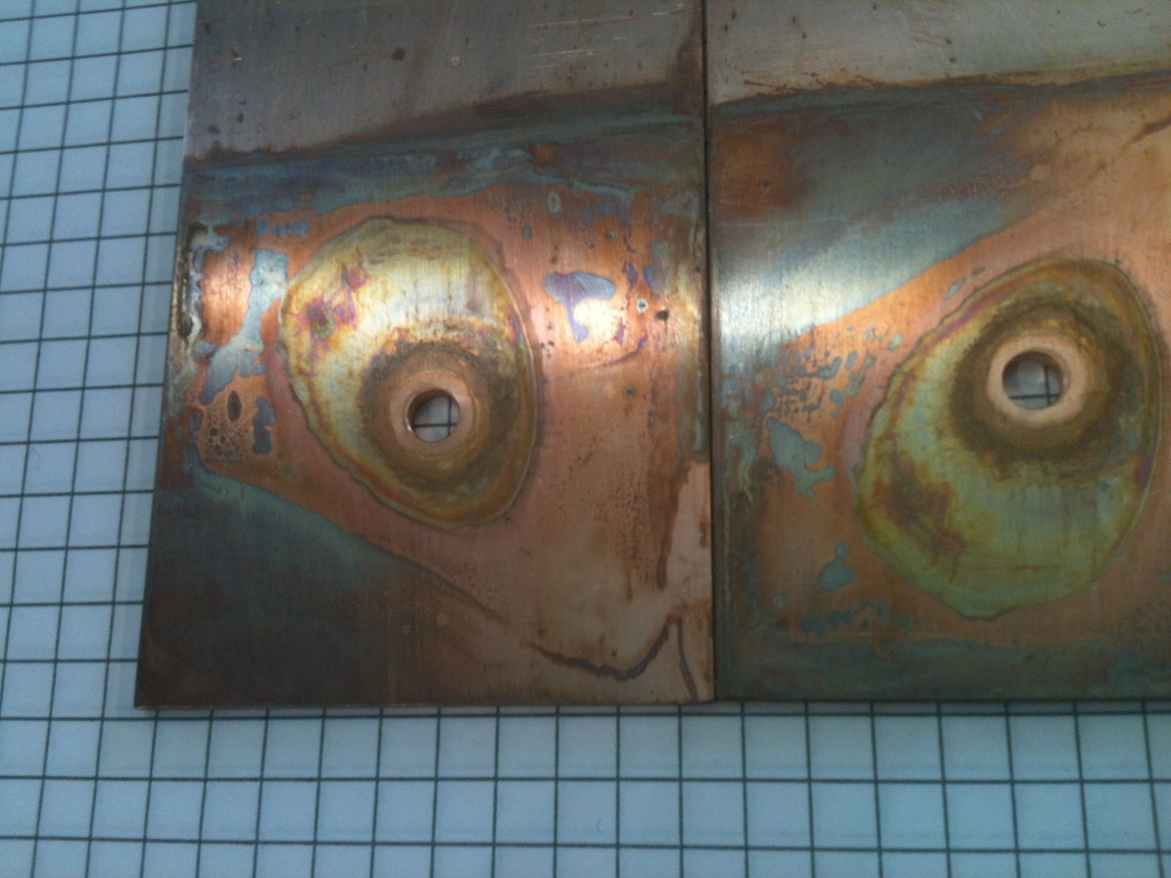
Contact Area

Slide 33
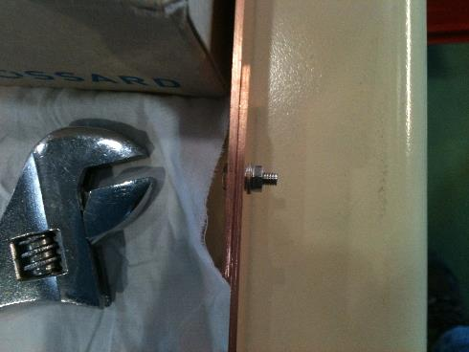
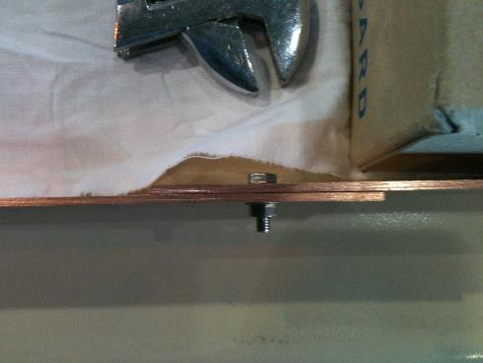
Plates Deformation

Slide 34
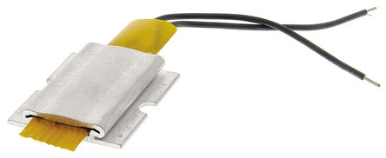
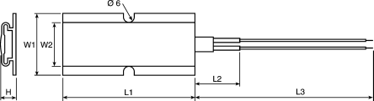
Heating Elements
PTC heating element with self-regulation housed in a compact flat aluminum alloy construction, allowing heat transmission to the thermal medium. This means that no thermal cut-out or thermostat is required.
Technical Characteristics:
From practical testing it was determined that they cannot operate bellow ~130 K. Bellow this point the resistance of the heating element becomes to high to allow any current to flow, effectively stopping any electrical heat dissipation.
Length | 40 mm
Width | 35 mm
Height | 8.5 mm
Thermal Power | 50 W
Surface Temperature | 100 º C
Voltage | 12 V ac - 24 V dc

Slide 35
Wiring
Copper OFE
180 mm length plate
40 mm from heater
40 mm from heat sink
50 mm x 50 mm overlap joint
0,22 mm copper wire
Copper OFE
200 mm length plate
10 mm from heater
10 mm from heat sink
50 mm x 50 mm overlap joint
0,12 mm manganin wire
Distance | Probe | Reading
0 | 1 | 92.0
25 | 2 | 91.3
50 | 3 | 88.8
100 | 4 | 84.9
125 | 5 | 83.9
150 | 6 | 82.8
Distance | Probe | Reading
0 | 1 | 78.7
50 | 2 | 79.6
100 | 3 | 79.1
150 | 4 | 77.9
200 | 5 | 77.3
250 | 6 | 77.5

Slide 36
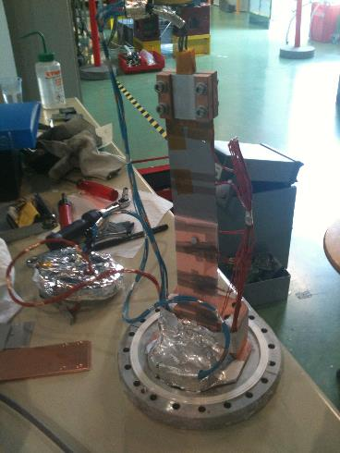
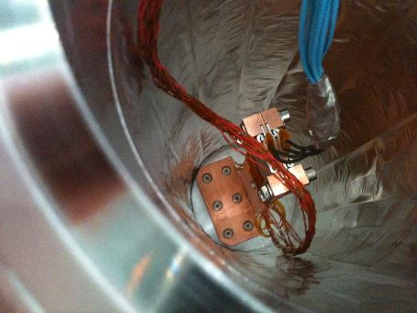
PT100 Fixation

Slide 37
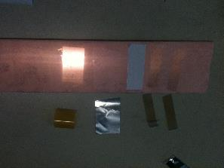
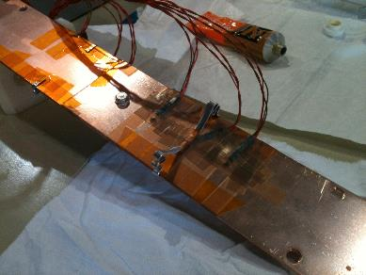
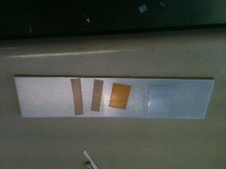
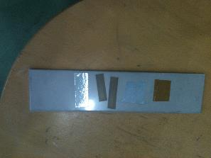
PT100 Fixation

Slide 38
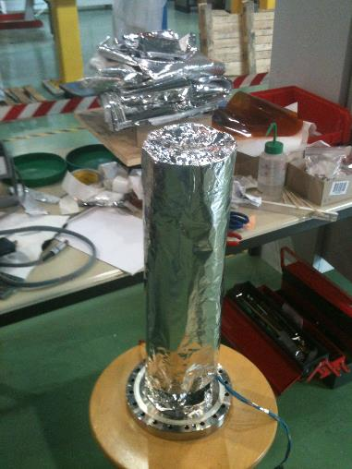
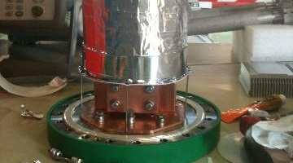
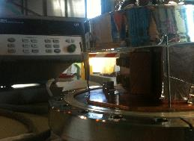
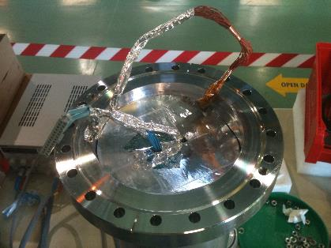
Radiation Shield

Slide 39
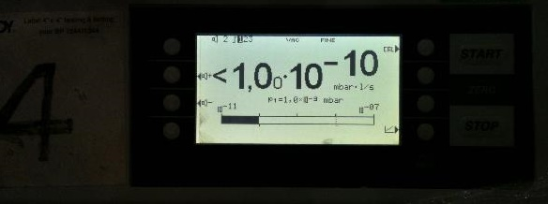
Leak Testing

