Slide 1
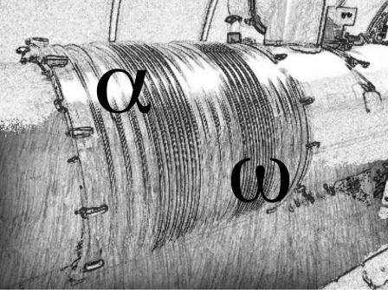
Alfa-Omega Team
General information
General information (Anna)
W Bellows (Alain)
DN200 (Andrea)

Slide 2
Long Shutdown 1 (LS1)
To upgrade the LHC and prepare machine for work with full energy (VAC, CRYO, RF,…)
Powering Tests
Consolidation of the Superconducting Circuits
  Replacement of non-conform cryomagnets
  Radiation to Electronics (R2E)
For experiments – time to upgrade detectors
And many other projects…
Timeframe: February 2013 – December 2014

Slide 3
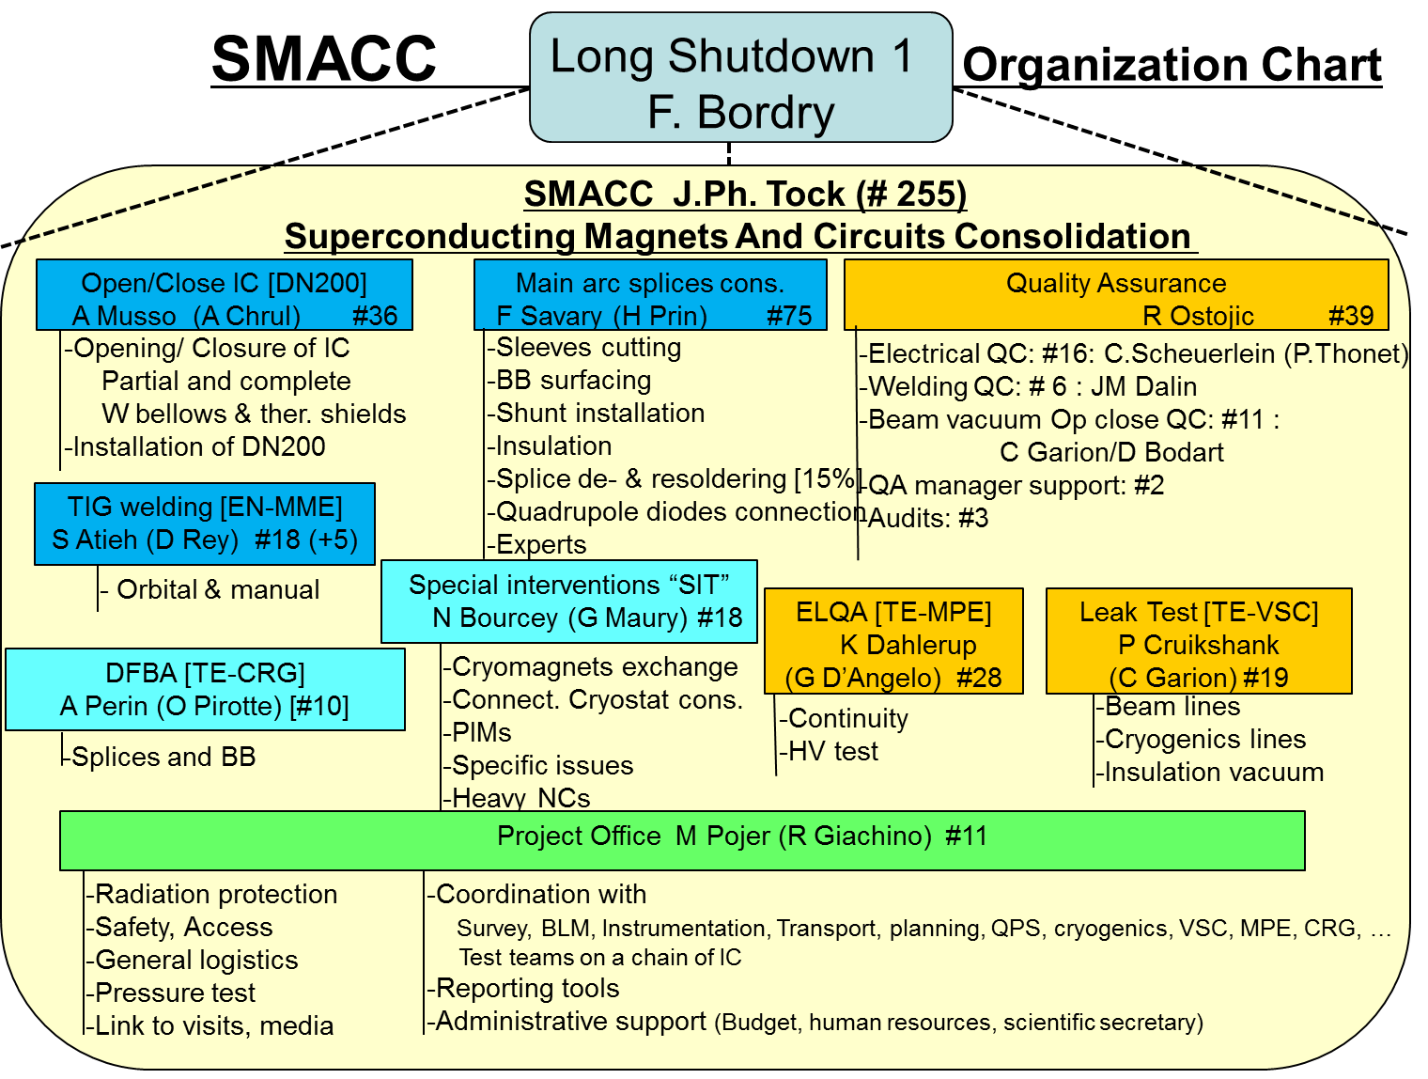
SMACC Project
Superconducting Magnets And Circuits Consolidation is one of the main projects and activities to perform during LS1.
Courtesy J.Ph. Tock

Slide 4
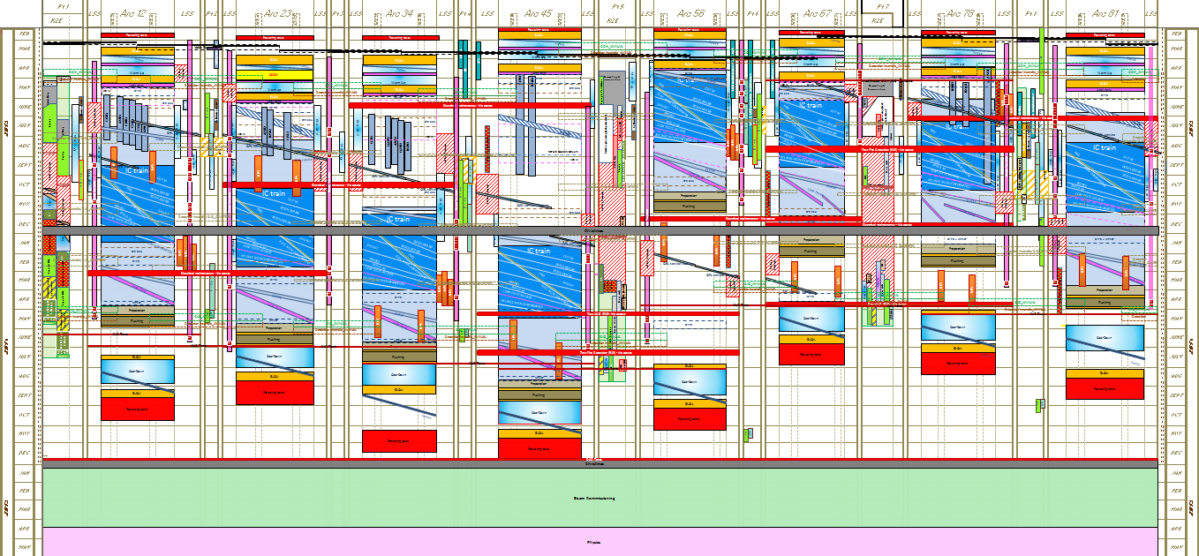
The schedule of LS1
K. Foraz, Third LHC Splice Review, November 12-14, 2012

Slide 5
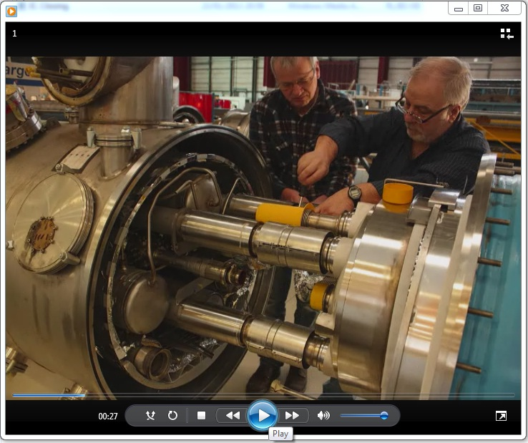
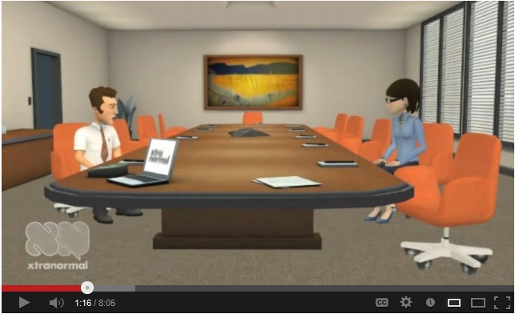
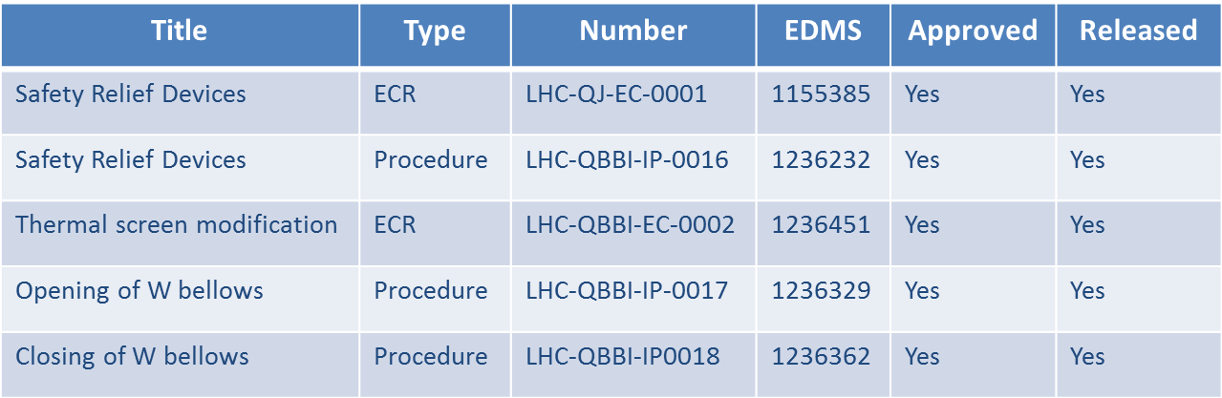
Alfa & Omega Team
Our tasks:
To open all W-bellows starting “The Train”
To close all W-bellows completing “The Train”
To install all missing SRV (DN200)
To upgrade all thermal screens
To remove, repair and reinstall M bellows’ protections
To install V-bellows and X-bellows protections
To support Special Interventions Team and VSC (leak detection)
\\cern.ch\dfs\Workspaces\a\AlfaOmega\Media\CERN clips
Some numbers:
612 SRV (DN200) to install in 4 sectors
1695 Interconnections to open/close (+ some extra…)
3390 Thermal Shields to modify in the workshop Bat. 183
5085 M bellows’ protections to remove – repair – install
http://www.youtube.com/watch?v=KcRDMjNiBts
Preparation period: visits, procedures, ECR, videos, orders, equipment...
Second phase (now!): training on surface

Slide 6
Alfa & Omega Team
International Team: 36 team members from 7 countries, 7 languages and a huge work to do!
Andrea Musso
(Anna Chrul, HNINP)
Jose Manuel Gomes De Faria
SRV
Activity Leader
DUBNA
Aleksander Ivanov
Alain Bastard
W Opening & Closure
Activity Leader
NTUA
Dimitrios Damianoglou
(Konstantinos Razakias)
WUT
Michal Strychalski
(Jacek Muszynski)
Graeme Barlow
Thermal Shields Upgrade
Activity Leader
Adel Tebigui (FSU)
Benjamin Pellet (FSU)
Team 1
March 15th 2013
Team 2
March 15th 2013
Team3
March 15th 2013
Team 1
March 1st 2013
Team 2
March 1st 2013
Team 3
March 1st 2013
Team 1
March 15th 2013
Team 2
March 15th 2013

Slide 7
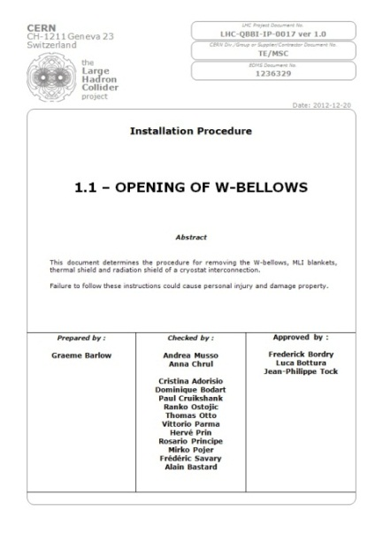
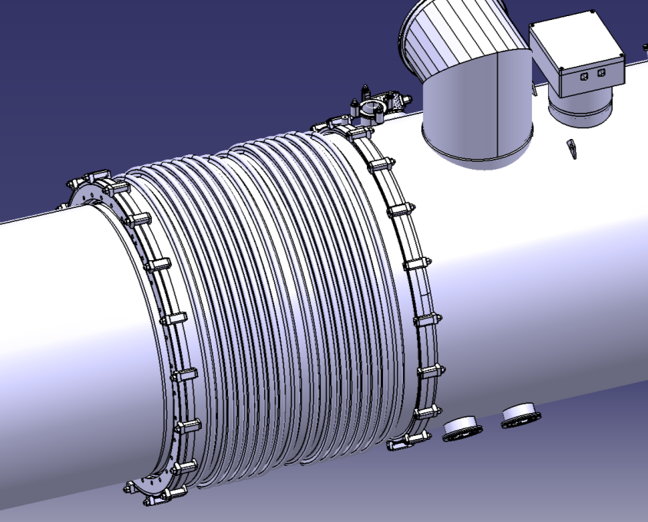
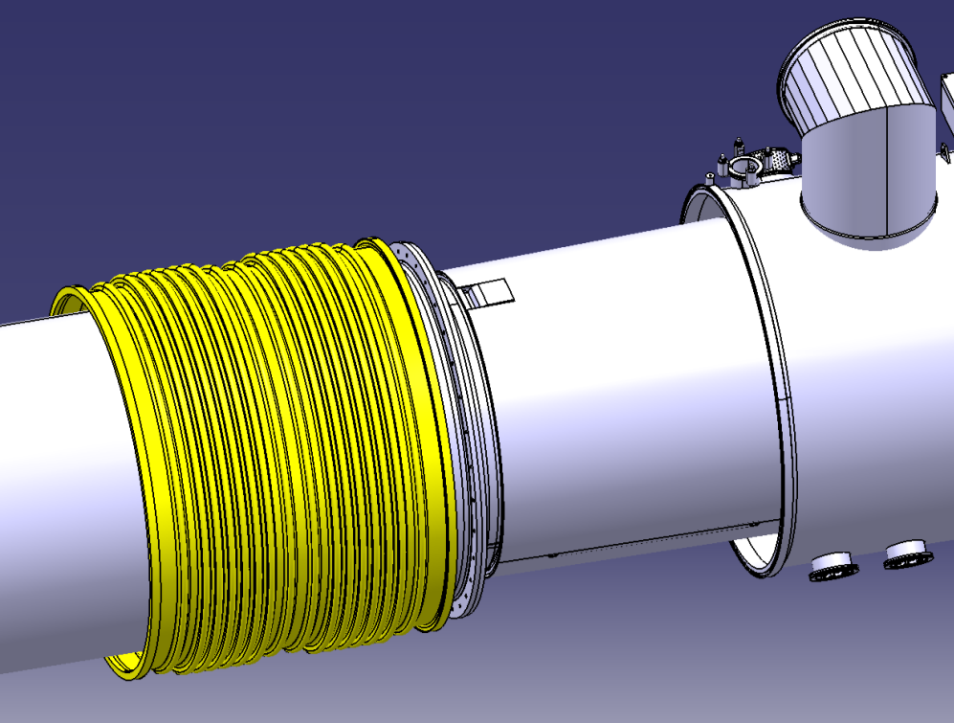
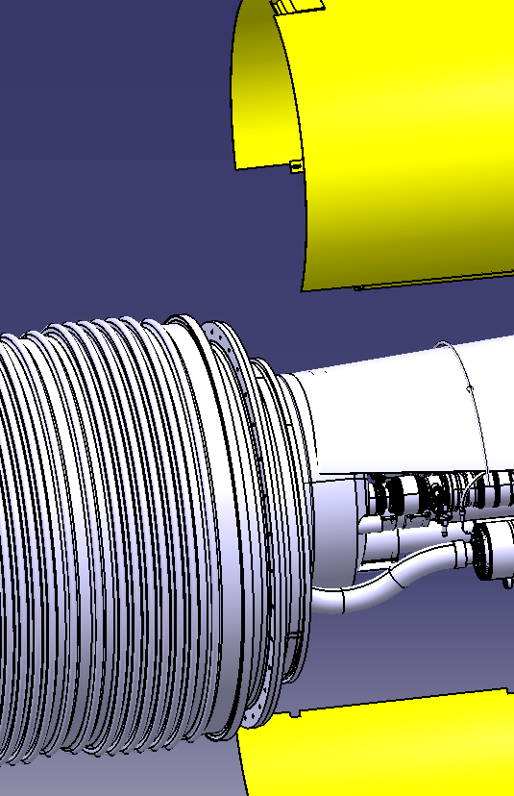
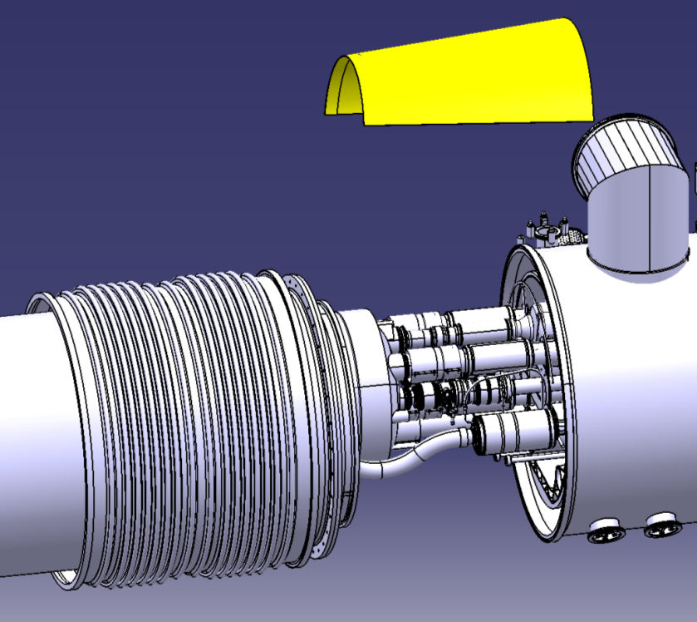
W-bellows opening
Remove screws
Open bellows
Remove MLI blankets 1
Remove thermal shields
Welds to cut
Remove MLI blankets 2
Remove shield (screwed)
Courtesy Thierry Renaglia

Slide 8
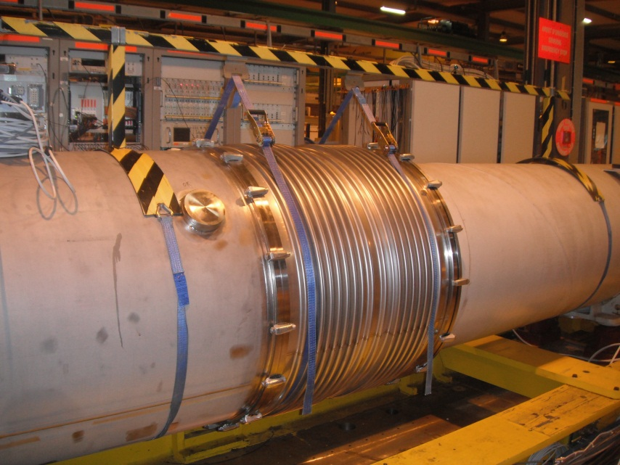
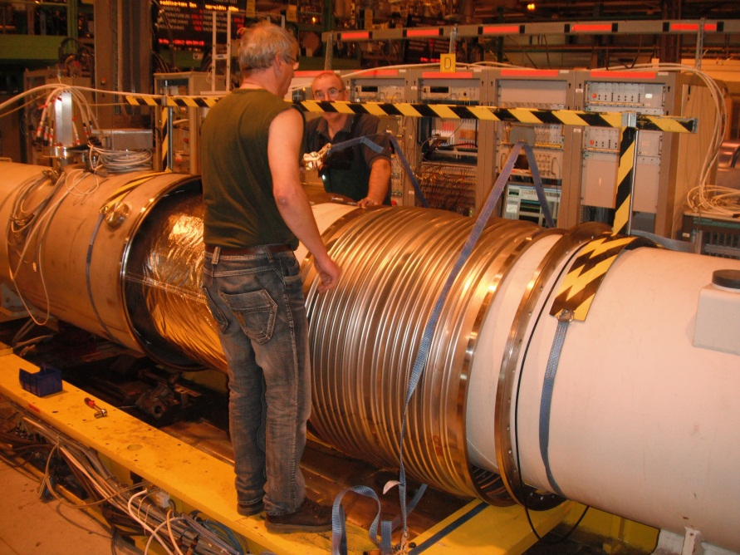
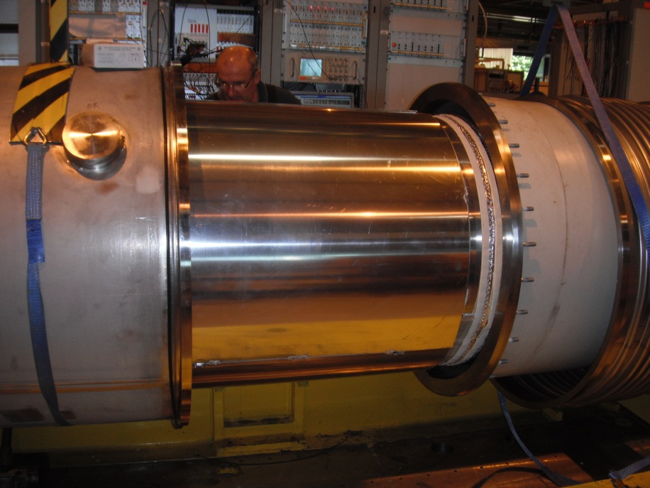
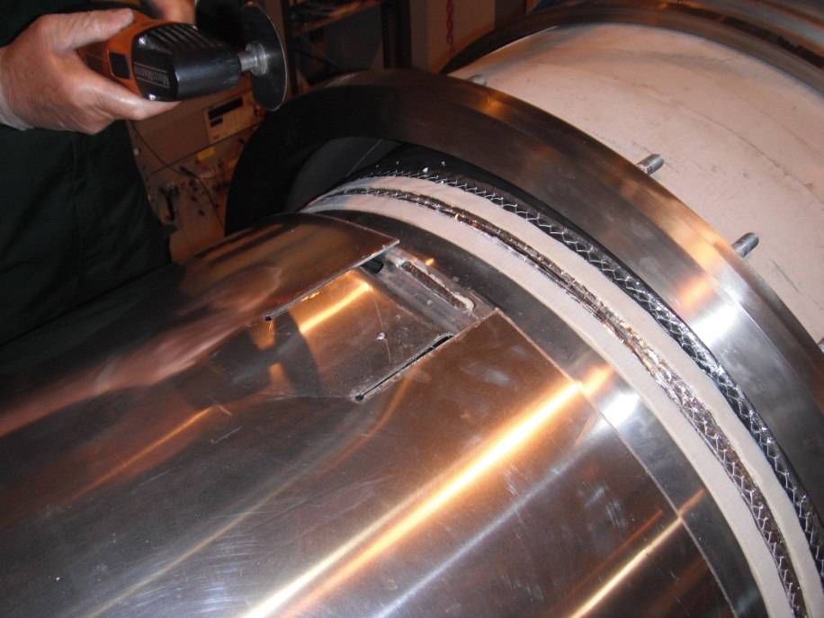

Slide 9
Machine de découpe des écrans thermiques:
Les contraintes que nous avions a respecter
Pas de poussières ni d’étincelles
Réduction des nuisances sonores
Sécurité pour les utilisateurs de machine
Rapidité
Qualité

Slide 10
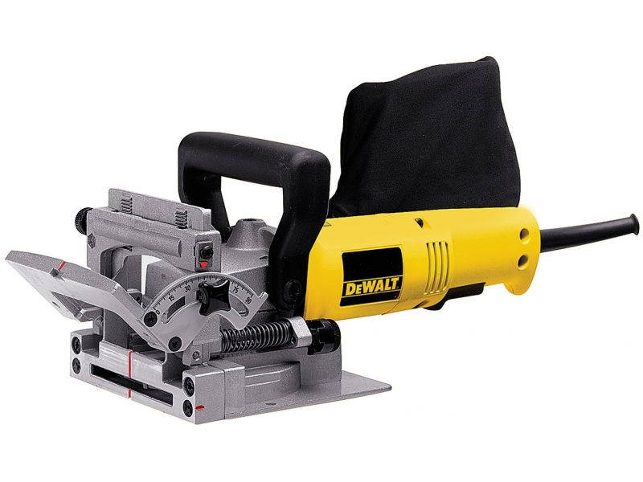
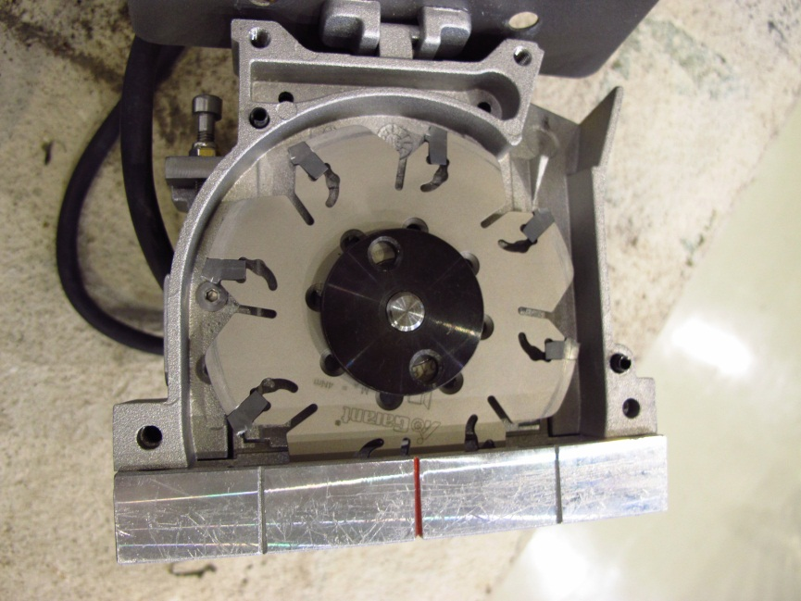
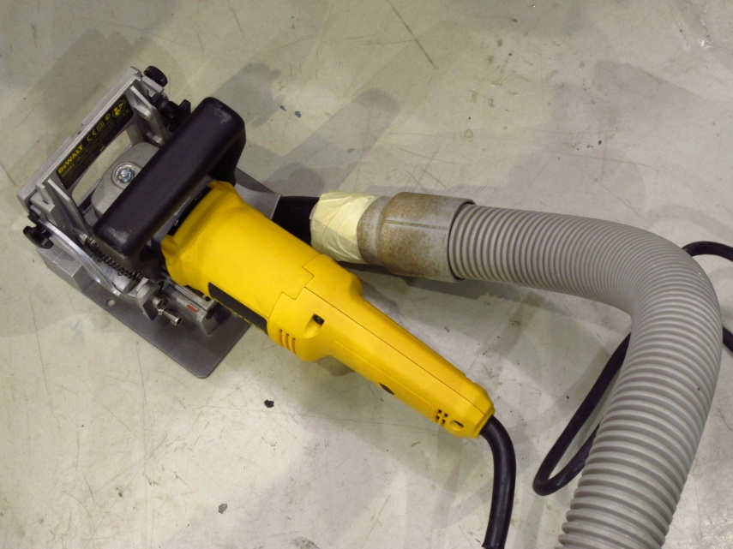

Slide 11
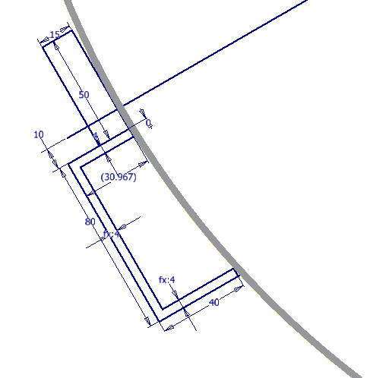

Slide 12
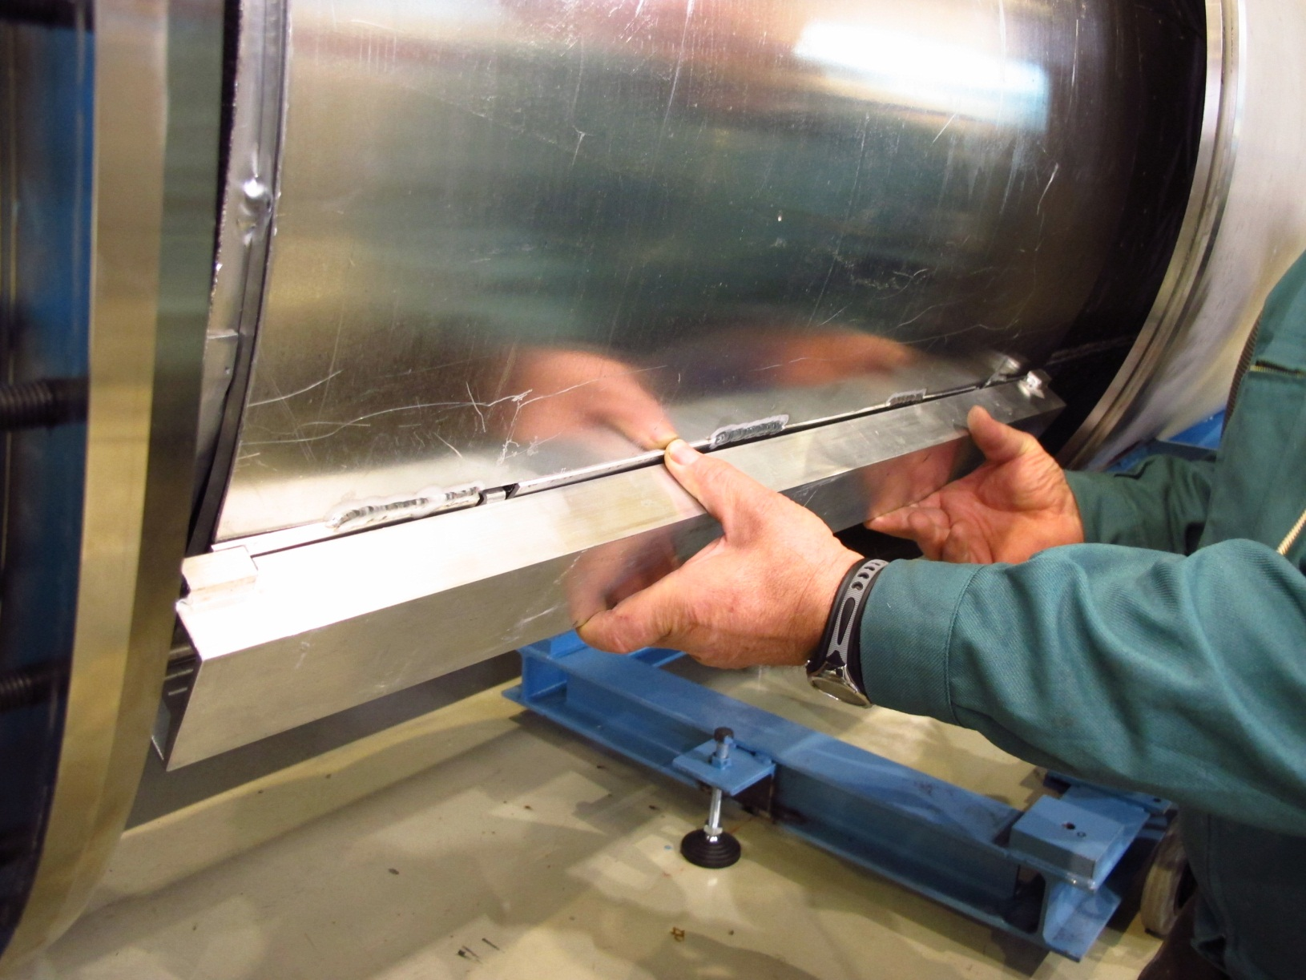

Slide 13
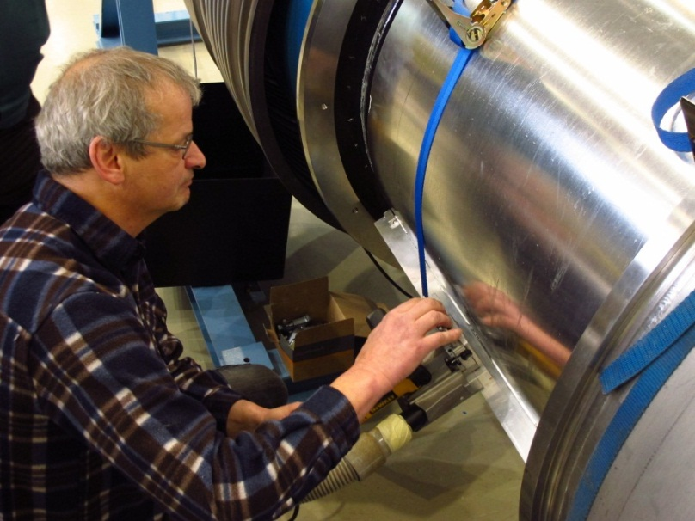
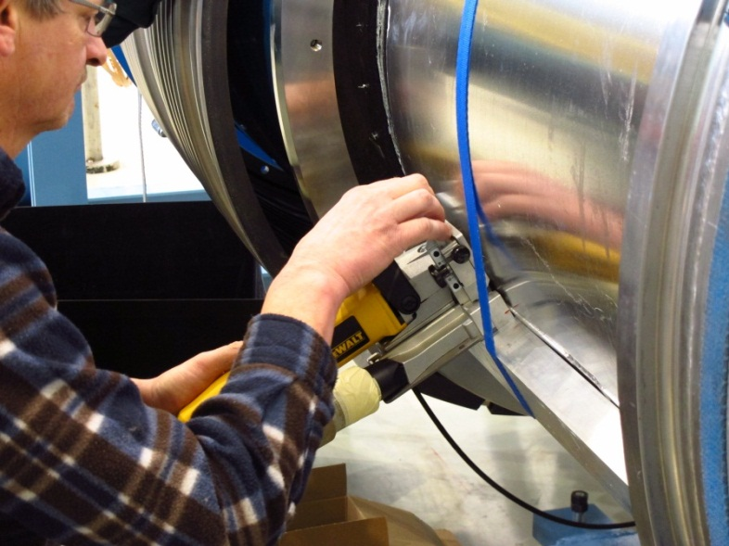
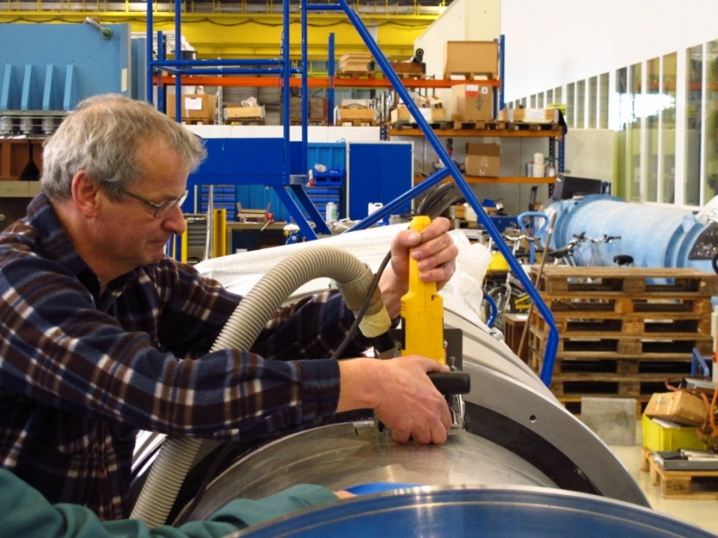

Slide 14
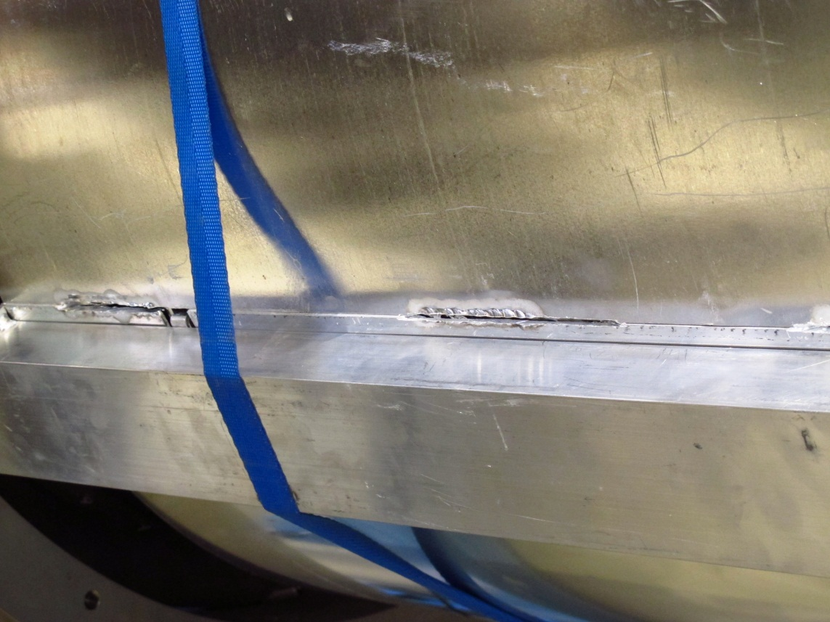
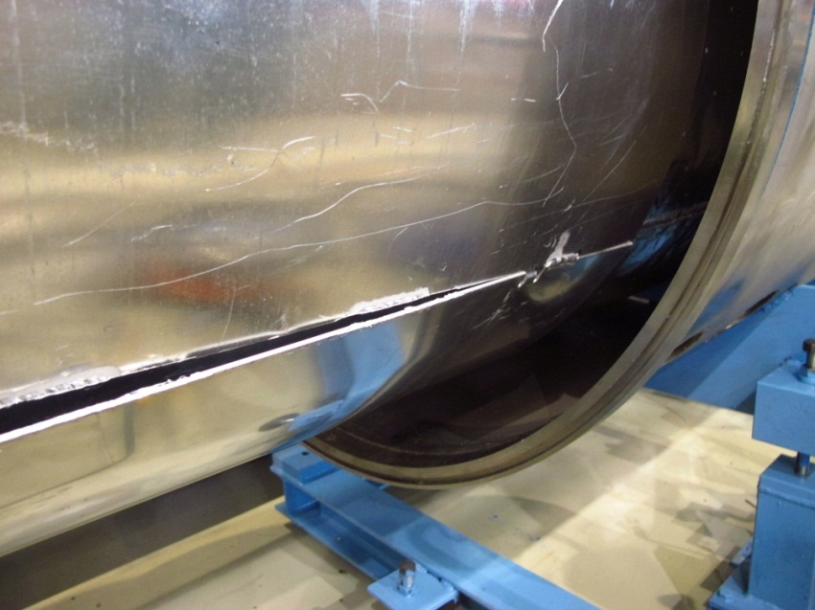

Slide 15
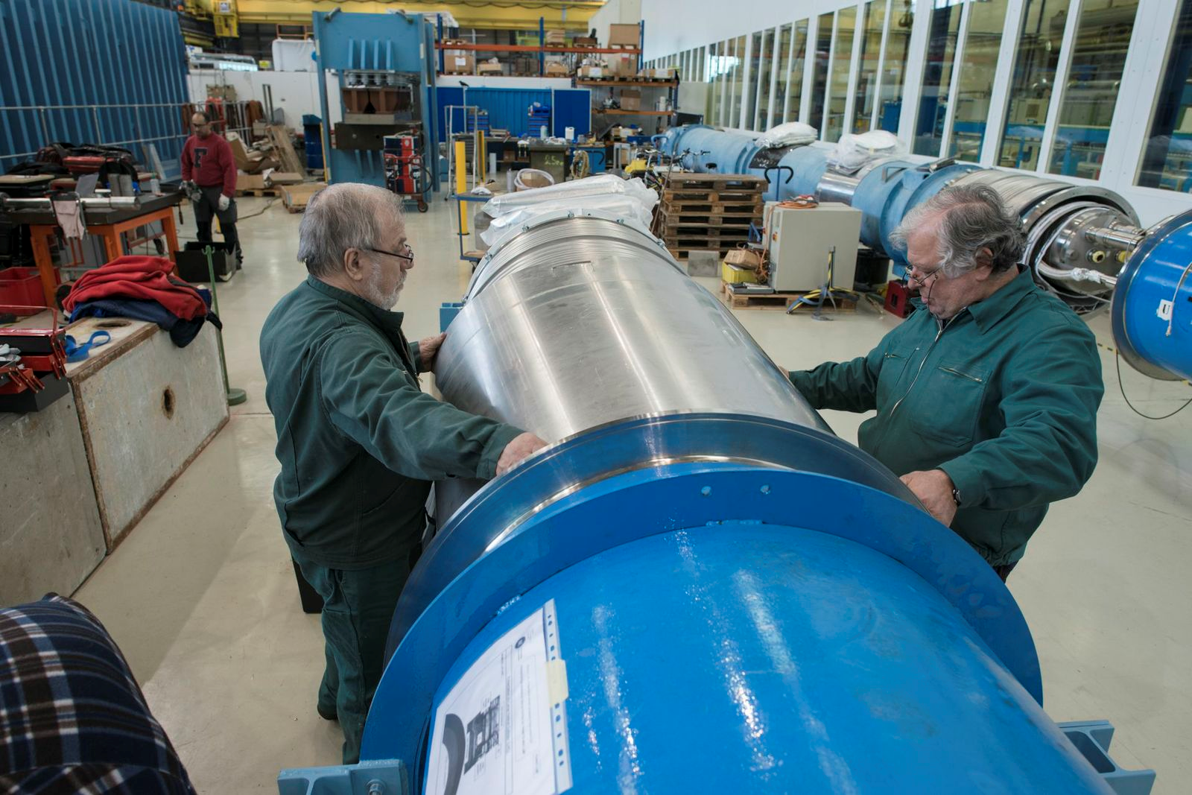

Slide 16
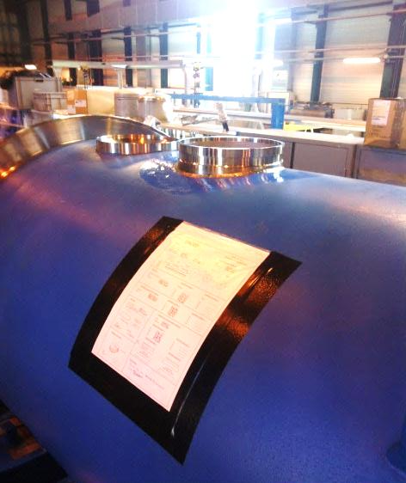
Installation of Safety Relief Devices (DN200) 1/2
This activity was partially performed during last shutdown
(2008-2009)
There are 612 SRV left for installation in 4 sectors:
  Sector 2-3
  Sector 4-5 (partially)
  Sector 7-8
  Sector 8-1
Nota: a partial opening of the interconnection (i.e. W opening and MLI removal)
is requested to install the SRD’s

Slide 17
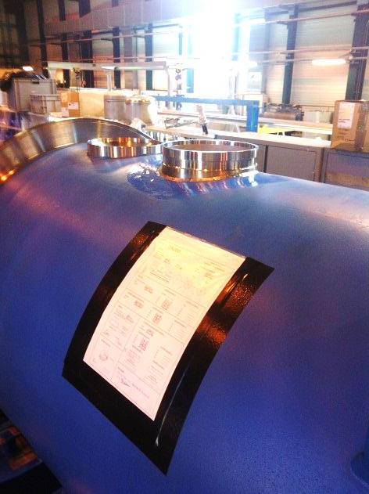
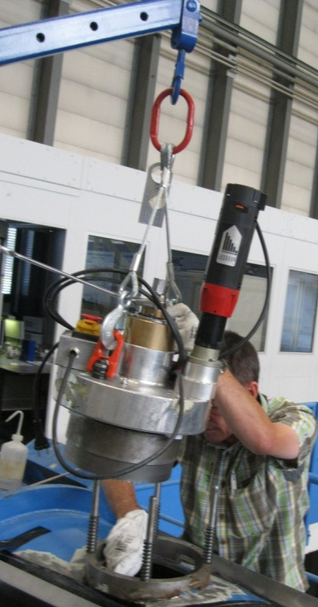
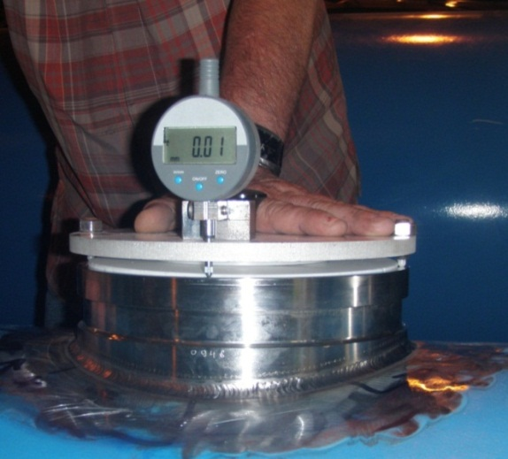
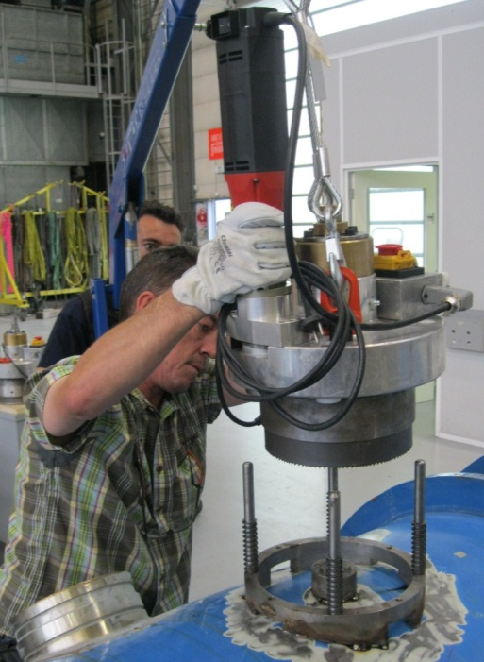
Installation of Safety Relief Devices (DN200) 2/2

Slide 18
Dziękuję
Merci
Grazie

